Slide 1
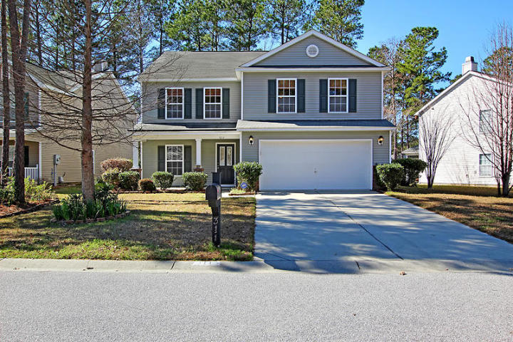
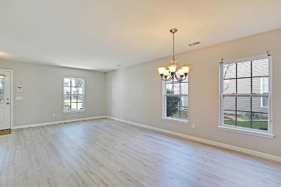
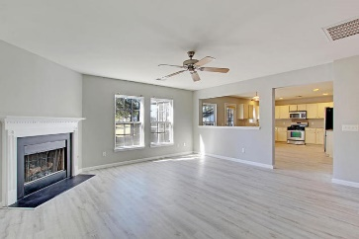
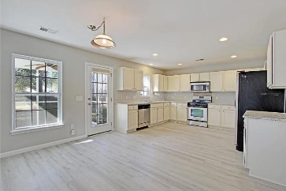
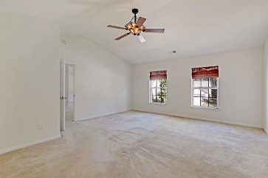
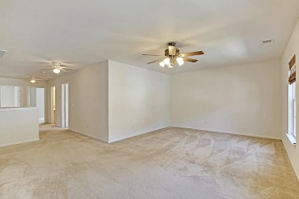
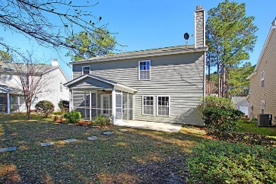
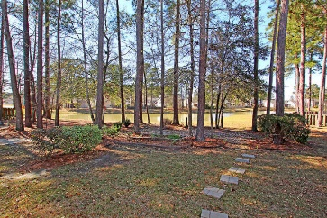
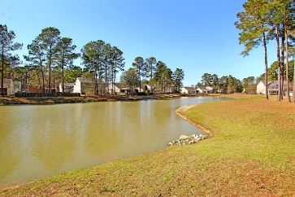

311 Breckingridge Drive Ladson, SC 29456 · MLS# 20005973 · $294,000
Summer Park
Pond Views
Summer Park
Pond Views
BEAUTIFUL 4+ bedroom, 3 bath home on stunning lake front/view lot. The home has wonderful curb appeal with mature landscaping, full front porch perfect for rocking chairs and relaxing with a cool beverage. Upon entering the home you are greeted with beautiful floors, large rooms, gorgeous lake views and an abundance of natural light. Continuing in is the living room and dining room that lead to the family room with gas fireplace with logs, and wall of windows to enjoy the grand lake views. The family room is open to the gourmet kitchen with granite counter tops, stainless steel appliances, upgraded cabinets with loads of counter/prep space, roomy eat-in area, and pantry. There is a flex space/office on the first floor that could also serve as a 5th bedroom with an added closet and is across from a full bath. This room would be ideal for visiting guest that need a first floor bedroom. The second floor has an oversized media room/loft area/bonus room that is a third living area for the home. The master bedroom suite is on the second floor and has an ensuite bath with relaxing soaking tub, separate shower, double sink vanity, and HUGE walk-in closet. There are 3 additional nicely sized bedrooms that share a full bath and a laundry room on the second floor. The backyard has amazing scenic views of the lake from the screen porch and there is an additional patio perfect for grilling and entertaining family and friends. The two car attached garage has additional storage and there is a long driveway that can park 4 cars. Summer Park in Ladson is a wonderfully community with a play park, and community pool! The neighborhood is close to local shopping and grocery stores and is a short drive to downtown Charleston with 5-star restaurants, world class shopping and iconic history as well as a short drive to the beaches, the airport, Boeing, Volvo, Mercedes and Daniel Island. Come take a look because you will not find another home that offers as much as this one: picturesque lake views and entertainer's dream!
Seller will pay buyer's agent $5,000 at closing
with accepted offer by noon June 7, 2019!
Stan Huff
843-670-2835 stan.huff@agentowned.com
Jill Marcacci
843-297-5590 jill@agentowned.com
www.agentownedrealty.com
AgentOwned Realty Co. Preferred Group, Inc. | 824 Johnnie Dodds Blvd | Mt Pleasant, SC 29464

