Slide 1
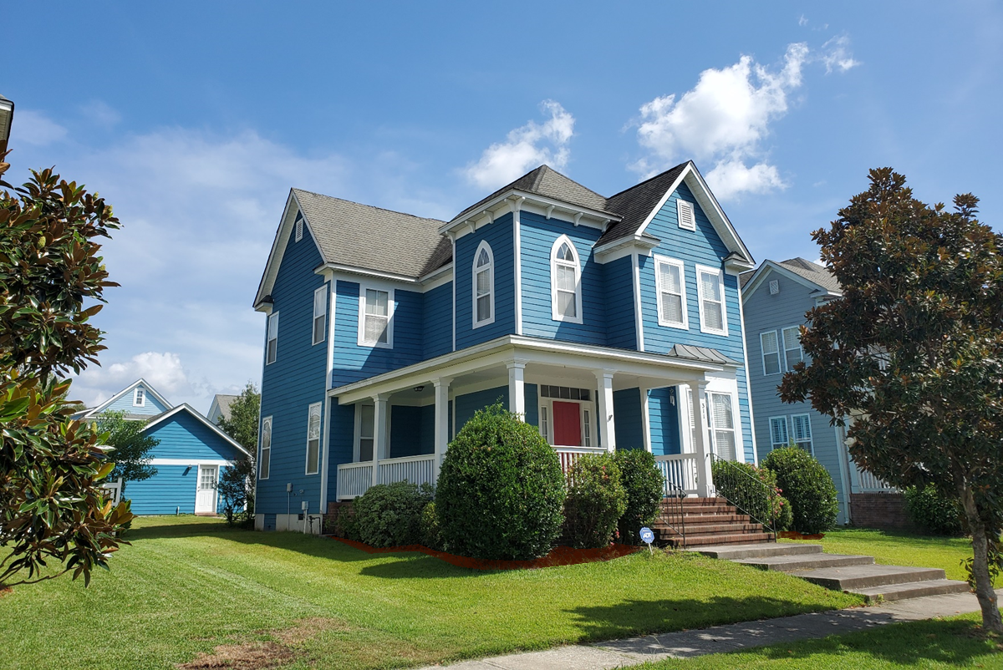
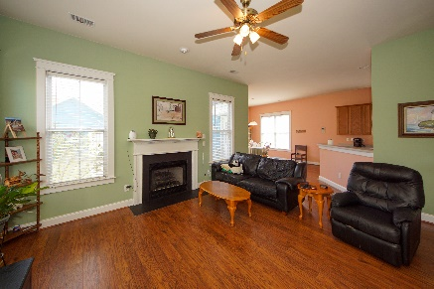
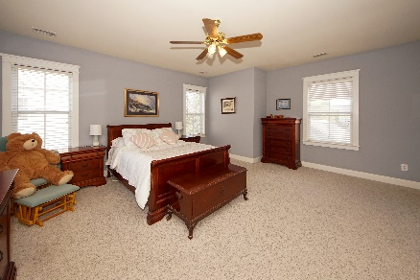
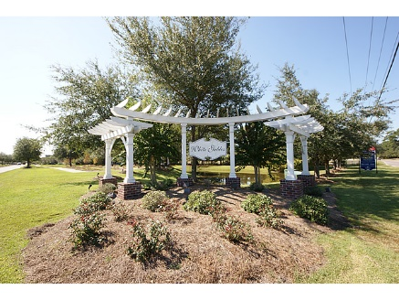


311 Hydrangea Street White Gables :: Summerville, SC 29483 MLS# 19027076 :: $239,995 3 Bed / 2½ Bath
Open House Saturday from 1-4pm
Open House Saturday
December 7th ~ 1-3pm
Curb appeal, color and Victorian Charm!!
Full front porch leads to an open foyer, formal dining room, family room with fireplace and spacious kitchen. Downstairs has wood floors and Saussy added door and window casings for interior detail. Master bedroom is over sized with an amazing master bath and walk in closet. Secondary bedrooms are spacious with walk in closets. Detached 2 car garage and large back yard set the tone for family fun! White Gables offers amenities from a grand club house, swimming pool, tennis courts, soccer, basketball, walking trails, fishing ponds, boat storage and two playgrounds. **HVAC Replaced in 2016**
Connie White, Broker
843-532-3356
connie@chrepros.com · conniewhiterealestate.com
Charleston Homes · 597 Old Mt. Holly Road · Suite 301 · Goose Creek, SC 29445

