Slide 1
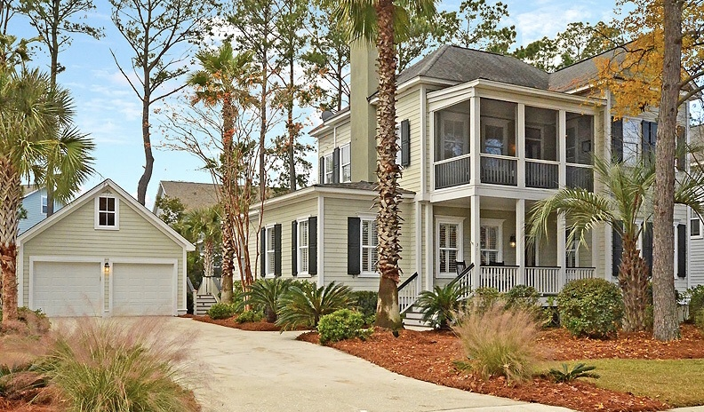
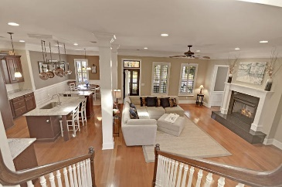
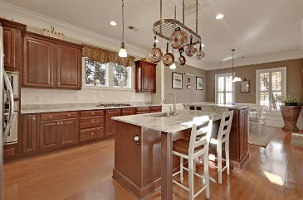
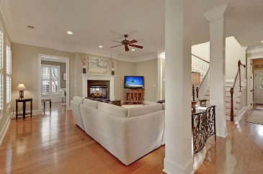
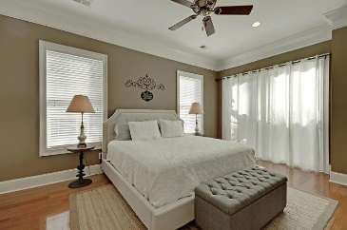
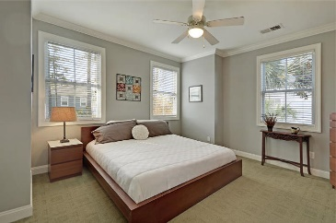
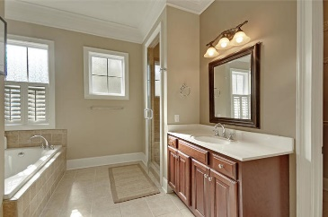
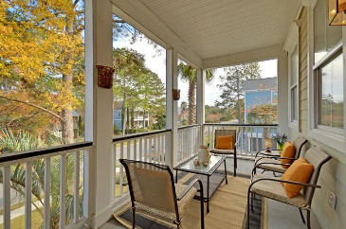
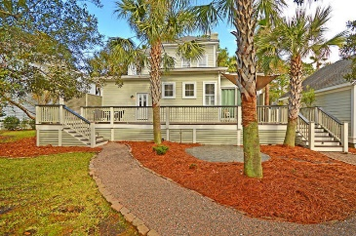

311 Shoals Drive Mount Pleasant, SC 29464 · MLS# 18033144 · $650,000
Just Listed in Grassy Creek
Just Listed in Grassy Creek
GORGEOUS OPEN FLOOR PLAN EXECUTIVE home! NEWLY RENOVATED GOURMET CHEF'S KITCHEN features new stunning granite, a center island with a new sink , new faucet, and breakfast bar, new white subway tile backsplash, new wall oven, Dacor gas cooktop, and an OVERSIZED walk-in pantry. The first floor has Brazilian Cherry 5'' hardwood floors throughout, 9+ ft ceiling, 8' doors, plantation shutters, wainscoting in the dining area, crown molding throughout, a separate Media/Flex/Office/Den off the Great Room. The first floor large Master Bedroom Suite has private access to the deck and is perfect for a morning cup of coffee or relaxing after a day of work and an ensuite SPA-LIKE master bath with relaxing jetted tub, separate tiled shower with bench and two shower heads, dual vanities, an abundance of natural light and walk-in closet. A guest bath, HUGE laundry room with utility sink, cabinets, and storage shelves and mud room style back entrance finish the first level. Beautiful wood tread stairs lead to the second level where you will find crown molding throughout, a large loft that is a second entertaining area, and two sizable bedrooms each with private access to full bathrooms. An exquisit screened porch is off the loft for relaxation. The backyard is perfect for entertaining family and friends with an expansive deck that has room for a large table, separate sitting, and grilling and the back also has a fire-pit area for cool nights! A detached two car garage has a pull down staircase that leads to a floored attic that provides plenty of storage. The home also boasts a whole house generator that will operate all 110 v outlets at once and new (2018) HVAC. The home has a central vacuum system for both floors and Rinnai tankless on demand water heater. Grassy Creek in Mount Pleasant is a wonderfully landscaped community with a play park, open air covered social pavilion, pier and floating crabbing dock, and sidewalks! The neighborhood is close to local shopping and grocery stores and is a short drive to downtown Charleston with 5-star restaurants, world class shopping and iconic history as well as a short drive to the beaches, the airport, Boeing and Daniel Island. Come take a look because you will not find another home that offers as much as this one: a chef's delight and entertainer's dream!
Stan Huff
843-670-2835 stan.huff@agentowned.com
Jill Marcacci
843-297-5590 jill@agentowned.com
www.agentownedrealty.com
AgentOwned Realty Co. Preferred Group, Inc. | 824 Johnnie Dodds Blvd | Mt Pleasant, SC 29464

