Slide 1
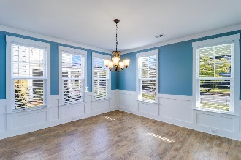
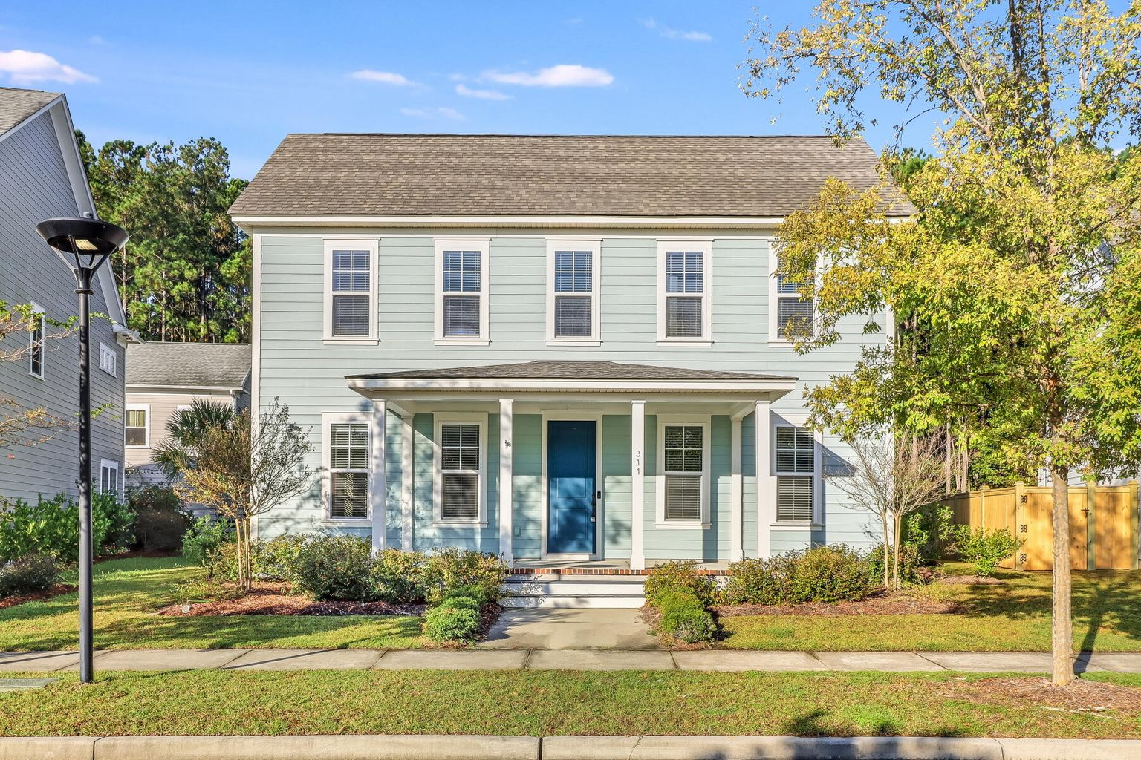
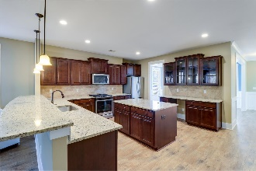
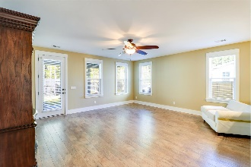
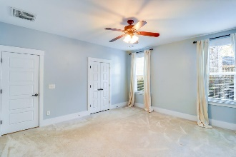
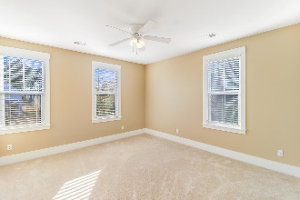
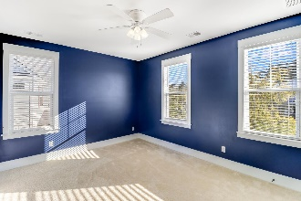
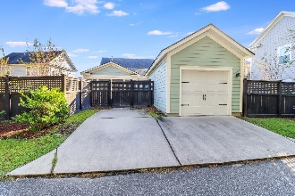

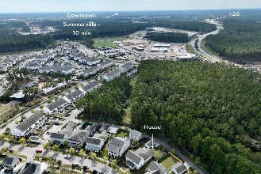


311 Scholar Way
Nexton | Summerville, SC 29486 | MLS# 22026361 | $490,000
BROKER OPEN HOUSE, 12/1, 12-1:30!
$1500 AGENT BONUS!
Open House
Wednesday, 7/20
3-5PM
Amazing location! This Charleston style home is located in the heart of Nexton with easy access to the interstate, restaurants, shopping, schools, miles of bike trails, and so much more! The home offers 3 bedrooms (master downstairs), 2.5 bathrooms, a separate office, and 2580 sq ft of living space. Approaching you will notice pristine landscaping and the extra care taken to maintain this lovely home. Enter the home through the wonderful foyer, the office is to your left and is filled with ample amounts of natural light. To your right is a spacious dining area with a walk-through to the kitchen. An open concept kitchen and living area is a great space to entertain or enjoy family gatherings. The kitchen has plenty of cabinet space for all your cooking accessories along with plenty of counter space to cook those delicious meals. Congregate around the island while socializing and cooking or pull up a stool at the bar height peninsula and grab a quick bite to eat. The large living area has a patio door that leads out to beautiful screened in patio and fenced in yard. Enjoy your morning coffee in the screened in patio, or just relax and enjoy the outdoors bug free. The first-floor master bedroom has an en-suite with dual vanities, and a tiled shower with a shower bench. Upstairs offers two generously sized bedrooms and a large full-sized bathroom with a tub/shower combo. Come see this beautiful home and all it has to offer as soon as possible; you don't want to let this one pass you by! Nexton is a growing community offering many amenities for any lifestyle, and this home is in the heart of it all.
Brandon Ray
(843) 499-1928
brandon.ray@carolinaone.com
www.therightrayhome.com
Carolina One Real Estate
900 N Main St
Summerville, SC 29483

