Slide 1
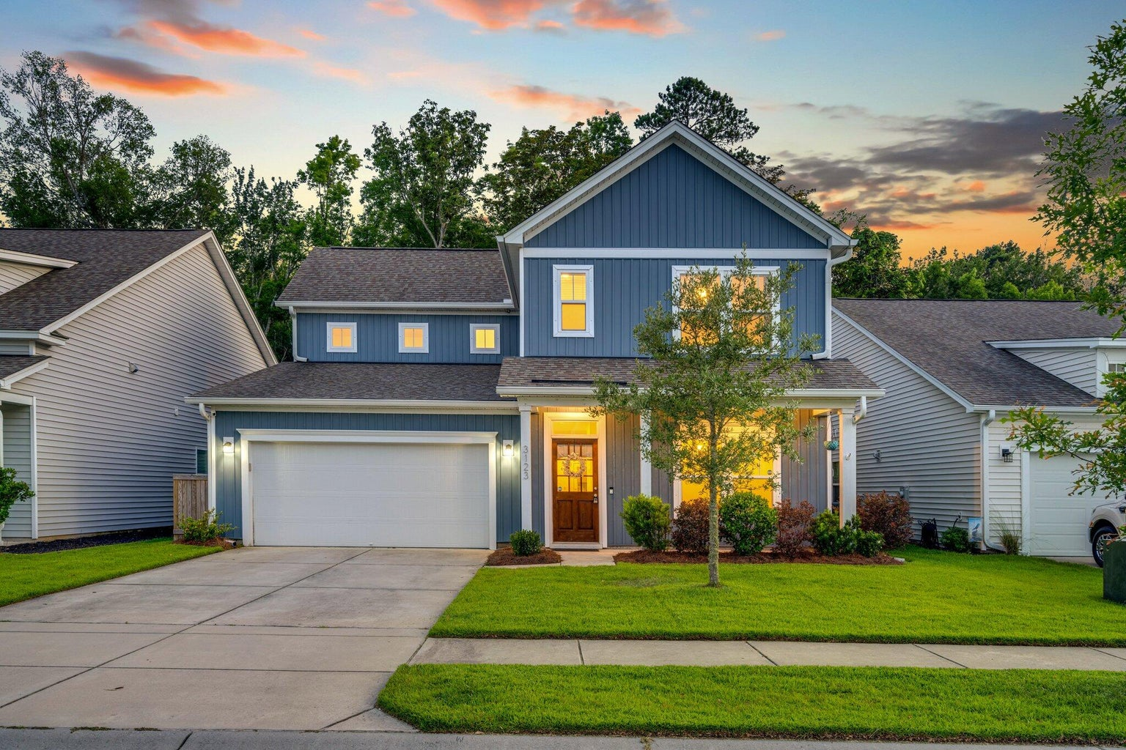

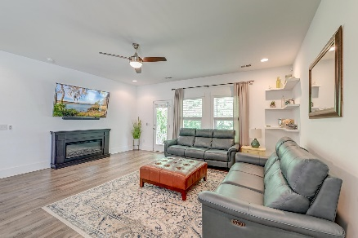
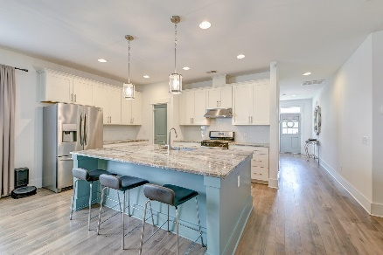
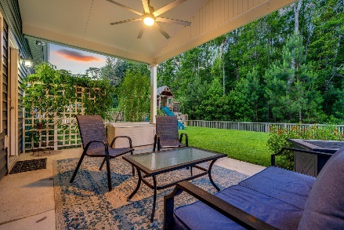
3000+ sq ft and Main Level Primary Suite
OPEN HOUSE
SATURDAY 12-3
Open House Saturday 12-3
3123 Safe Harbor Way
The Pointe at Rhodes Crossing | Charleston, SC 29414| MLS# 24013788 | $625,000
Look no further- the home you've been looking for is right here!
Boasting a first-floor primary bedroom suite and four additional bedrooms upstairs, this 3200-square-foot stunner is ready for you! Space for everyone and everything! With 3.5 baths, an office, a loft, a two-car garage, an upgraded chef's kitchen, a walk-in pantry, and a fenced yard- this light-filled home is beautifully outfitted for your Lowcountry lifestyle. Enjoy evenings on the back porch, overlooking the spacious fenced-in backyard, which backs up to a wooded area and offers pond views.
The Pointe at Rhodes Crossing is convenient for shopping, dining, schools, recreation, and more!
Book your showing today!
Amanda Kennedy-Colie akcolie@mattoneillteam.com 843-224-5865

