Slide 1
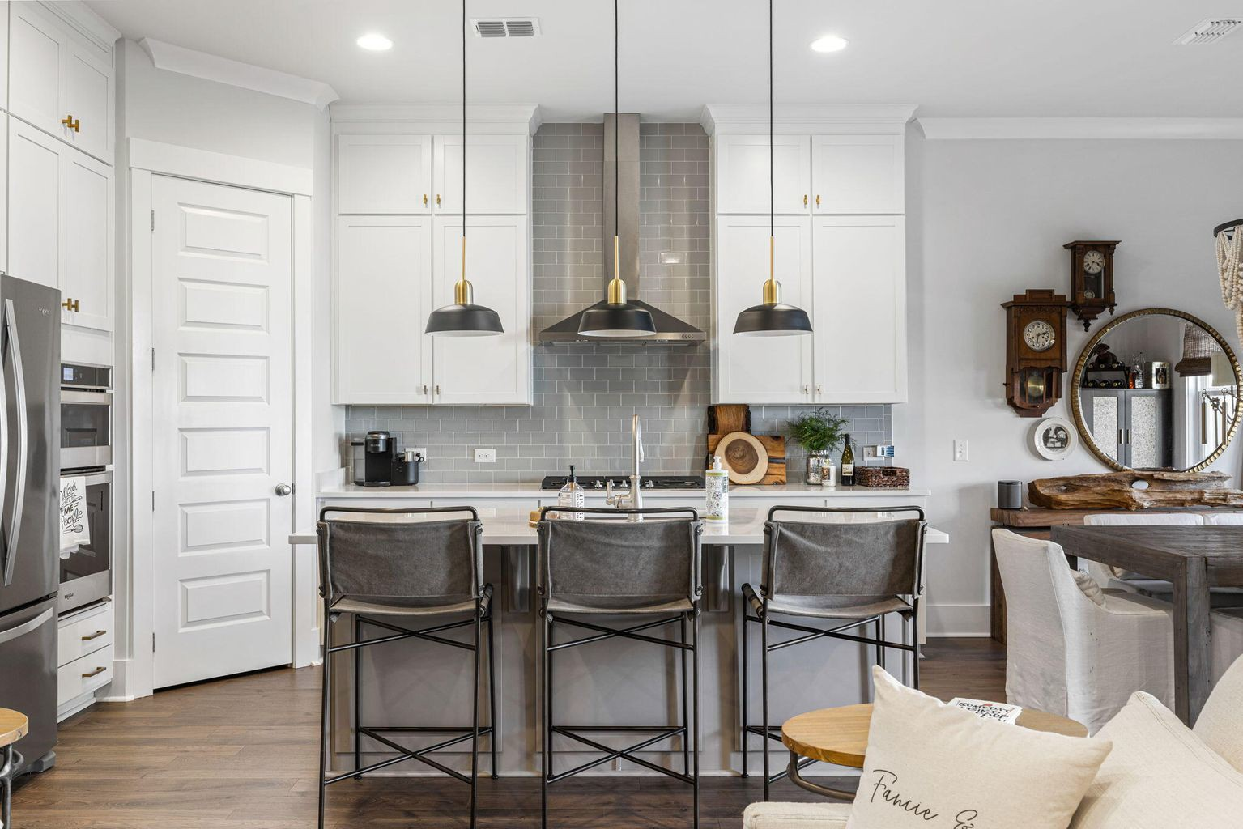
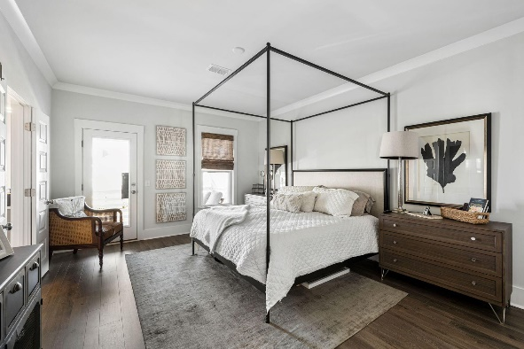
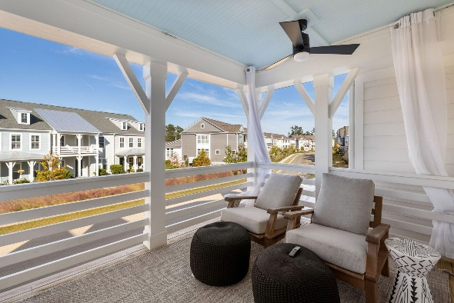
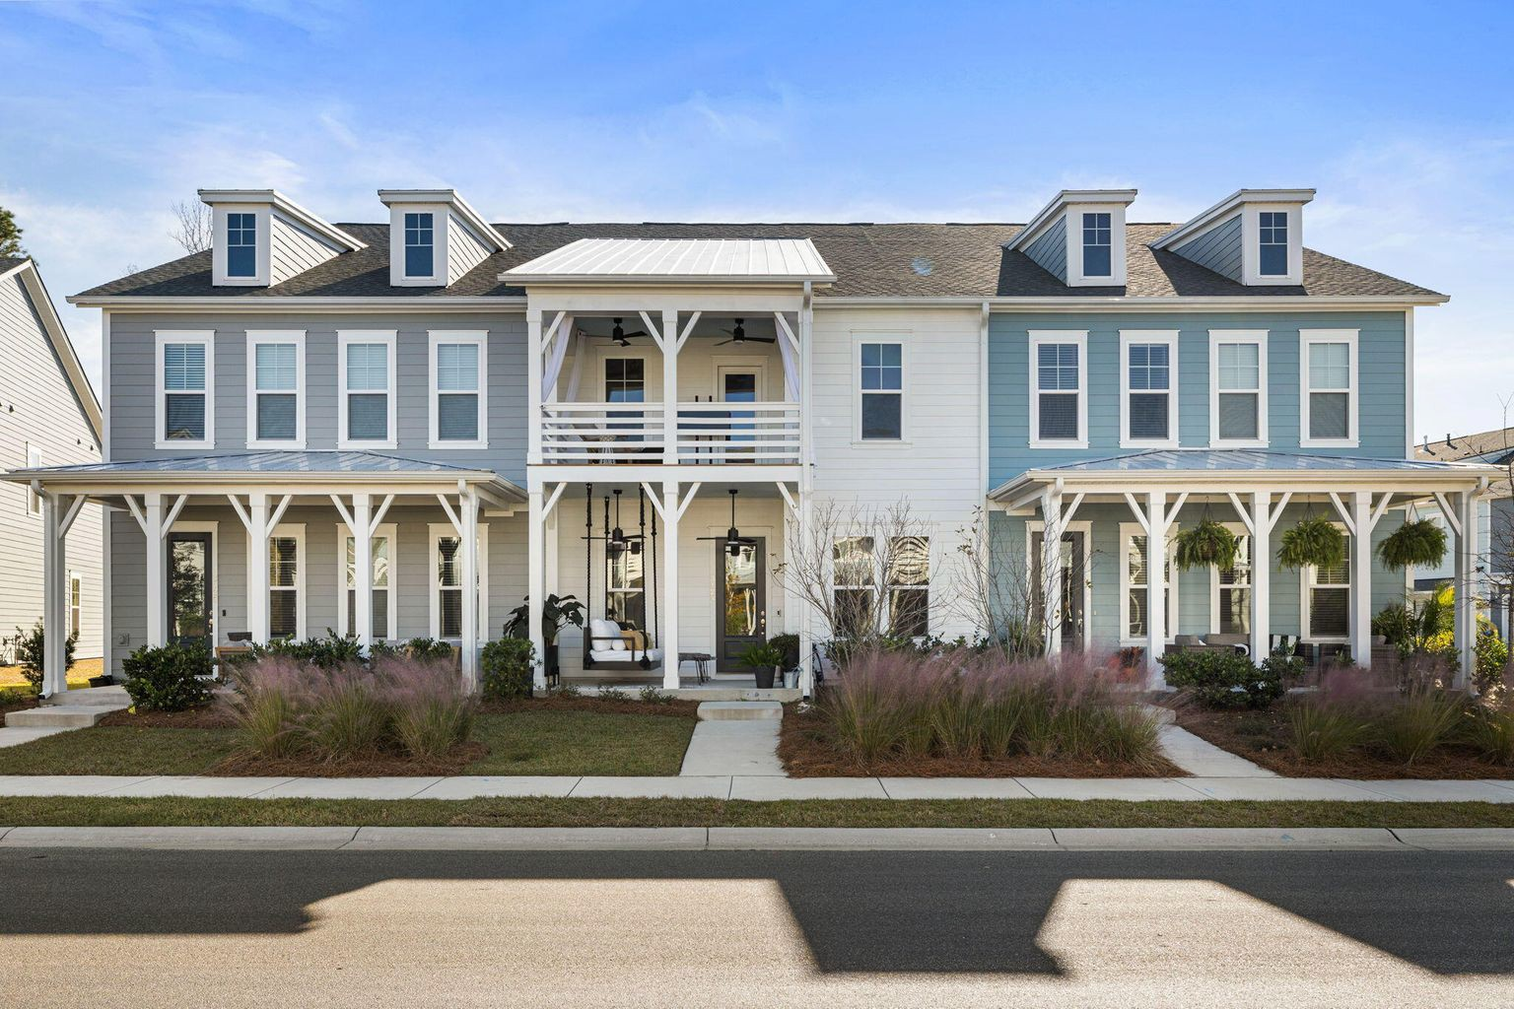
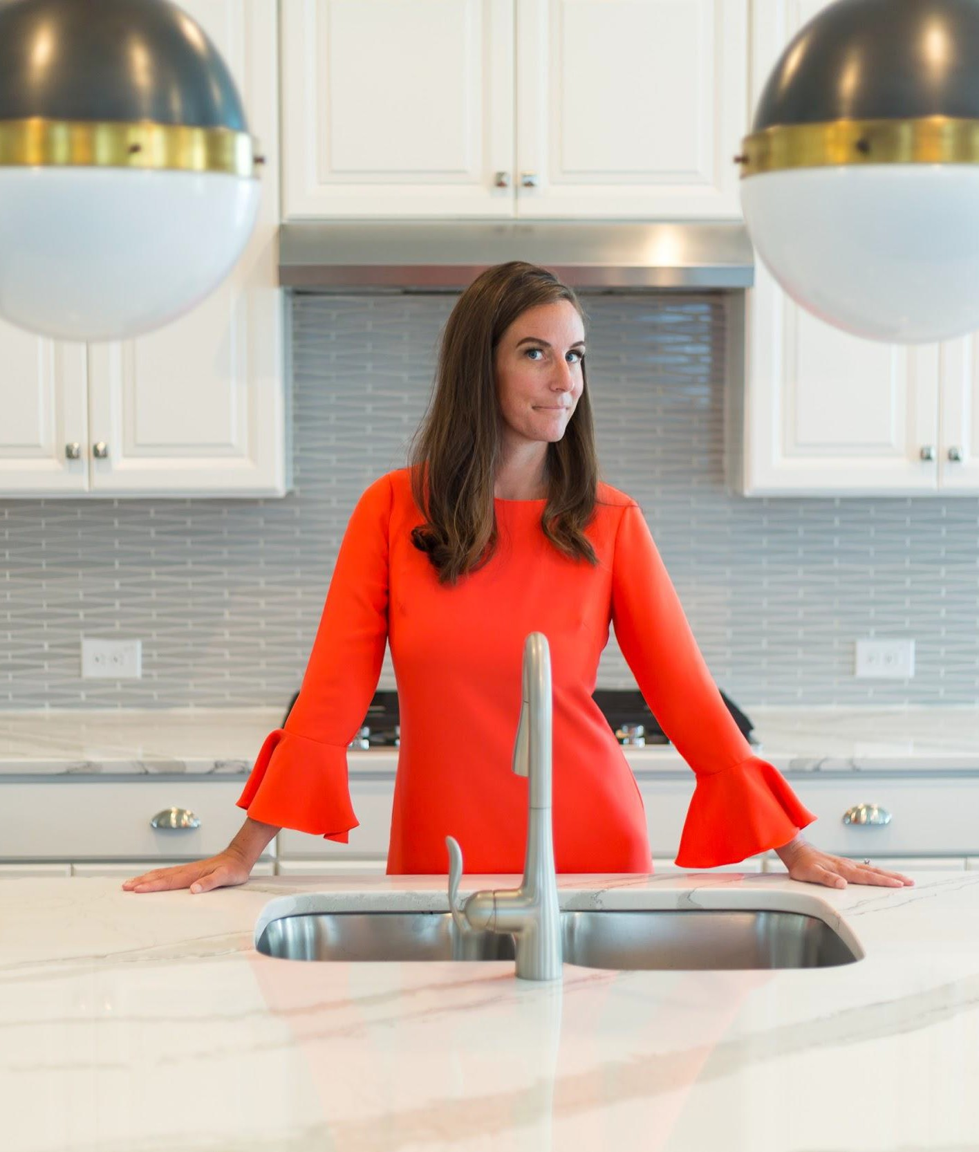
Agent Bonus
4% for a Two year old
Dunes West townhome
3124 Sturbridge Road • Mount Pleasant, SC
MLS# 22028516 • $600,000 • 3 Bed • 2.5 Bath • 2,008 sq ft
This better than new, 2 year old, luxury townhome is not to be missed! From the instant arrive & see the upgraded fans on the double front porches & custom porch swing it is apparent the seller has selected every finish with extreme detail.
Why wait for new construction to be completed when you can move right in to a fully upgraded unit now?
Mary Beth Bennett
843-367-1774
marybeth.bennett@agentowned.com
mbbennettrealestate.com

