Slide 1

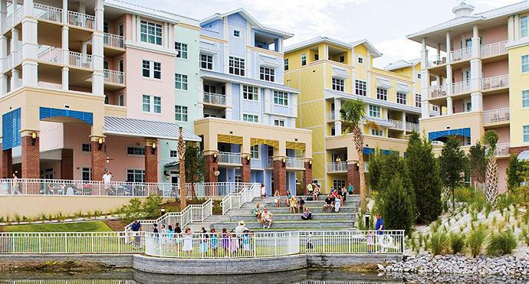
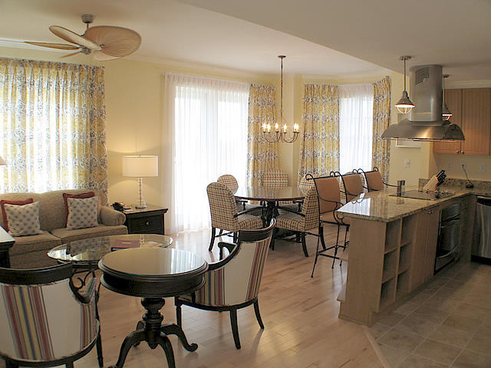
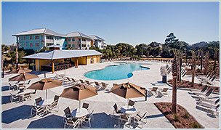
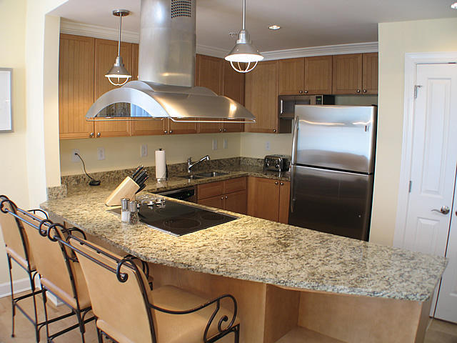




FOR SALE
The Village At Wild Dunes
AAA Four Diamond Award Winning Property
Listed @ $647,900 – 4% COMMISSION
High End 2BR Condo Generates Approximately $70K* in Rental Income Per Year
*Voted World's Best Hotel For Families by Travel & Leisure in 2012-2015
*Voted Top Resort in Southern US by Conde Nast Traveller in 2012-2015
Beautiful 2BR w/desirable open floor plan; corner unit w/huge wrap around porch overlooking newest resort pool & cabana bar. Includes a gourmet kitchen w/granite countertops, stainless steel appliances & overhang for bar stools. The dining area is large enough for a table for six & is situated adjacent to the Family room area complete with designer furnishings, TV and a pull out sofa bed. The space allows plenty of room to entertain family & friends complete with a decorator flair. Primary residence, investment or 2nd home! The Village has the best of both worlds; clean high-end units w/excellent amenities but not subject to erosion issues & protected w/concrete & steel construction. Village owners have access to full resort amenities, owners' BEACH HOUSE & award-winning services. Don't miss this opportunity to purchase real estate in the very heart of a private, gated, full-service island resort!
MLS# 14029391
Margaret Hekker
BIC/Realtor
843-296-7520

