Slide 1


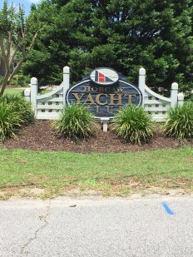
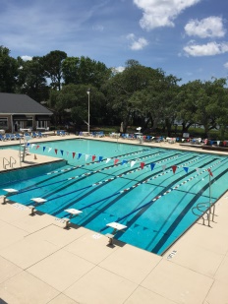
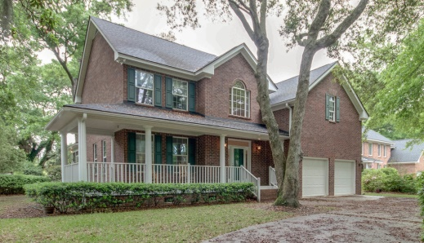
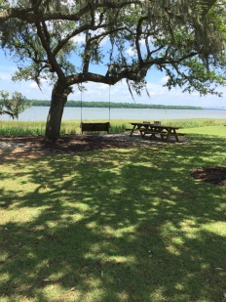
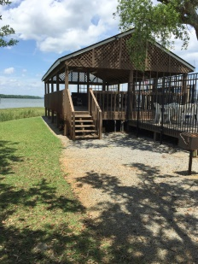
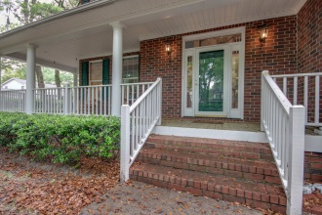
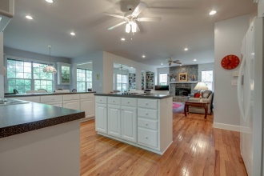
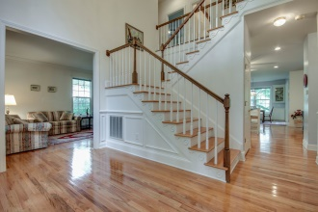
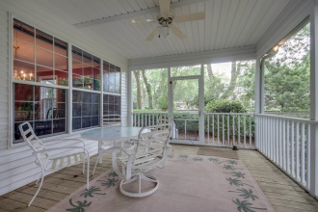
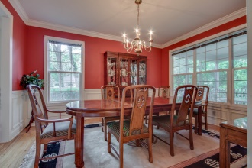
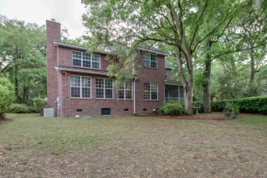
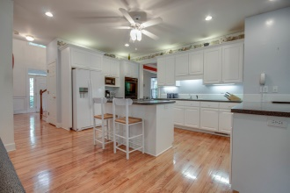
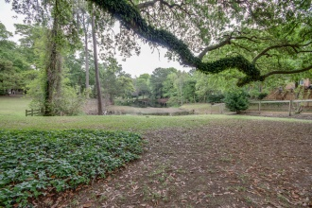


Custom home in waterfront neighborhood
312 Bampfield Drive
Hobcaw Point - Mount Pleasant
MLS# 15010003 - $845,000
Lakefront home in highly sought after Hobcaw Point.
Enjoy the traditional design of this custom built home featuring hardwood floors, custom cabinetry, spacious great room and kitchen, formal living and dining with crown moldings and wainscot, large master bath, walk-in closets, screen porch and two car garage.
Hobcaw Point has easy access to downtown Charleston, Mt. Pleasant shopping and the beaches of Sullivan's Island and Isle of Palms.
No HOA fees in this neighborhood and you can park your boat in your yard!
Hobcaw Point is home to a private yacht club offering pool, boat yard and ramp, club houses for members and guest, cabana and playground.
Mt. Pleasant has outstanding public schools with many community amenities nearby.
All information is believe correct but should be verified by buyers and their agents.
Lori Claussen
loric@goldenbearrealty.com
www.GoldenBearRealty.com
Golden Bear Realty | 654 Coleman Blvd, Suite 100 | Mt Pleasant , SC 29464
Cell (843) 224-8506 | Office (855) 352-9088 | Fax (561) 721-3311

