Slide 1
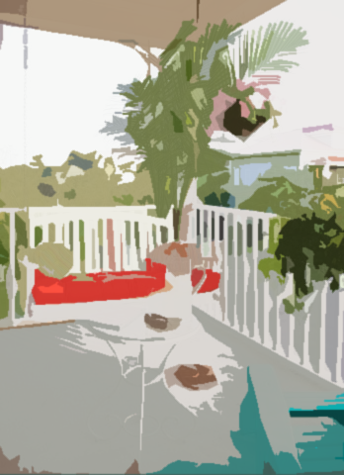
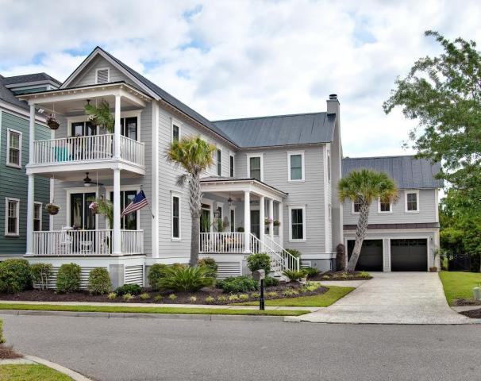
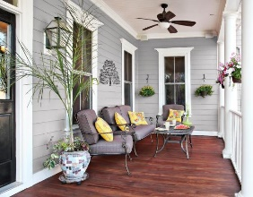
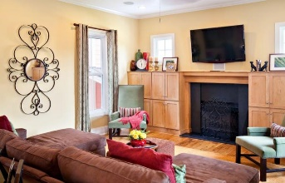
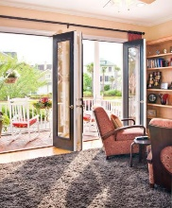
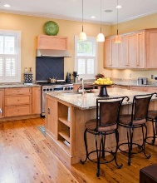
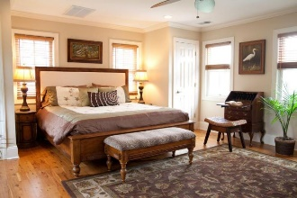
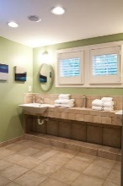
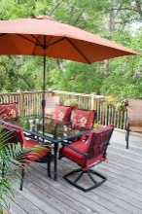
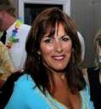
Looking for a Guest Suite in Mt. Pleasant?
312 Bermuda Towne Row
Belle Hall ~ Mount Pleasant, SC 29464
MLS# 16008888 ~ $795,000
In the Spirit of another Era, we present a custom treasure inspired by the beloved classic architecture of Charleston in the 1800's. Currently owned by a famed Star of the TV series "Army Wives", the home enjoys further celebrity by being featured in Charleston Home & Design Magazine. Superbly located in prestigious Hibben, the property captures the alluring aesthetics of the past while intersecting with a modern lifestyle. Generous windows bathe the home in abundant radiant natural light by day, while recessed lighting provides a pleasant glow in evenings. Appealing features include a Chefs kitchen, Sun Parlor, Study, secluded suite with a private entry. This distinguished home offers an enhanced quality of life for the fortunate new owners, and enduring value for years to come.
Kathy Jordan
(843) 442-0782
kathycharleston@gmail.com
Kathy Jordan Properties | 321 Palm St | Mt. Pleasant, SC 29464

