Slide 1
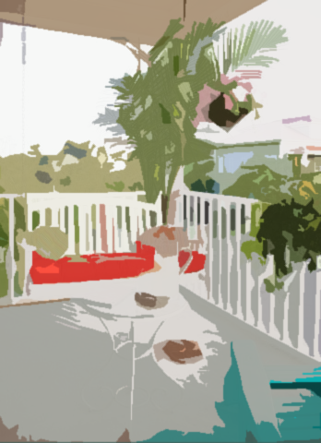
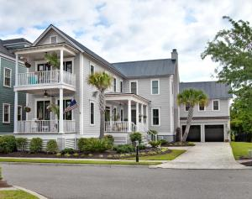
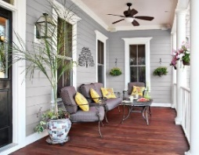
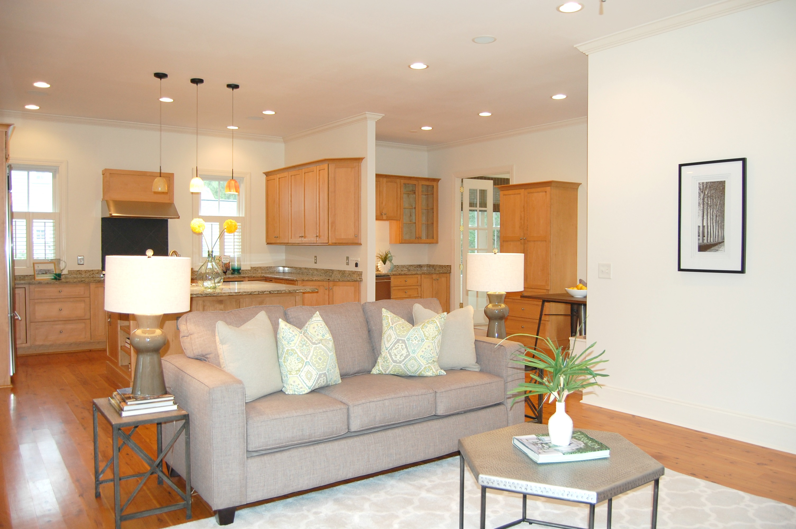
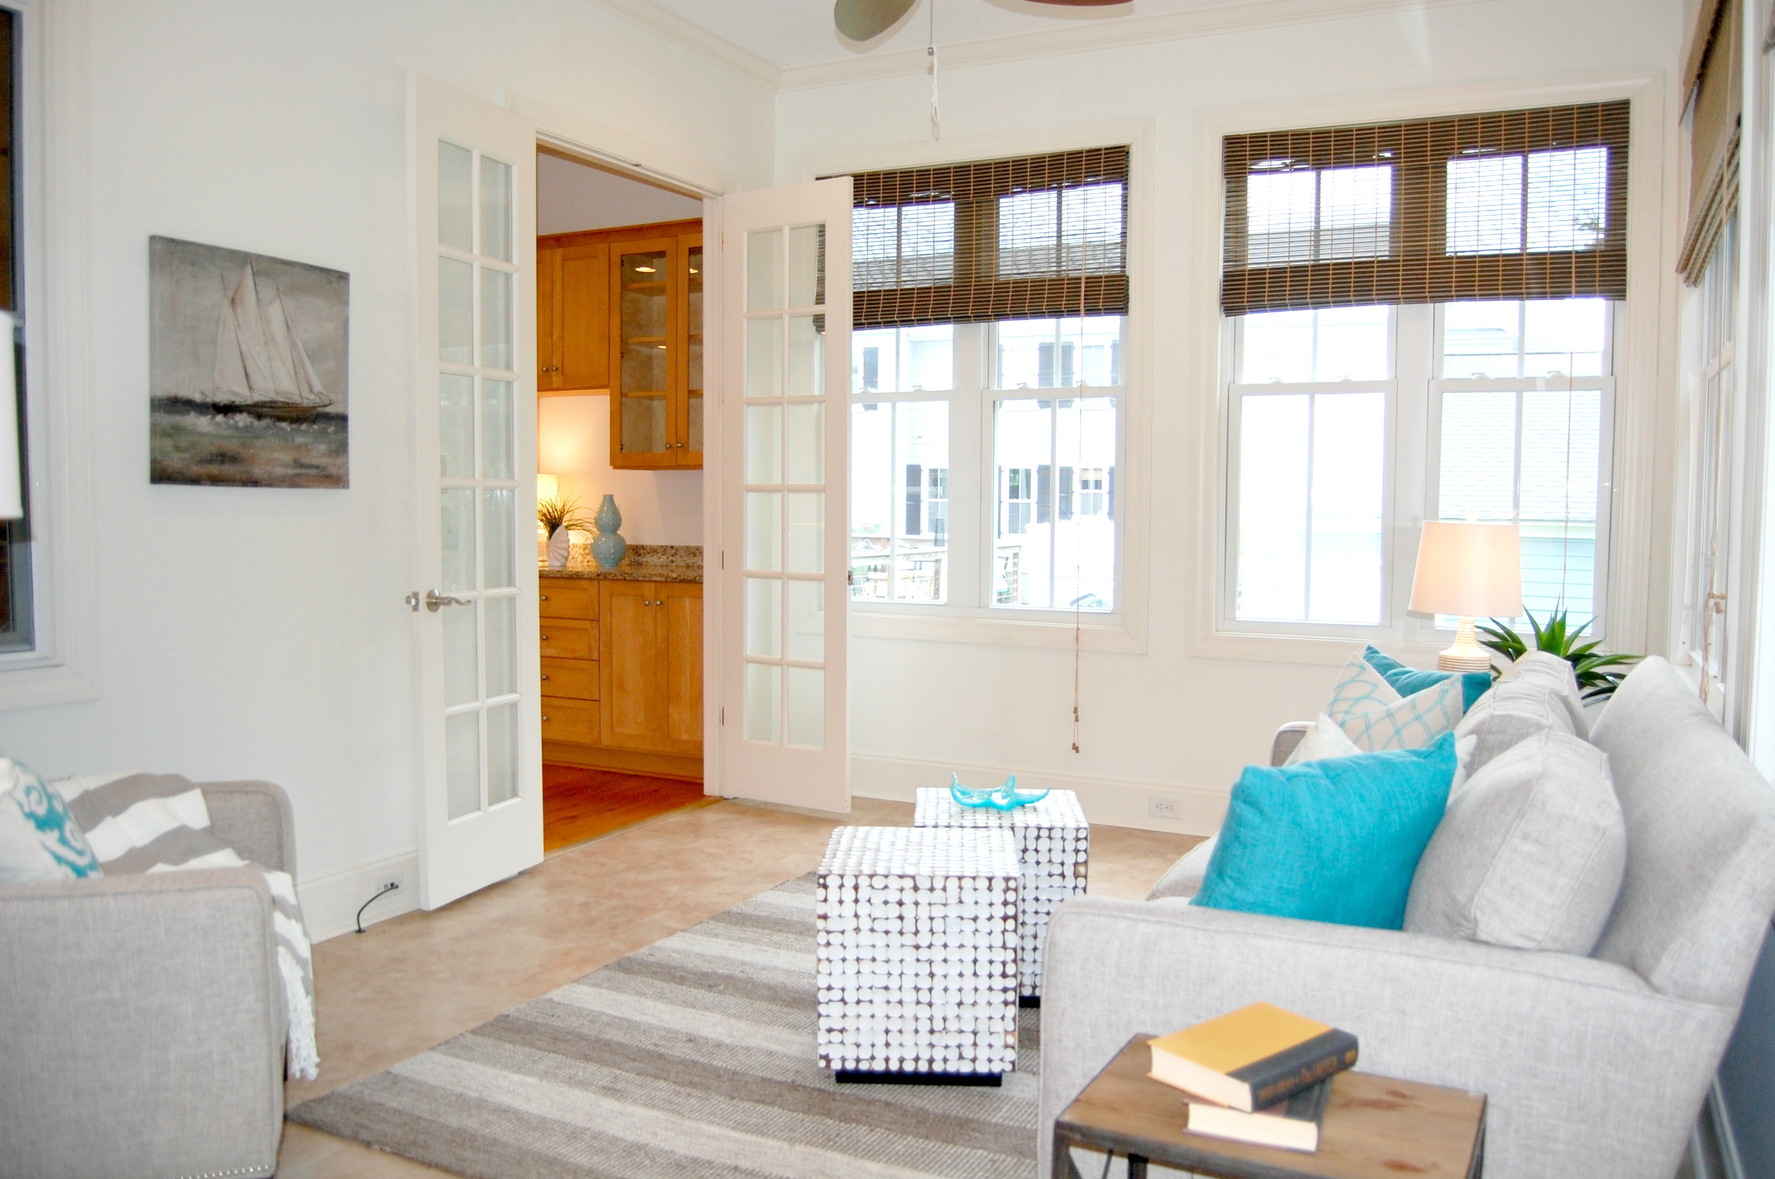
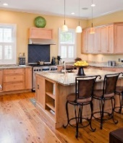
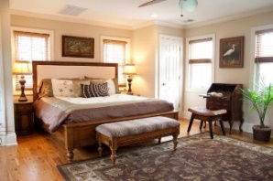
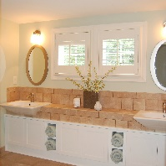
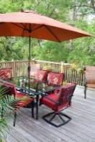

Screaming Deal in Hibben at Belle Hall
312 Bermuda Towne Row
Belle Hall · Mount Pleasant, SC 29464 · MLS# 16008888 · $699,000
This gorgeous and spacious newly staged home has 3 bedrooms + a full guest suite above the attached garage, totaling 4 bedrooms.
The average cost per sq ft in Hibben is $262. This home is 19% below at a cost of $212 per foot for 3298 sq ft!
Kathy Jordan
(843) 442-0782
kathycharleston@gmail.com
Kathy Jordan Properties | 321 Palm St | Mt. Pleasant, SC 29464

