Slide 1
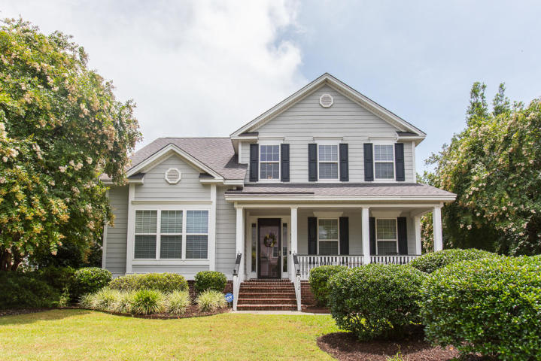
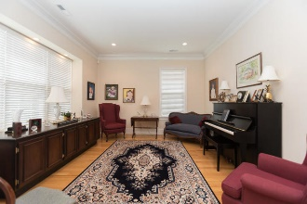
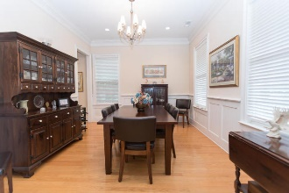
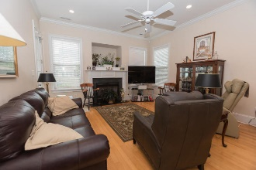
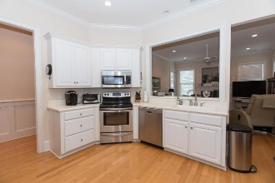
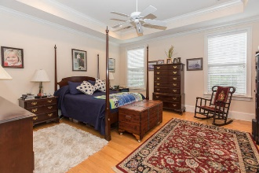
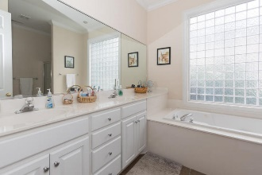
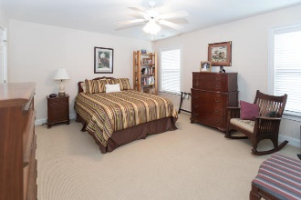
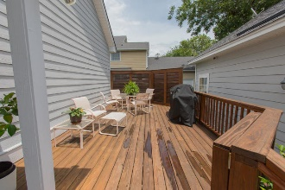
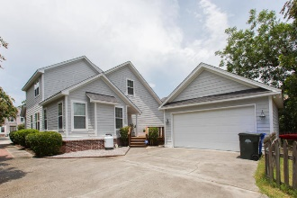


312 Bounty Lane
Woodward Pointe
Charleston, SC 29412
MLS# 19020251
$539,000
Beautiful and well maintained home in desirable Woodward Pointe on James Island. Hardwood floors on first floor. Formal living & dining rooms. Master bedroom downstairs has tray ceilings, 2 large closets, garden tub & shower. Kitchen is open to family room & has solid surface counter tops, lots of cabinet space & storage. Gas log fire place in family room open to kitchen with door leading to deck & 2 car garage in back. Small fenced in area for your pets to roam in backyard as well. Upstairs you will find 3 nice size bedrooms & large 2nd bathroom with two showers & a tub. The landing upstairs has hardwood floors & the bedrooms are carpet & the bathroom tile. New HVAC in 2012,New deck was rebuilt in 2015, New doors & drawers for kitchen cabinets in 2018. Interior & exterior was completely repainted and new carpet installed upstairs in 2010. Come see this well priced beautiful home close to Downtown and Folly Beach. Thank you for showing.
Just Listed To $425,000
Well Maintained Home
Cathy Rosenblum
843-817-7869
crosenblum@comcast.net

