Slide 1
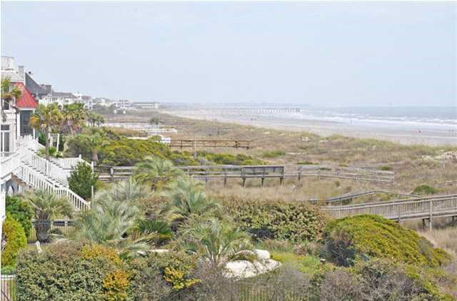
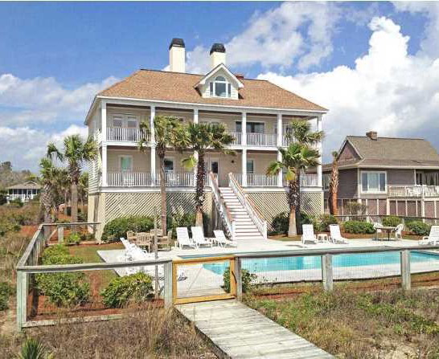
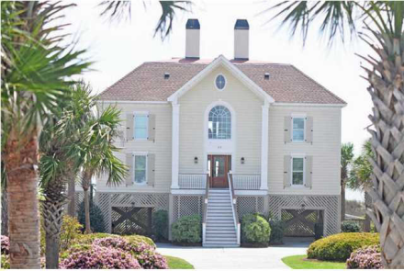
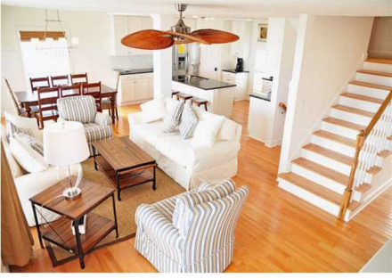
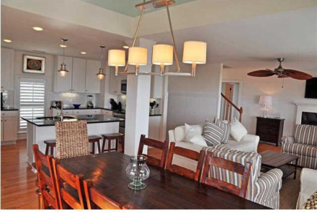
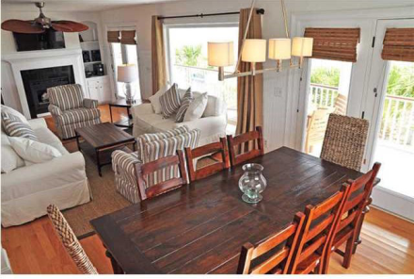
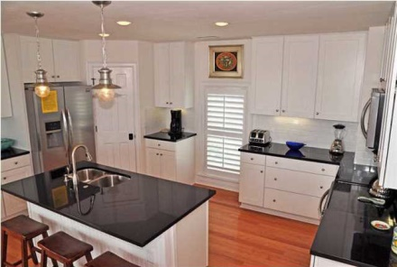
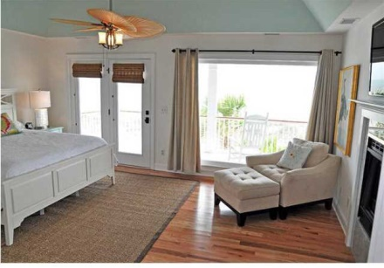
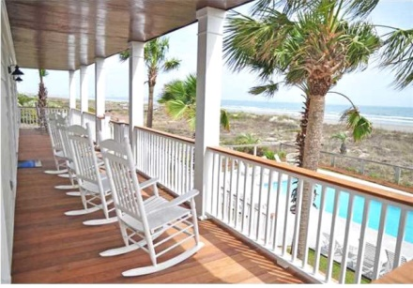
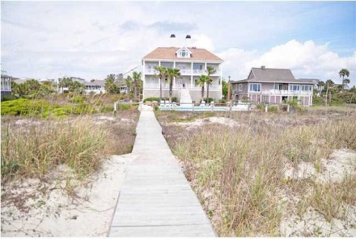

312 Ocean Blvd Isle of Palms, SC MLS# 1315207 $2,595,000
Great Rental History!
This Gorgeous home was completely renovated last year and is the best deal on Ocean Boulevard! It is located in between 3rd and 4th Avenue on Ocean and there is little to no traffic at this quiet end of the street. As you enter 312 Ocean you can see that renovation was professionally designed and executed. Downstairs you will find a TV/Sitting Room Area, 4 Spacious Bedrooms and expansive views of the Ocean. The Downstairs Deck is all Brand New complete with an Ipe Floor that will stand the test of time. The Second Floor has a Beautifully Renovated Kitchen, Spectacular Family Room and Dining Area, Bath room and Lovely and Spacious Master Suite complete with outside access to another expansive Deck with beautiful ocean views! The third floor has another large bedroom. The elevator goes from the ground level to the second floor making for easy access to all main areas. As you pull into the driveway at 312 Ocean, you immediately feel as if you are entering a Grand Estate. The house has wonderful curb appeal and the inside is sure to impress as well! The back yard is very spacious and has a large pool and fenced in patio area that accommodate any large gathering. If you are looking for a move in ready Ocean Front Estate at the right price, then you have to see 312 Ocean! At this price.....it won't last long! Contact the Agent for the Rental History if you are interested. It has a strong history.
Holly Covington
Office - 843-971-1312 Mobile - 843-442-4560
hcovington@thebeachcompany.com

