Slide 1

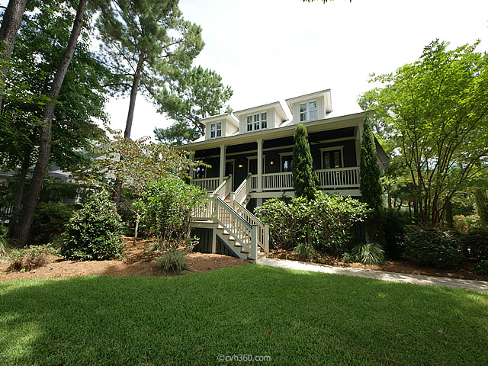
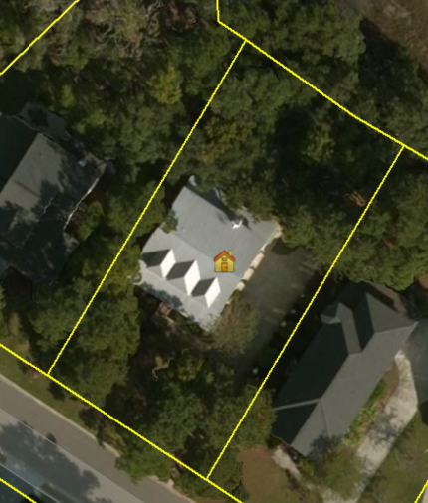
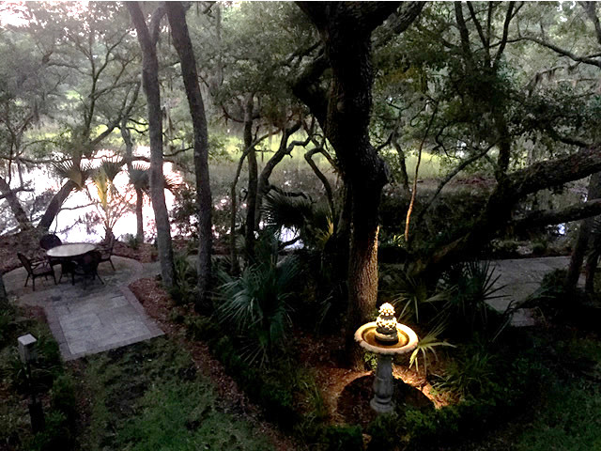
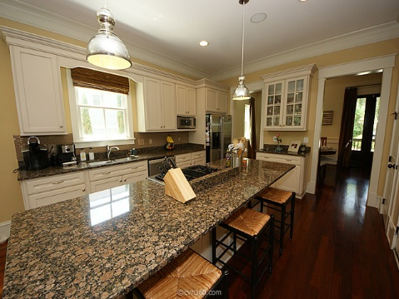
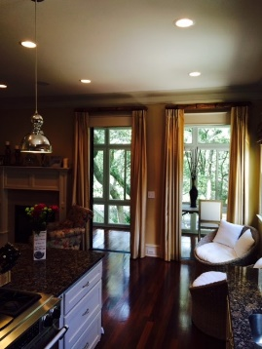
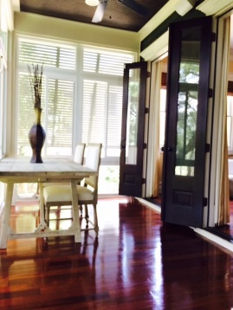
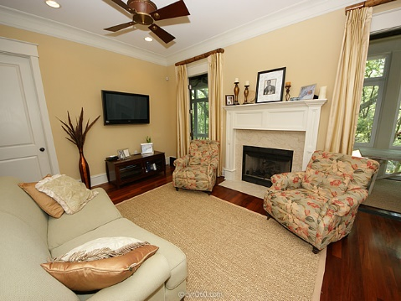
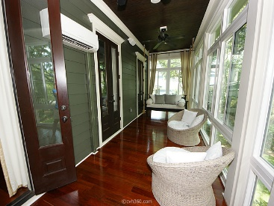
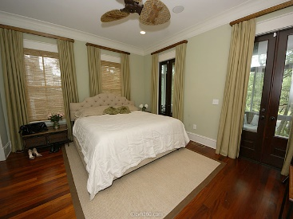
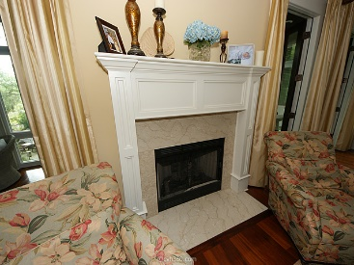
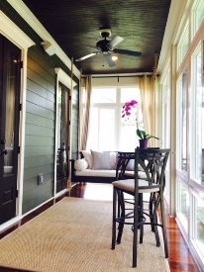
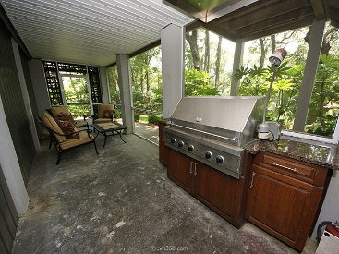
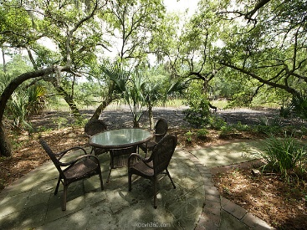


Drop it like it's hot in Mt. Pleasant!
Gorgeous Marshfront Executive Home
312 Shoals Drive
Grassy Creek | Mount Pleasant, SC 29464 | MLS# 15017005 | $824,900
Wow. A beautifully upgraded home with class and tidal marshfront ready for you. Ten foot ceilings, Brazilian cherry hardwood flooring and all of the indoor and outdoor accents of entertaining with convenient access to highways and the Belle Hall Shopping Center. Entertain with the best of them with four sets of French doors in the front and five more sets in the back and built in surround sound throughout the home. Wainscoting, crown molding, fireplace, granite countertops and a gas stove make this a gathering place for years to come. The little touches count here with even granite countertops in the bathrooms and outside in the screened in porch where the built in gas grill sits next to the outdoor patio in a well maintained yard with irrigation and large oak trees. MUST SEE!
Apx. SqFt: 3,103
Area: 42 - Mt Pleasant S of IOP Connector
Bedrooms: 5
Baths - Total: 3.5
County: Charleston
Tax Map #: 537-00-00-159
Year Built: 2005
Legal Description: Lot 5, Phase 2, District/Ward 2-1.

