Slide 1
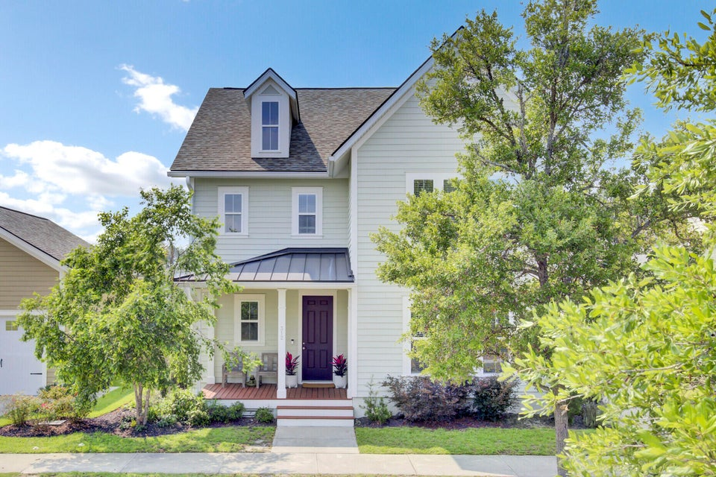
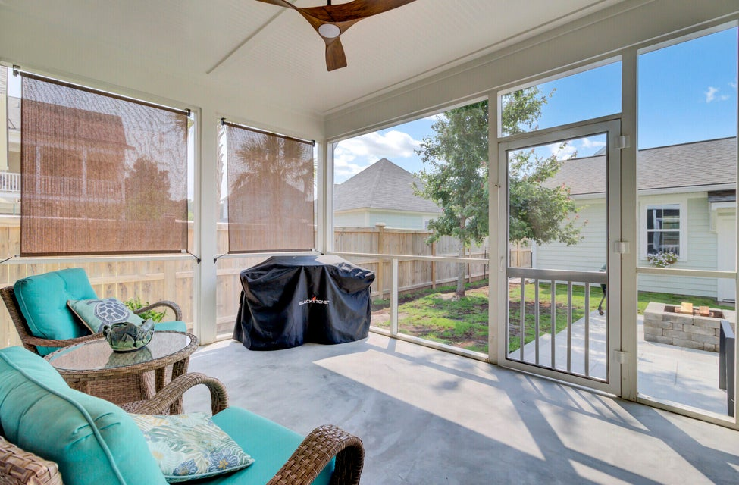
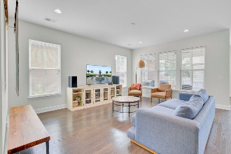
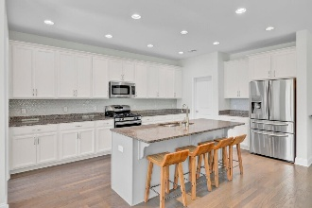
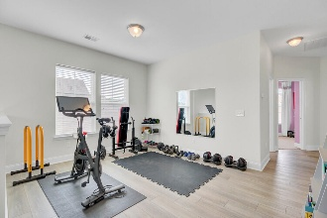
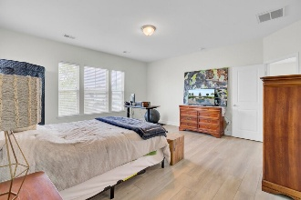
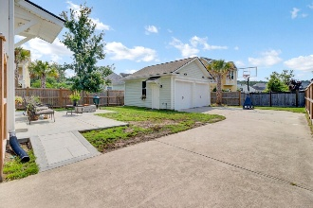


$2500 Agent Bonus and NEW PRICE!
312 Greenhouse Row
Summers Corner | Summerville, SC 29485 | MLS# 25015448 | $511,400
Welcome to 312 Greenhouse Row, where Lowcountry charm meets modern living in the heart of award winning Summers Corner. This vibrant community in Summerville offers something for everyone with pools, parks, walking trails and a beautiful community lake all just steps from your front door. This Sabal Golden Bell floorplan welcomes you with a classic Southern front porch perfect for morning coffee or evening chats with neighbors. Inside, the main floor features an open layout ideal for entertaining with a gourmet kitchen, dining area, drop zone and a versatile bedroom with a full bath perfect for guests or a home office. Step out back and enjoy summer evenings on your screened porch or gather around the firepit on the extended patio. The oversized driveway provides plenty of parking and space for play or projects.
Upstairs the primary suite is a peaceful retreat with a spacious bedroom walk in shower and a customized closet with built in shelving for optimal organization. The flexible loft area offers additional space for relaxing working out or creating a media room.
Do not miss your chance to enjoy the laid back lifestyle and tight knit community Summers Corner is known for schedule your showing today
TAKE A VIDEO TOUR
Hillary Jones
843-709-4666
realcharlestonagent@gmail.com
www.realcharlestonagent.com
Carolina Elite Real Estate | 706 N Cedar St | Summerville, SC 29483

