Slide 1
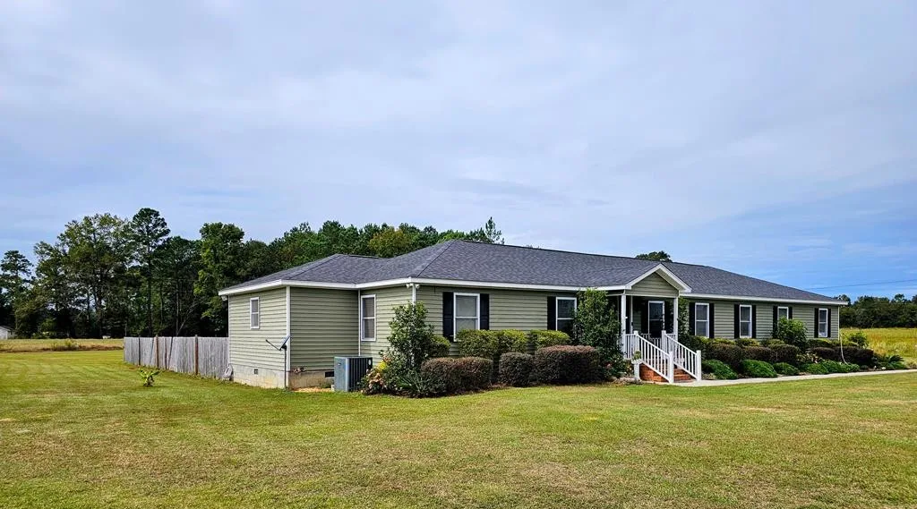
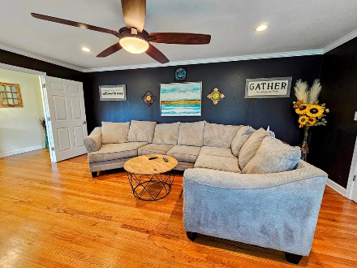
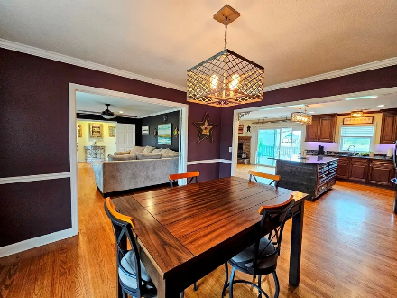
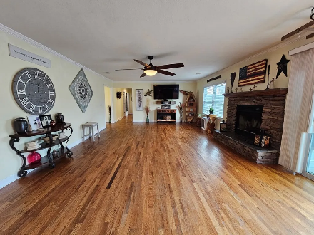
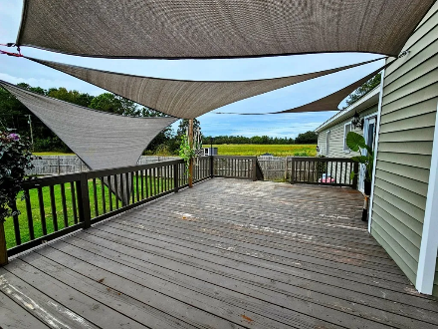

Have You Seen This?
312 Wactor Drive
Santee, SC 29142 ~ MLS# 165838 ~ $405,000
Smuge ( the cat) Says Welcome HOME! This beautifully remodeled 3-bedroom, 2-bathroom home offers modern comforts with a touch of country charm. Nestled in a rural area just 8 minutes from the scenic shores of Lake Marion and 5 minutes from I-95, this home offers the perfect balance of tranquility and convenience. Step inside and be greeted by an inviting open floor plan, perfect for family gatherings and entertaining. The fully updated kitchen features appliances, stylish countertops, and plenty of cabinet space, flowing seamlessly into the spacious living and dining areas. Enjoy the serenity of rural living while being just minutes away from outdoor adventures on Lake Marion, local shops, and easy access to the interstate for commuting or weekend getaways. Large Yard!
Lake Homes Realty, LLC
Elloree, SC 29047
www.SCLakeLife.com
Kristie Anderson
(803) 387-9459
kristie@sclakelife.com

