Slide 1
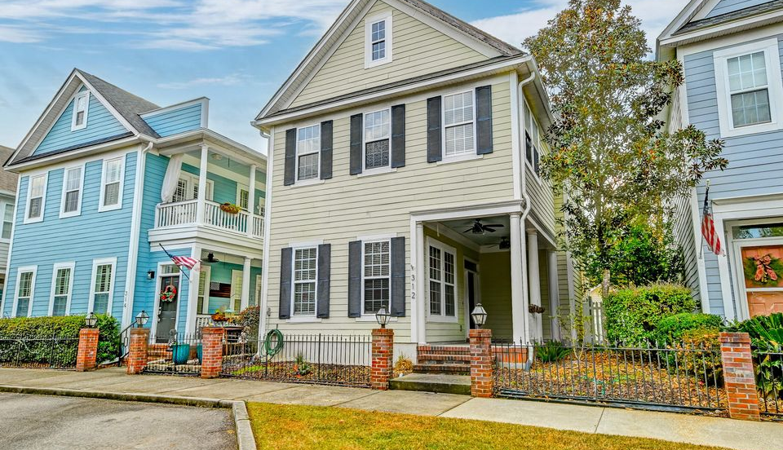

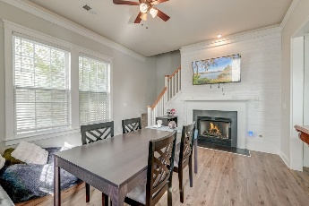
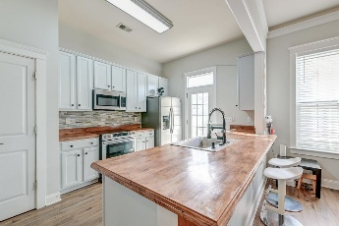
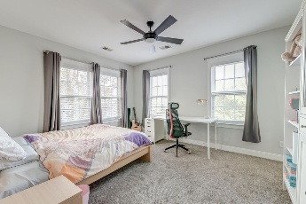
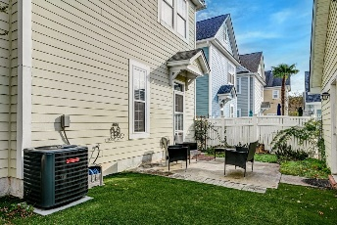
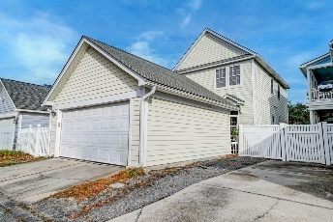
Back on the Market
312 White Gables Drive
White Gables | Summerville, SC 29483 | MLS# 25007289 | $349,999
This cool home with great vibes is back on market due to no fault of the Seller. Welcome to one of Summerville's favorite neighborhoods. The desirable White Gables community is ready to welcome you. From the moment you arrive, the Charleston Single-style exterior invites you to step inside and discover the charm within. A welcoming front porch sets the tone as you enter to find a thoughtfully designed home featuring attractive LVP flooring, crown molding, abundant natural light, and an open floor plan that effortlessly combines style and functionality. To the left of the entryway, a spacious dining room or flex space offers versatility to suit your needs. Continuing down the hall, you'll uncover the heart of the home—a delightful galley-style kitchen that's as beautiful as it is practical. With ample white cabinetry, stainless steel appliances, a chic stone backsplash, and a breakfast bar with seating, this kitchen is made for culinary creations and entertaining alike. The kitchen flows seamlessly into the inviting family room, complete with a cozy gas fireplace, creating a warm and comfortable gathering space.
Upstairs, the primary suite awaits with a walk-in closet and an en suite bathroom designed for relaxation. Two additional bedrooms and a full bathroom complete the second floor, providing plenty of space for family or guests. Step outside to enjoy the fenced backyard with turf, featuring a patio for outdoor dining or unwinding. Surprise: there is no lawn to cut. It has easy to maintain indoor/outdoor in the backyard. A detached two-car garage adds convenience and additional storage options.
Come be a part of this well established family community with amenities that include walking paths, tennis court, fishing ponds and a swimming pool. White Gables is truly a LowCountry lifestyle. Located just 3.7 miles from historic downtown Summerville, 5.5 miles from I-26, 6.8 miles from the shopping and dining of Nexton Square with a grocery store, restaurants and drug stores located less than a mile away; this home offers both tranquility and accessibility. Don't let this exceptional property slip away. Schedule your showing today.
Betsi Green bgreen@mattoneillteam.com 843-276-8782

