Slide 1
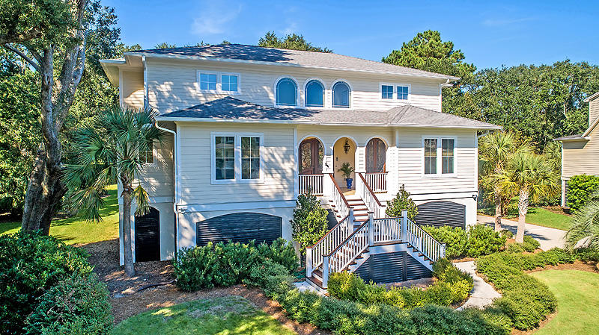
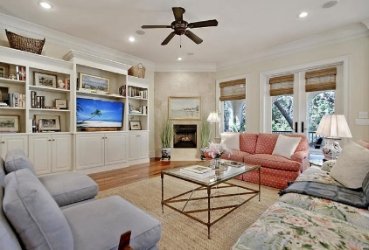
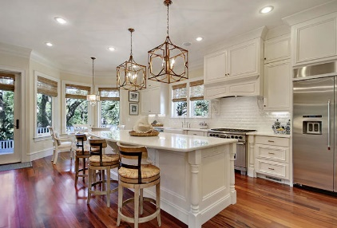
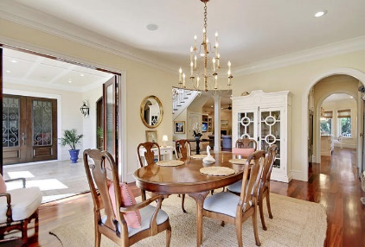
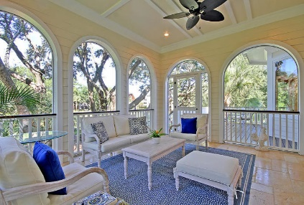
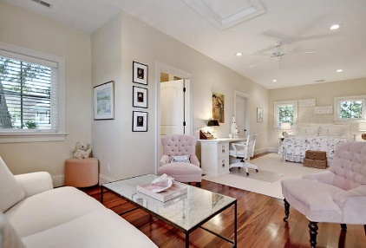
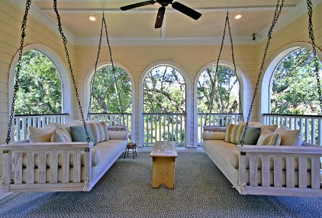
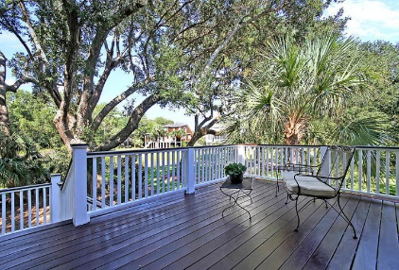
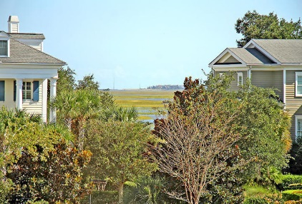


Just Listed in Hamlin Plantation
Open House Sunday 1-4
3130 Sand Marsh Lane
Mount Pleasant, SC 29466
MLS# 18027439
$1,199,000
4 Bed · 4½ Bath · 4,543sf
This is a truly elegant & meticulously kept, custom built home located in the desirable 'Sound' section of Hamlin Plantation. No expense has been spared! You are greeted on the front porch with 3 sets of mahogany doors, flanked by gas lanterns & a travertine tile porch that continues into the impressive grand foyer. Here you'll find a curved staircase, 3 story elevator & crystal chandelier. Gourmet kitchen has a huge island, quartz counter tops, convection microwave, Wolf oven/stove & Dacor fridge. Custom coffee bar/appliance cabinet, apron front sink, beveled subway tile, under cabinet lighting & sophisticated chandeliers to top it off! A glass front sub zero fridge & wine cooler are located in the butler's pantry that flows nicely into the well appointed dining room. On the main level you will also find an office and master bedroom. The master bedroom has a sophisticated master bath that includes his/her vanities and closets with organizers, marble flooring, a beautiful shower and a claw foot tub. A Costco sized pantry and laundry room are on the main level as well. Exotic hardwood throughout the entire home, a whole house Sonos system (found in the foyer closet) conveys, along with 2 TVs that are connected to the Sonos.
Each additional bedroom, all upstairs, have their own full bath, plus there's a media room and a vaulted, ventilated and fire retardant 'safe room' for valuables. Views of The Sound are found from the upstairs hallway and in 2 of the upper level bedrooms!
Notice the elegant archways throughout and on both screened porches (2 Charleston porch swings included) which overlook the peaceful backyard retreat with the sweet smell of salt air, beautiful live oaks, palms & pond! The home also has a deck and stairs down to the ground level where additional porch space is located with a partially covered porch & sitting area. There's plenty of usable outdoor living space in this house!
Plenty of room for your toys, cars and boats in the 3 car garage (can hold up to 5 cars or a small boat) with break away walls, a workshop & a separate shed area. There's so much indoor and outdoor space in this 4,543 square ft home.
Community amenities leave nothing to be desired: Jr. Olympic pool with water slide, full fitness center, walking/jogging path, nature trails, basketball & volleyball courts, an active tennis league & courts, playground & a clubhouse that can be used for private functions. Many social events throughout the year for adults and kids - It's just an overall great neighborhood!!
Lauren Zurilla
(843) 991-9149
laurenismyrealtor@gmail.com
LaurenZurilla.com
AgentOwned Premiere Group
824 Johnnie Dodds Blvd
Mt Pleasant 29464

