Slide 1
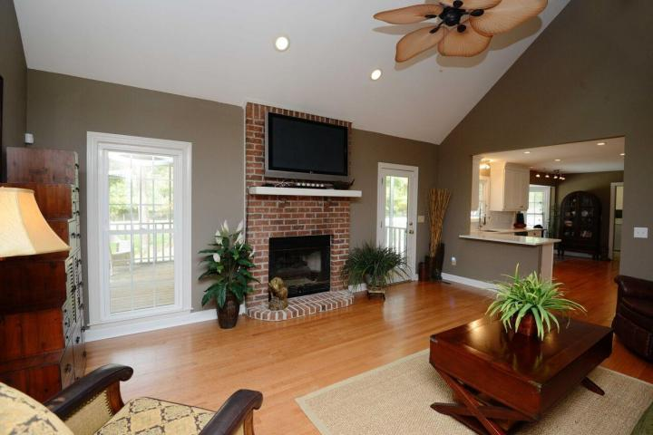
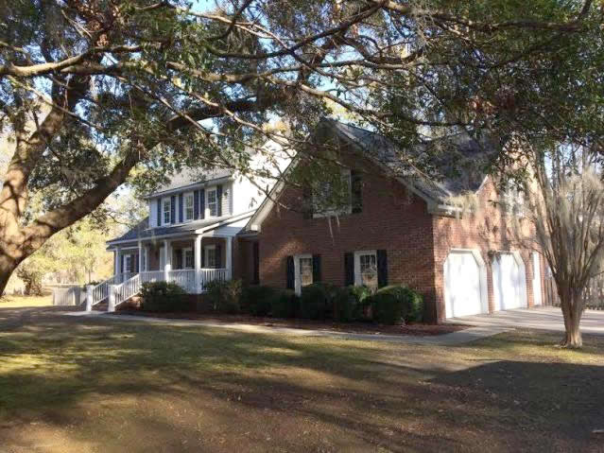
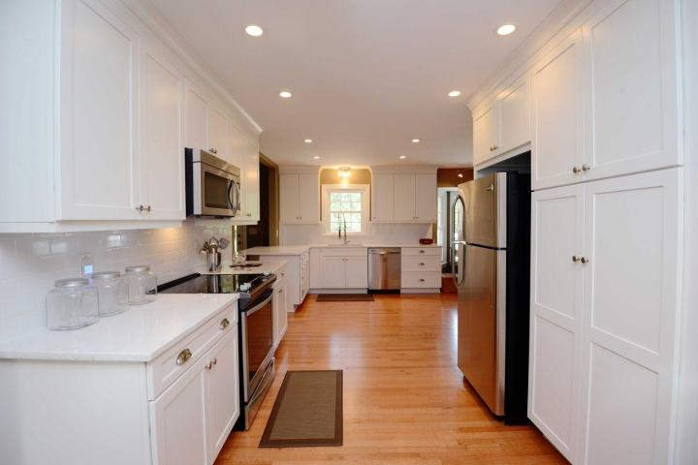
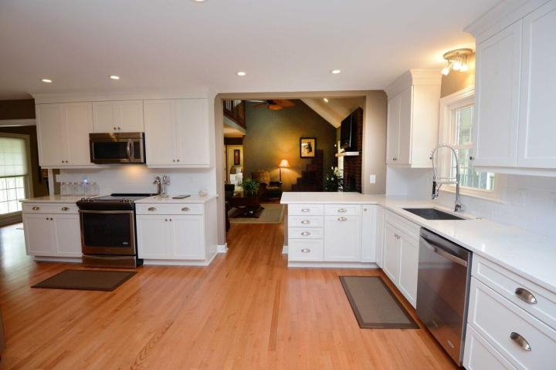
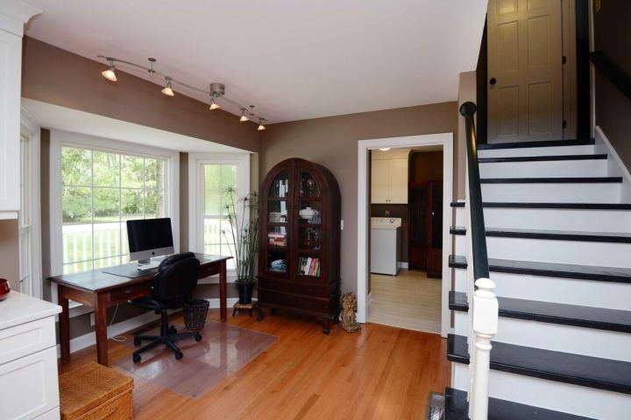
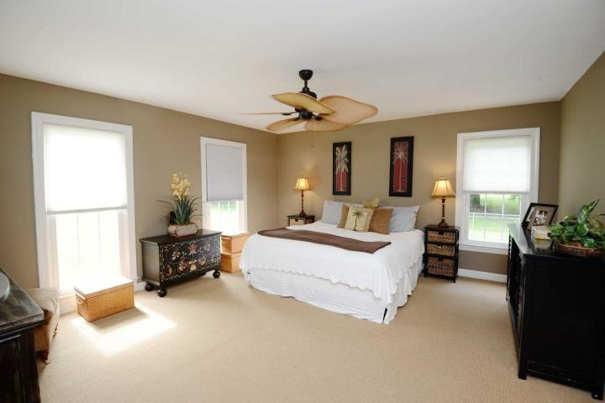
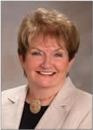

3131 Winners Circle
Hickory Farms ~ Charleston, SC 29414
MLS# 16031256 ~ $624,500
Recently Reduced!
Enjoy the privacy and comfort of spacious country living in the city
Agent Open House
Thursday, January 19th 11:00AM - 2:00PM
Food provided ~ $1000 Agent Bonus ~ $50 gift card giveaway
RARE opportunity to buy in sought after Hickory Farms - one of West Ashley's best kept secrets. Enjoy the privacy and comfort of spacious country living in the city. Minutes from shopping, Roper St. Francis, I-526 and downtown Charleston. This beautiful brick home with extraordinary curb appeal is located on 1.49 acres including a fully fenced back yard with irrigation system and plenty of room for horses if so desired. The first floor includes a brand new kitchen including all new cabinets, stainless appliances and quartz counter tops & quiet close drawers. The spacious Master Suite is also located on the first floor with a large walk-in closet and Jacuzzi tub in the Master Bath. Renovation on this home has just been completed and includes a new roof, all new exterior shutters and landscaping. Plenty of walk-in storage throughout. No HOA.
Barbara Shaw
REALTOR
(843) 442-2889
barbarasellscharleston@gmail.com
Coldwell Banker Residential Brokerage
4969 Centre Pointe Dr. Ste 203
Charleston, SC 29418

