Slide 1
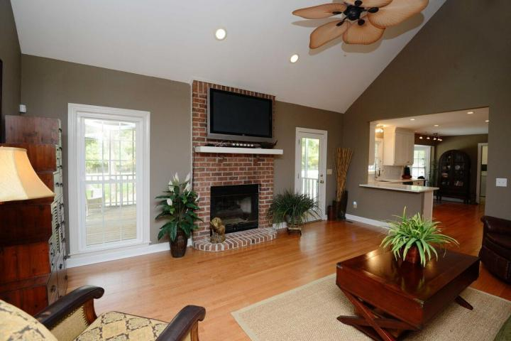
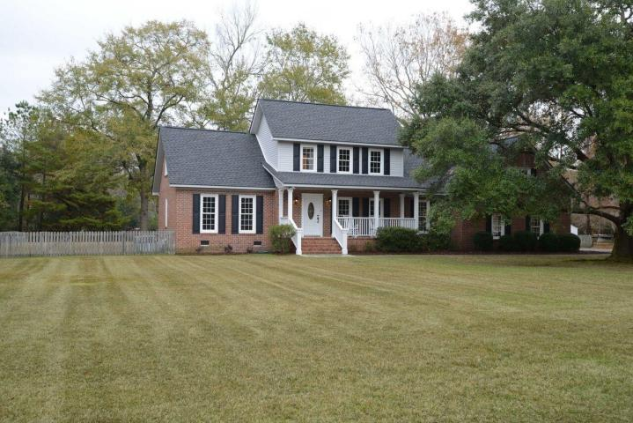
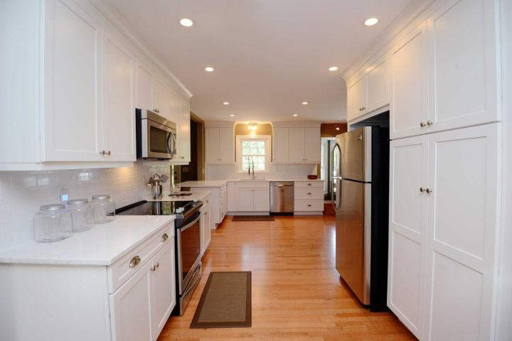
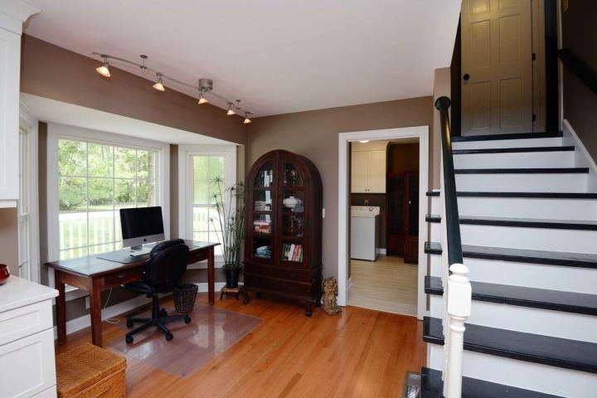
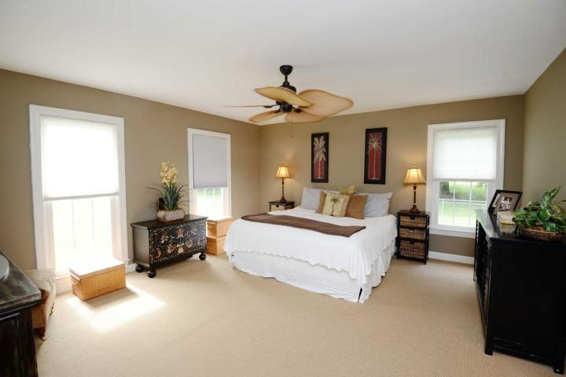
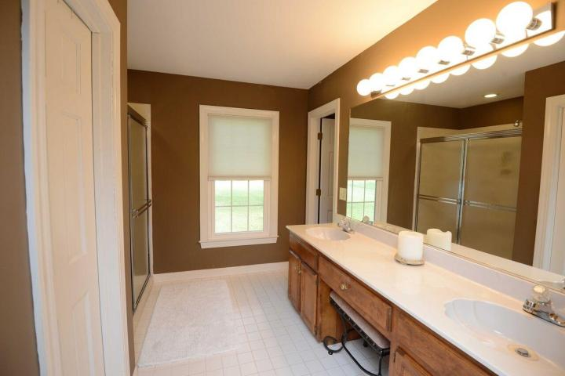
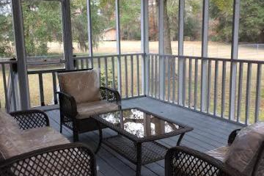
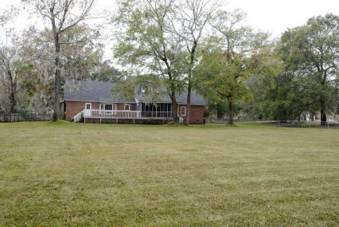
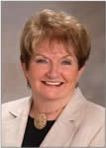

3131 Winners Circle Hickory Farms ~ Charleston, SC 29414 MLS# 16031256 ~ $649,900
RARE opportunity to buy in sought after Hickory Farms - one of West Ashley's best kept secrets. Enjoy the privacy and comfort of spacious country living in the city. Minutes from shopping, Roper St. Francis Hospital, and I-526, beaches & Historic Downtown Charleston. This beautiful brick home with extraordinary curb appeal is located on 1.49 acres including a fully fenced back yard with irrigation system and plenty of room for horses if so desired. The first floor includes a brand new kitchen including all new cabinets, stainless appliances and quartz counter tops & quiet close drawers. The spacious Master Suite is also located on the first floor with a large walk-in closet and Jacuzzi tub in the Master Bath. In addition, the Great Room boasts gorgeous newly refinished hardwood floors, sky lights and a gas fireplace. From here, step out onto the screened porch and back deck overlooking the huge secluded back yard. Upstairs are two spacious bedrooms and an enormous finished room over the garage with its own half bath. The large two-car garage is pristine with workbench already installed & utility sink. Renovation on this home has just been completed and includes a new roof, all new exterior shutters and landscaping. Plenty of walk-in storage throughout. No HOA. Transferable termite bond & crawl space has moisture barrier. This one WILL NOT LAST!!!
Enjoy the privacy and comfort of spacious country living in the city
Open House previously scheduled for 9/15/16 Has been rescheduled due to bad weather
Barbara Shaw
REALTOR
(843) 442-2889
barbarasellscharleston@gmail.com
Coldwell Banker Residential Brokerage
4969 Centre Pointe Dr. Ste 203
Charleston, SC 29418
www.palmettopremierpartners.com

