Slide 1
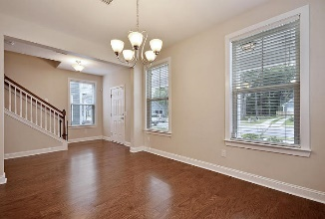
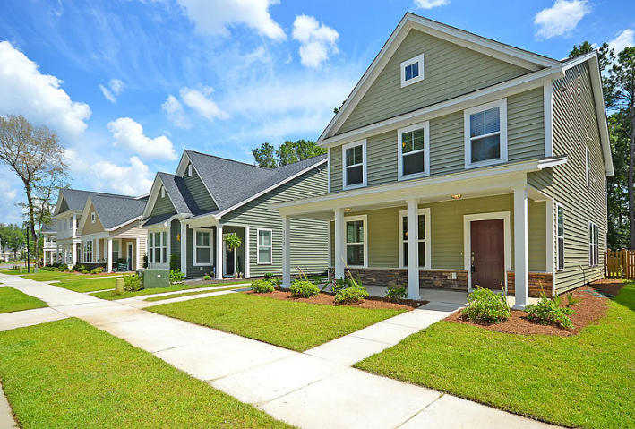
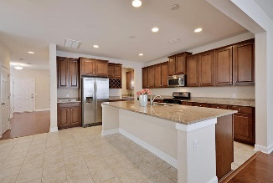
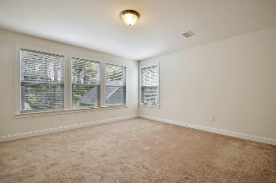
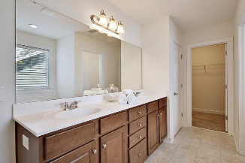
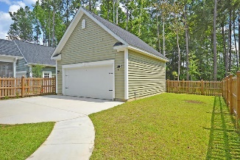
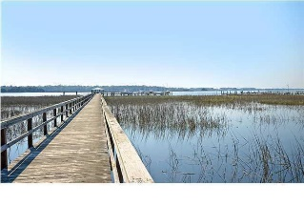

3132 Moonlight Drive
Boltons Landing | Charleston
MLS# 16015870 | $289,900
Loaded with Updates
Just Listed! ~ Move-in Ready!
Beautiful 3 bedroom 2.5 bath home on private fenced backyard lot. Great floor plan with an abundance of natural light and a GOURMET eat-in kitchen including HUGE granite flattop island, gas stove, stainless steel appliances, gorgeous cabinets, over-sized pantry and open to family room. This home also boast a butlers pantry with granite and cabinets that leads to a flex room that could be used as a separate dining room, living room, or office. Finishing off the first floor is a mud room area off the back yard to store backpacks, shoes, and garden equipment when entering from the back. Upstairs is the master suite with private spa like bath and two additional large bedrooms that share a full bath. This home is READY TODAY so call now to go and see this fabulous home! Bolton's Landing is a wonderfully landscaped community with a play park, walking trails, and community pool! The neighborhood is close to local shopping and grocery stores and is a short drive to downtown Charleston with 5-star restaurants, world class shopping and iconic history as well as a short drive to the beaches, the airport, Boeing and Daniel Island.
Stan Huff
843-670-2835
stan.huff@agentowned.com
Jill Marcacci
843-297-5590
jill@agentowned.com
www.agentownedrealty.com
AgentOwned Realty Co. Preferred Group, Inc. | 824 Johnnie Dodds Blvd | Mt Pleasant, SC 29464

