Slide 1
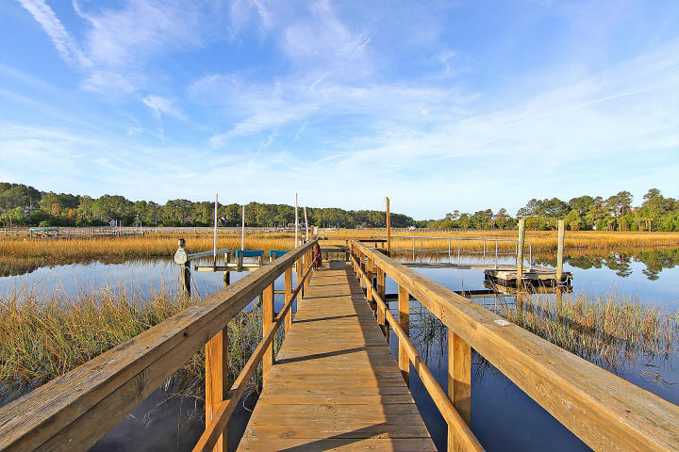
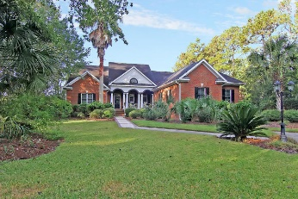
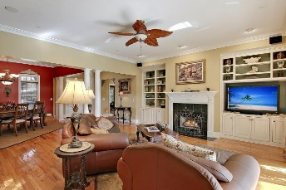
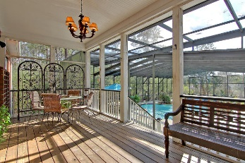
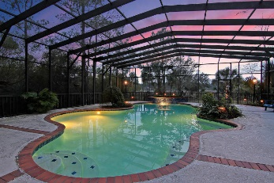
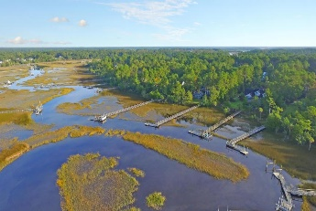


DEEP WATER IN DUNES WEST!
3136 Pignatelli Crescent
Dunes West
Mt Pleasant, SC 29466
MLS# 17003802
$1,325,000
Magnificent Fully detached 2 story brick home is situated on a tree-lined street and surrounded by a large 1.24 acre, tidal creek (water front) lot. This Stunning 4975sqft. home with gleaming wood flooring offers 3 large bedrooms upstairs with new wall to wall carpet, 2.5 bathrooms, a huge media room and a useful computer room. There are several large rooms on the main floor including an incredible gathering/family room with 10 ft ceilings, classic fireplace, built-in shelving, distinctive decorative columns, moldings and gleaming wood floors. The spacious kitchen with Exclusive Granite Counter tops, Stylish stainless appliances and Beautifully Crafted wood cabinets is a Chef's Delight and offers priceless marsh views. The downstairs offers 3 large bedrooms including the Master bedroom Suite that offers an awesome walk-in closets. The master bathroom with ceramic flooring offers a comfortable jetted soaking tub, a large separate walk-in shower and Amazing views of the marsh and tidal creek. Two of the downstairs bedrooms are perfectly located for privacy and can be utilized as a downstairs mother in law suite. The Glamorous Formal Dining room offers the exquisite wood flooring, classic moldings and is perfect for formal entertaining. There is an Authentic Sunroom that is perfect for informal dining or just kicking back and enjoying the million dollar views of the tidal creek and the huge heated salt water in-ground pool that is screen enclosed and has an awesome waterfall! The private dock with power and water offers a boat lift (one new motor). Per the current owner, the water depth is 5 feet at low tide. Please confirm. Additional features include interior fire preventive sprinkler system, built-in central vacuum system, central sound system, and electric yard fence. This Executive home is located in the Gated Dunes West Golf and River Club Neighborhood. Dunes West offers a magnificent Golf Course, Club House and many more amenities. Age, sqft, taxes, acreage, water depth, and schools are approximate buyer to verify any and all information deemed necessary.
Mason Thurber
(843) 709-5109 – C
(843) 576-2699 – O
mason@theeverettgroup.net
RE/MAX Pro Realty, 9209 University Blvd, Charleston, SC 29406

