Slide 1

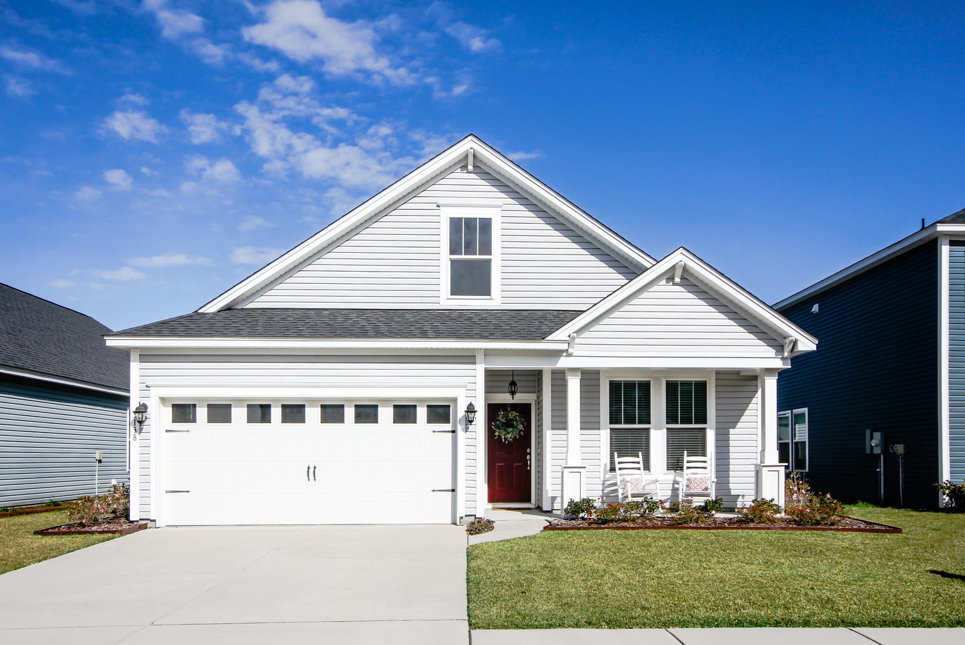
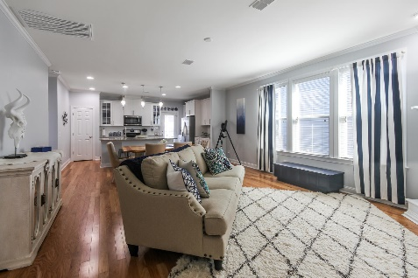
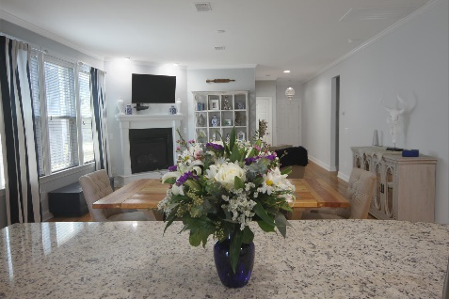
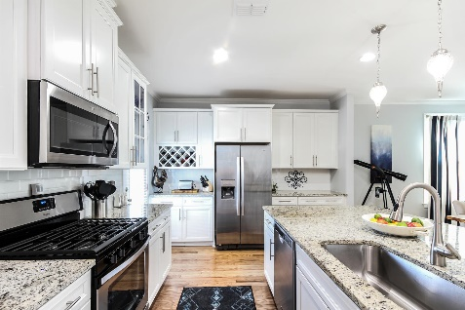
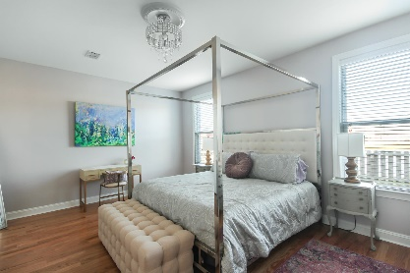
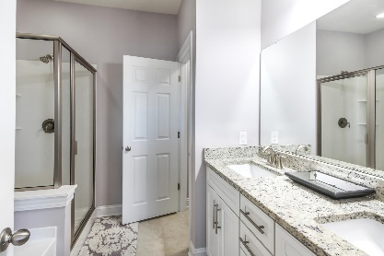
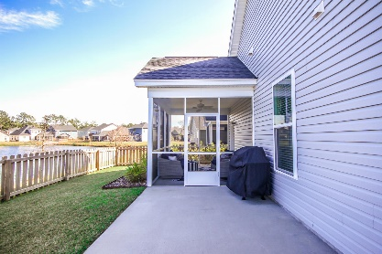
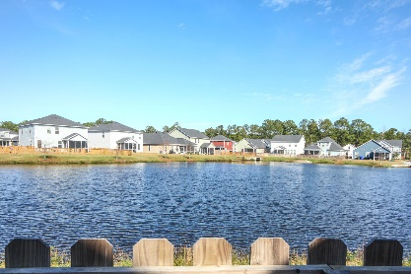
Featured Listing
3138 Timberline Drive
$320,000
Maybank Village
Johns Island, SC 29455
MLS# 20002184 | $320,000
Gorgeous, waterfront ranch in pristine condition. Built on a premium lot with a spacious and bright open floor plan making it ideal for entertaining! Tons of upgrades, from custom paint and hardwood and ceramic tile flooring throughout the home, to gas fireplace, recessed lighting, crown molding, and extra oversized windows outfitted with plantation blinds. Gourmet Chef's kitchen showcases a gas range, stainless steel whirlpool appliances, granite countertops, oversized sink, custom cabinetry, and a luxe center island with breakfast bar seating. Huge master suite located at the rear of the home with sizable walk-in closet and ensuite master bath boasting dual sinks, granite countertops, a deep garden soaking tub and walk-in shower. Large spacious screened in porch with a fenced in yard making it child and pet friendly. Welcome home!
Erin Miller
781-704-6577
ERINMILLER519@YAHOO.COM
Limited Listing by Behren Kittrell | Charleston Flat Fee Real Estate

