Slide 1

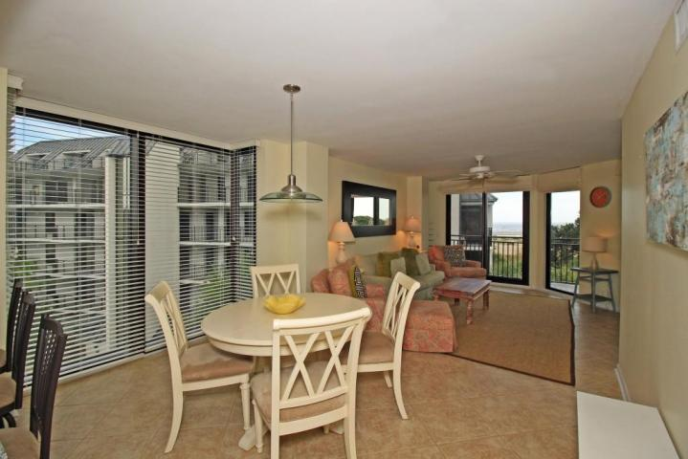
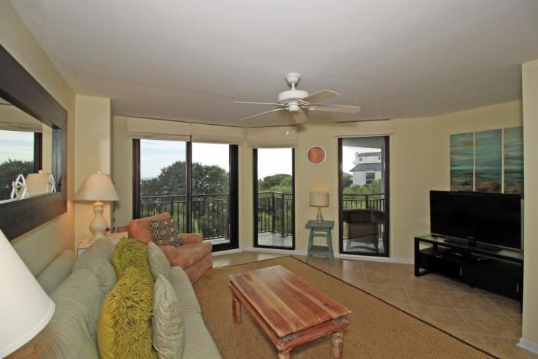
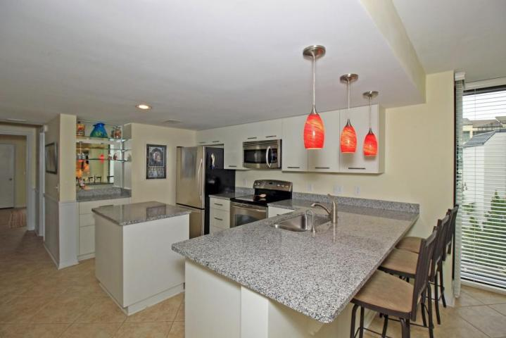
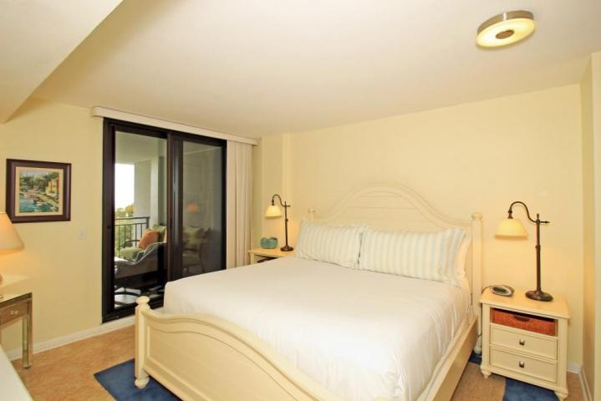
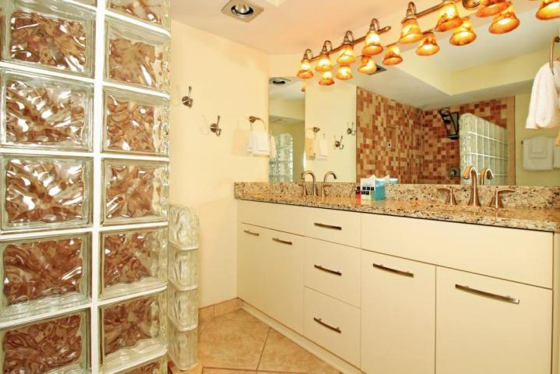
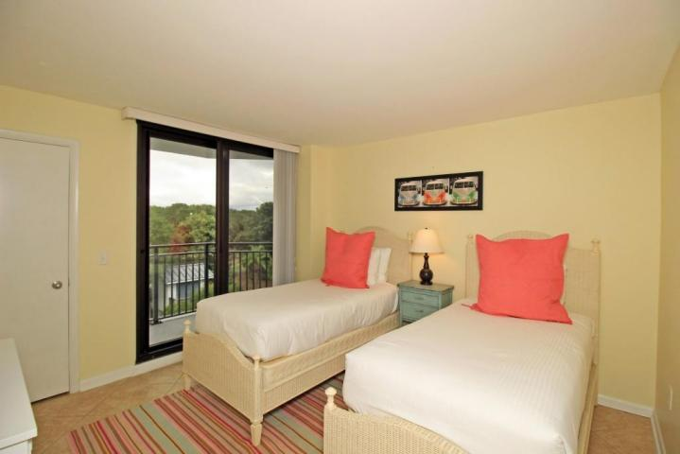
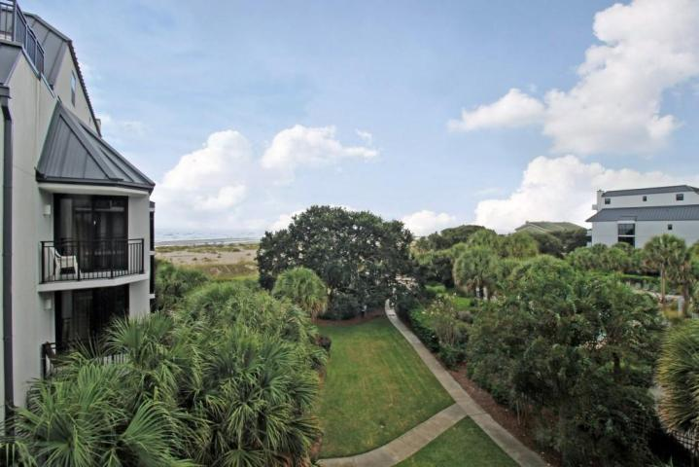


313-C Shipwatch Villa
Wild Dunes
Isle of Palms, SC 29451
MLS# 1422385
$679,000
Shipwatch is back!
Fantastic Rental Property
Renovations have been completed in buildings C and D and you MUST treat yourself to a peek. Shipwatch in now better than new--new siding, metal roofs, railings, and brand new storm-rated doors and windows. AND Shipwatch sits on a beautifully wide and stable stretch of beach. With an eye for detail, this unit was beautifully renovated, including granite countertops, tile floors throughout, new cabinetry in kitchen and baths, and fun and eclectic lighting and furnishings. You will not be disappointed. As a corner unit, light floods in through the large floor-to-ceiling bay window in addition to the sliding glass doors with access to the generous deck with expansive ocean views. There is a large storage closet just outside the unit that easily houses your beach supplies and overflow. The grounds are beautifully landscaped with a mixture of low country live oaks and tropical palms with tasteful cupped lighting along the walking paths. The pool is one of the best in the Resort making Shipwatch a great rental property although this property is not currently in a rental program.
Ann Cortes
Office - (843) 886-8110
Mobile - (843) 324-6808
ann.cortes@carolinaone.com
Carolina One Real Estate | 1503 Palm Blvd | Isle of Palms, SC 29451-2280

