Slide 1
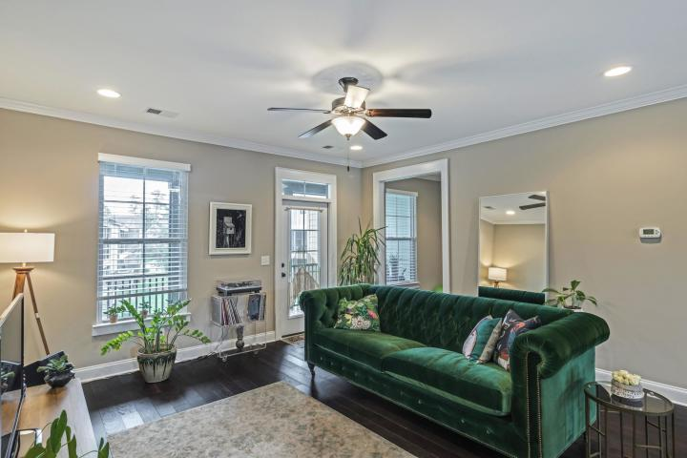
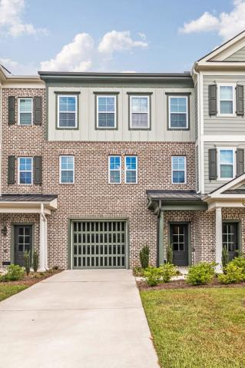
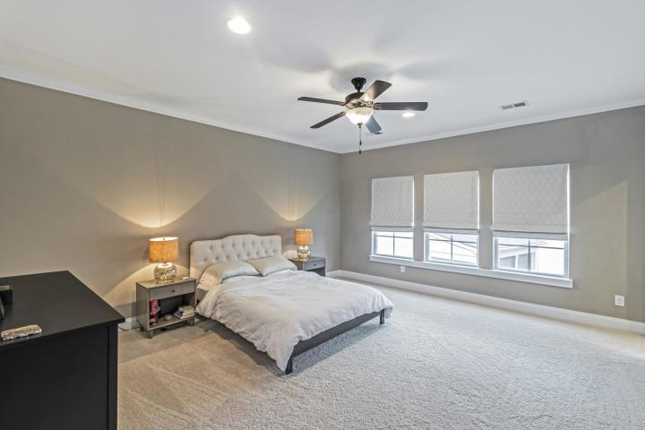
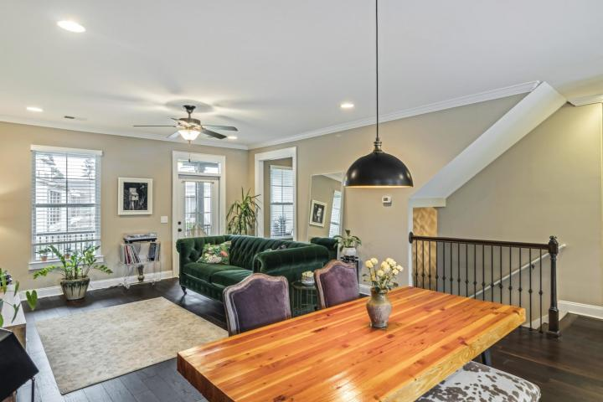
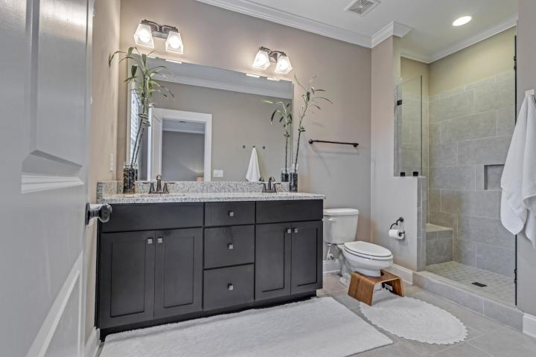
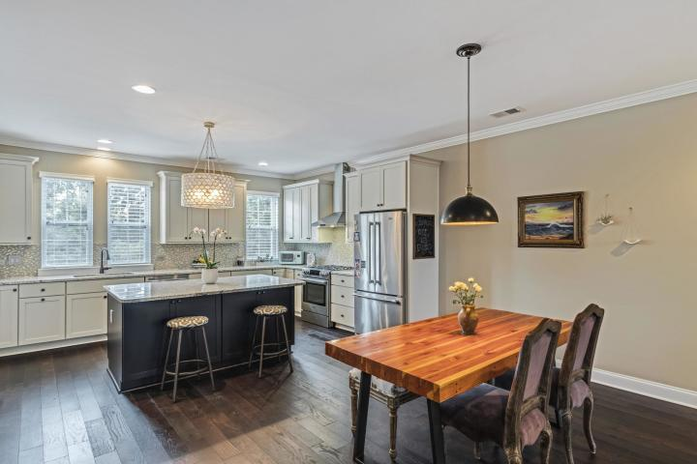
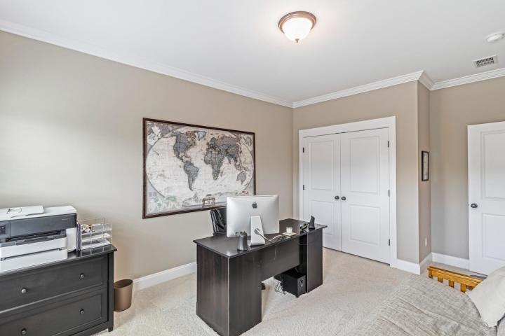
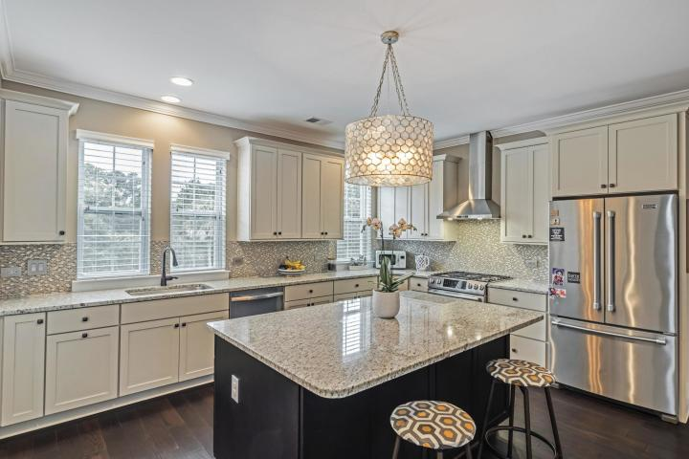
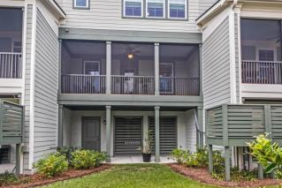
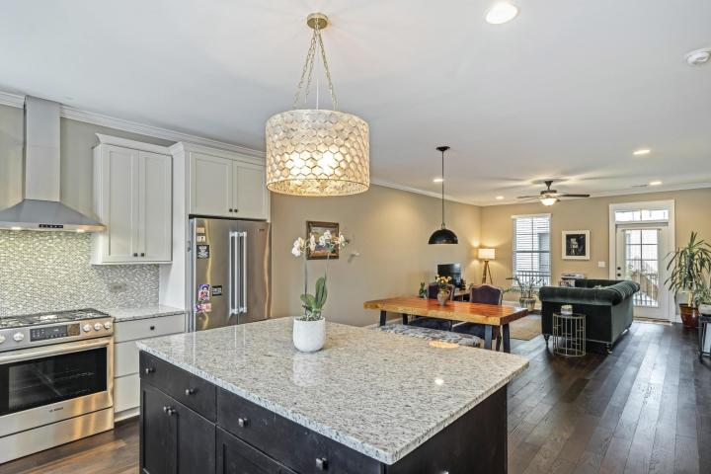
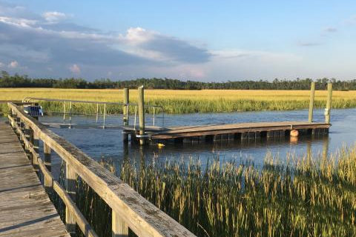
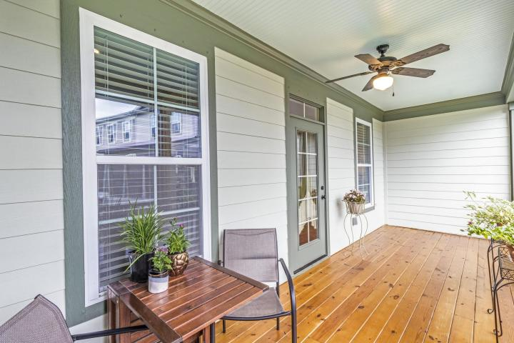



Open House
Thursday 11a-1p
313 Etiwan Point Drive
Etiwan Pointe ~ Mount Pleasant, SC 29464
MLS# 18027642 ~ $395,000
Beautiful 3BR/2.5BA Townhouse with the heart of Mount Pleasant. This modern open floor plan concept comes with stylish fixtures, dark hard wood floors, amazing kitchen with a huge pantry. Huge master bedroom with a modern bathroom and a walk-in closet. A spacious balcony off the main living area over looks the Marsh Pointe courtyard. The pragmatic design utilities every inch with plenty of storage space. The exclusive Marsh Pointe subsection has deep water dock facilities, clubhouse, a neighborhood pool, exercise area, and jog/walk trails.
Jason Newhauser
(843) 534-6564
jasonsellscharleston@gmail.com
www.jasonnewhauser.com
Coldwell Banker Residential Brokerage
1127 Queensborough Blvd. 103
Mt Pleasant, SC 29464

