Slide 1
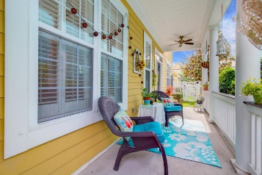
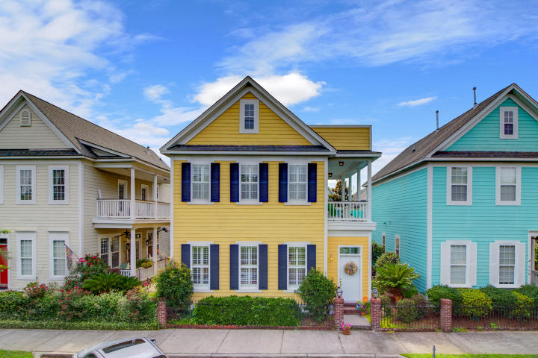
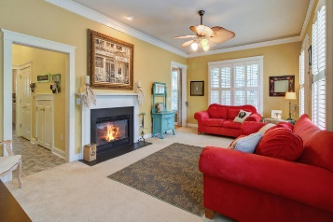
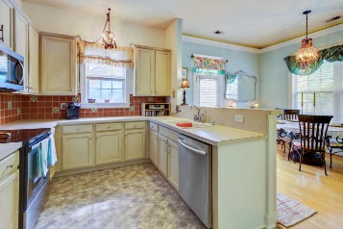
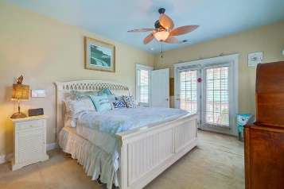
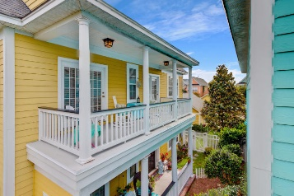
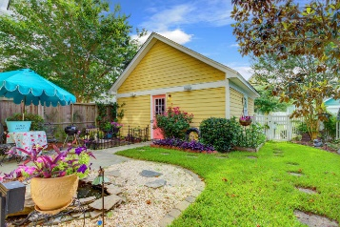
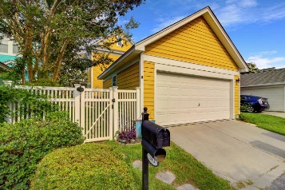
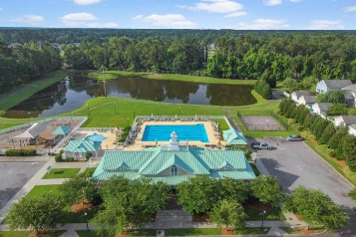


313 White Gables Drive White Gables ~ Summerville, SC 29483 MLS# 18015617 ~ $220,000
Open House Lunch ~ Friday, Oct 3 from 11 - 1
Handyman Special… Bring your hard hats!
Great New Price!
Welcome to a Charleston style home located in the charming neighborhood of White Gables, where neighbors are family. This home is just minutes from downtown Summerville, where you will find local shopping, restaurants and pubs. The home features expansive double porches which offer views of the White Gables green out front and charming courtyard. White Gables has monthly and Holiday events with neighbors, which make it easy to meet new people. Just a few homes down the block is the is the park, clubhouse and pool where you can relax with friends. This Saussy Burbank home features 10' ceilings with crown molding and pedestal window sills. The living room has plantation blinds, 10'' ceilings and you can enjoy chilly nights by the gas fireplace. The inviting kitchen is a chef's delight with a brand new stainless steel appliances, two pantries for food storage as well as many cabinets for dishes and cookware. The floor plan features an ample size dining area with access to the landscaped backyard with a pond and surround sound speakers. Low maintenance yard with irrigation system allow you to live the lifestyle this community offers. Upstairs master suite with walk in closet, in suite bathroom and access to the porch, make this a must see! The other two bedrooms are generous in size and can be used for office space, work out room, or guest rooms. Your new backyard calls for you to set out a lawn chair and have a morning coffee. The garage boasts an attic for extra storage space. HVAC 2 years old, the front porch door recently replaced and the home has been freshly painted. HOA fees allow use of the Olympic size swimming pool, tennis courts, firepit, miles of walking/biking trails and Four stocked ponds for fishing.
Hillary Jones
(843) 709-4666 hillaryjones@sc.rr.com | www.ahomeinsummerville.com
Realty ONE Group Coastal | 1510 Trolley Rd | Summerville, SC 29485

