Slide 1
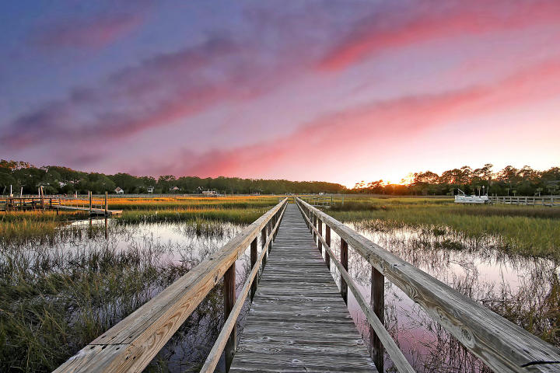
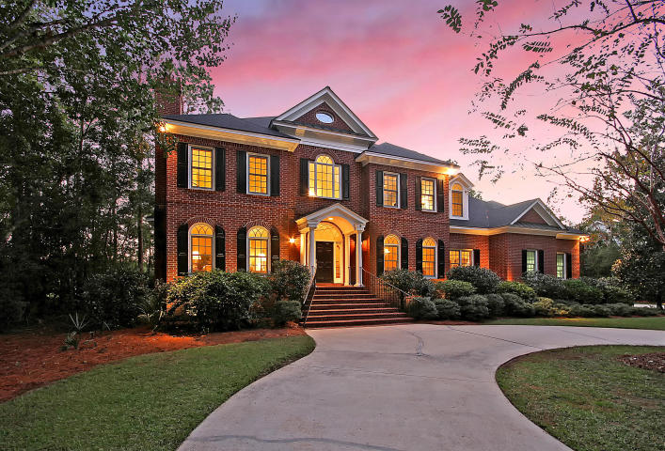
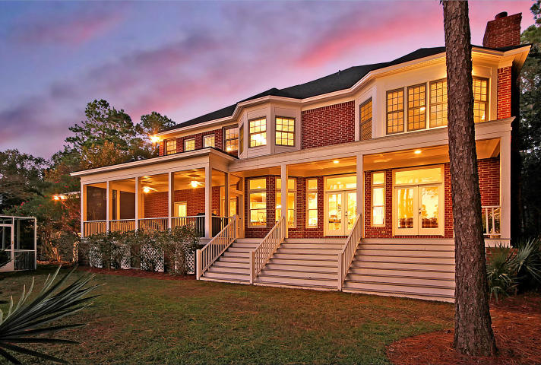
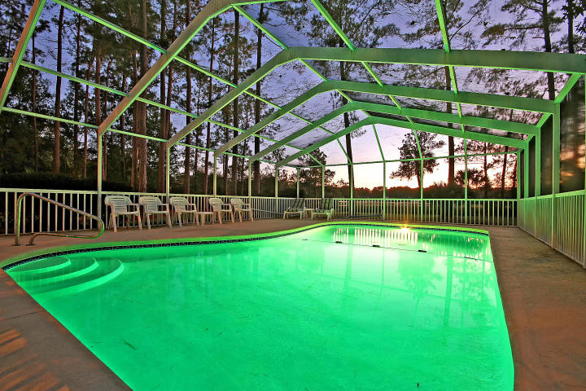
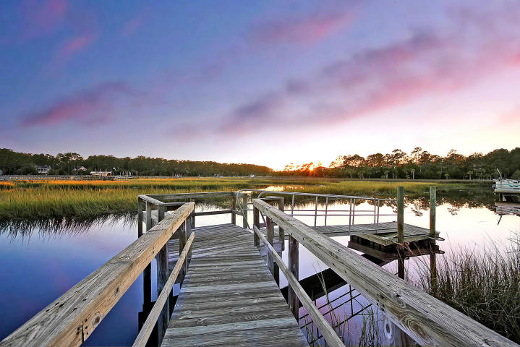
Seller Offering $15,000 Upgrade Concession
To Be Paid To Buyer With Seller Closing Proceeds!
Price Reduced!
Spacious and beautiful are two words that will continually come to mind when you view this stunning two story home in the gated community of Dunes West. The front yard, the back yard, the master bedroom, the finished space & storage space on the third level, the three car garage, all these spaces are large! The welcoming front porch, the soaring ceilings in the 2 story family room with its floor to ceiling windows, the eat-in kitchen, formal dining room & first floor guest suite are all beautiful components of this house that make it a home & provide you with several WOW moments when touring the residence. It'll be very easy to envision family & friends comfortably gathering here. Don't forget to take advantage of the community's world class amenities that make home seem like vacation!
3140 Pignatelli Crescent Dunes West ~ Mount Pleasant, SC 29466
MLS# 17029742 ~ $1,289,000
Nate Gainey nate@mattoneillteam.com 843-513-2038

