Slide 1
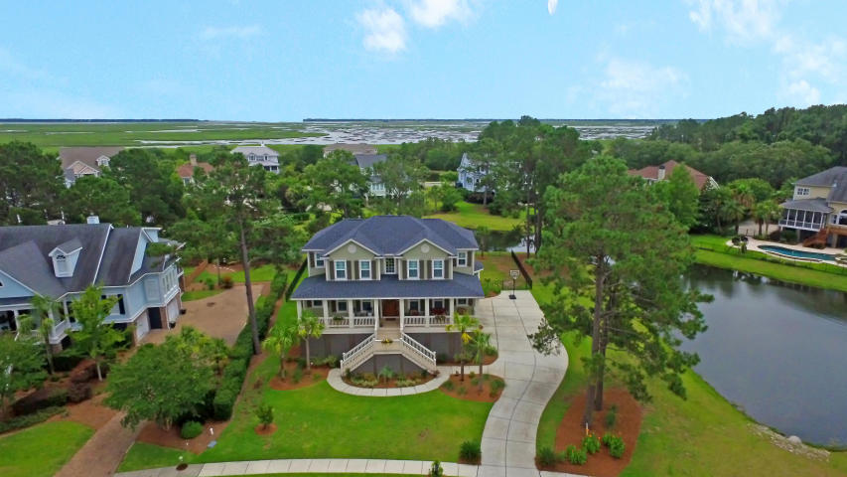
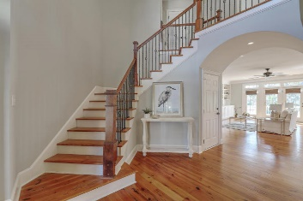
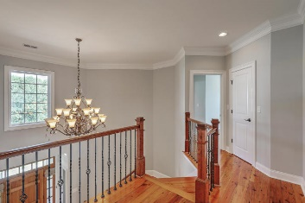
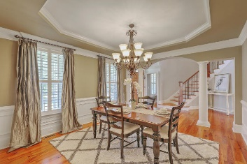
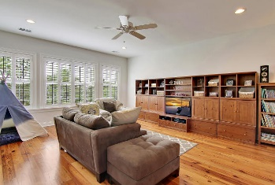
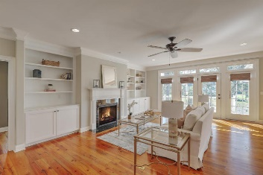
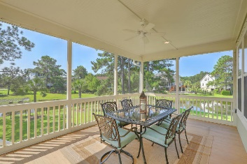
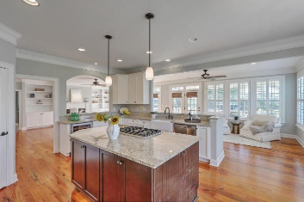
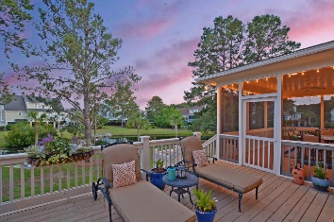
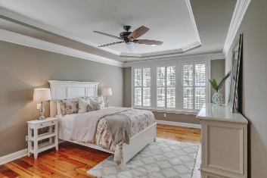
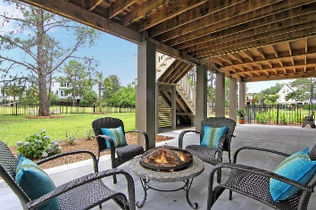
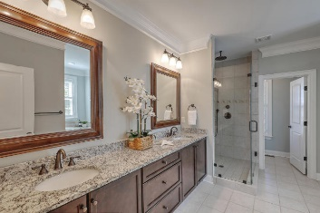
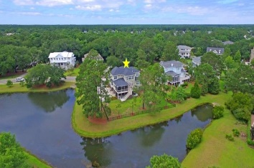

Wine and Cheese Open House
Thursday, August 24th ~ 4:30-6:30
Price Reduced!
3141 Sand Marsh Lane
Hamlin Plantation ~ Mount Pleasant ~ MLS# 17023424 ~ $929,900
Spacious lot with Water-Views on 2 Sides of this elevated, custom home built in 2014. You’ll be greeted by warm ocean breezes from the Hamlin Sound in a house built for entertaining with every upgrade while enjoying the executive southern lifestyle. The home boasts wall to wall hardwood floors, open concept layout, expansive windows & French doors with views of wrap around tidal pond for added privacy. The two-story foyer greets you on the way to your open concept kitchen with double ovens, SS appliances, center granite island, and farmer sink. The home has two master suites and an elevator shaft for added flexibility. Hamlin Plantation includes award winning amenities and top-rated schools including the #1 STEM school in the nation.
Additional features include:
Fenced in backyard
Screened in porch and deck
Columns in Dining Room
Gas Lanterns
Fireplace & built ins in Family Room
Wrought Iron railing on staircase
Crown molding throughout
Wainscoting in Formal Dining Room
Built in Wine Cooler
Plantation shutters & Roman shades
Professional landscape uplighting
Amenities including Jr. Olympic size pool, Tennis courts, Fitness center, Basketball & Volleyball Courts, Walking & Bike Trails
Book your showing today!
Matt O’Neill matt@mattoneillteam.com 843-532-4220

