Slide 1
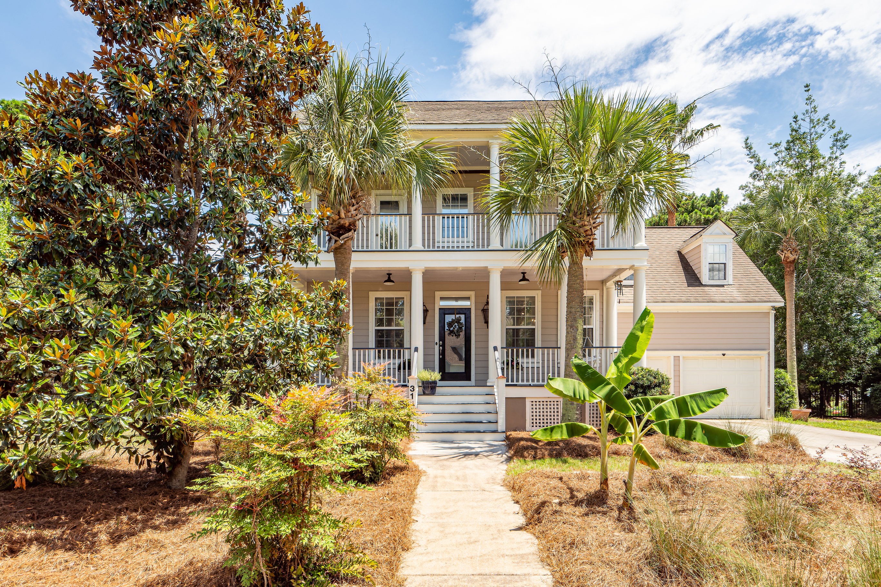
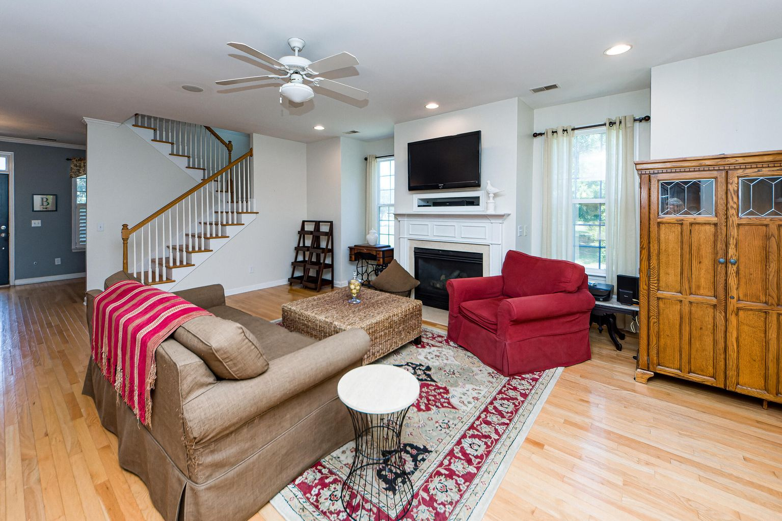
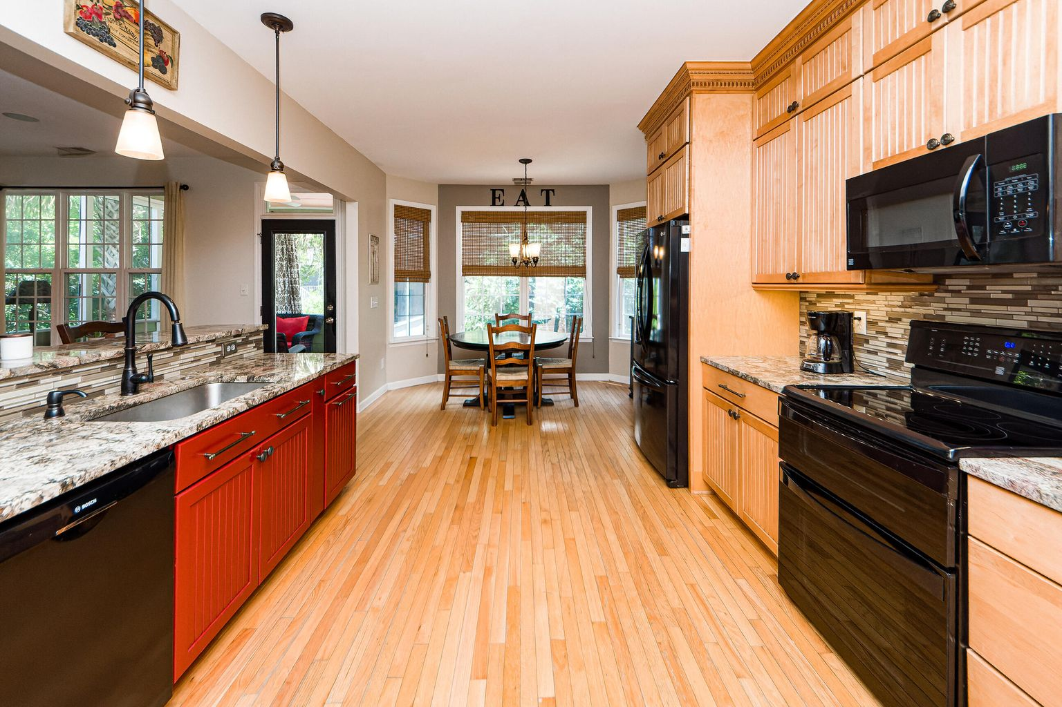
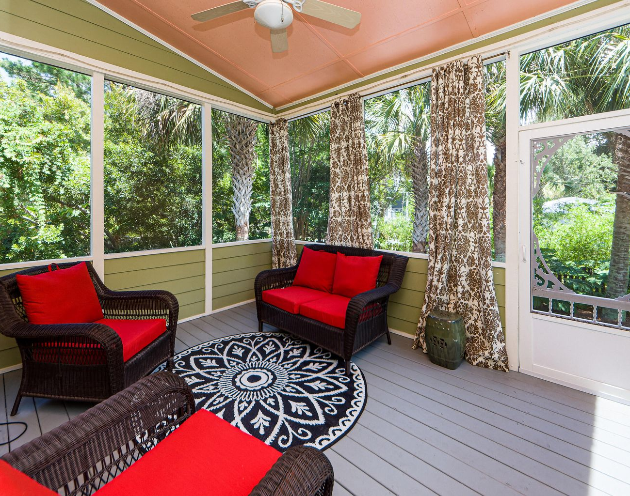

NEW LISTING
Open House Sat & Sun from 12-3
3144 Treadwell Street
Hamlin Plantation | Mt Pleasant
MLS# 22016759
$725,000
3 Bedrooms
2½ Baths
2,416 Square Feet
Renovated Kitchen
Private Fenced Yard
Large Screened Porch
Patio Perfect for Entertaining
TAKE A VIRTUAL TOUR
Jennifer Nipper-Crockett
REALTOR
843-478-1800
Jen@AgentOwned.com
AgentOwned.com
Notes:
DO NOT ALTER LAYOUT. YOUR FILE WILL BE RETURNED OR EDITED IF IT IS RECEIVED ALTERED.

