Slide 1
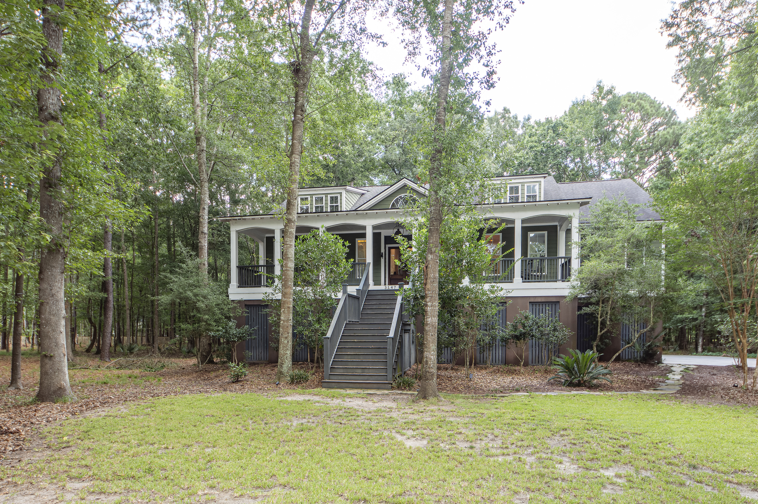
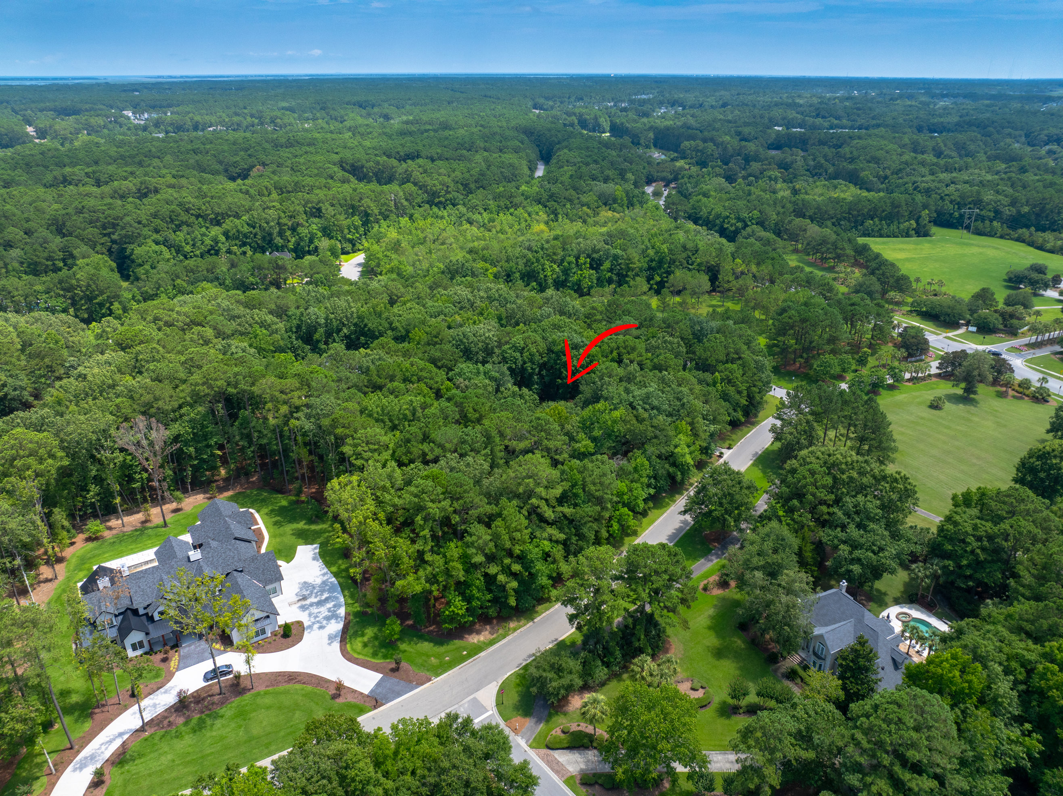
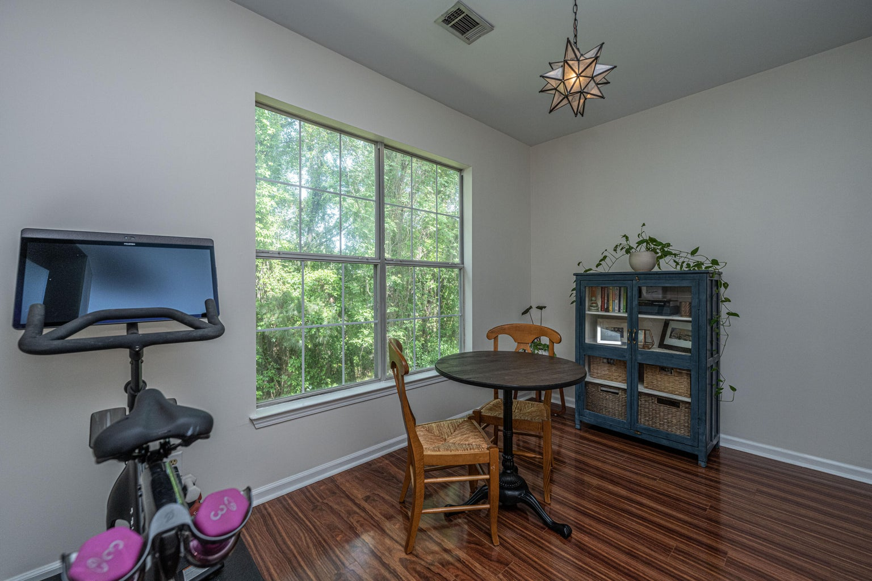
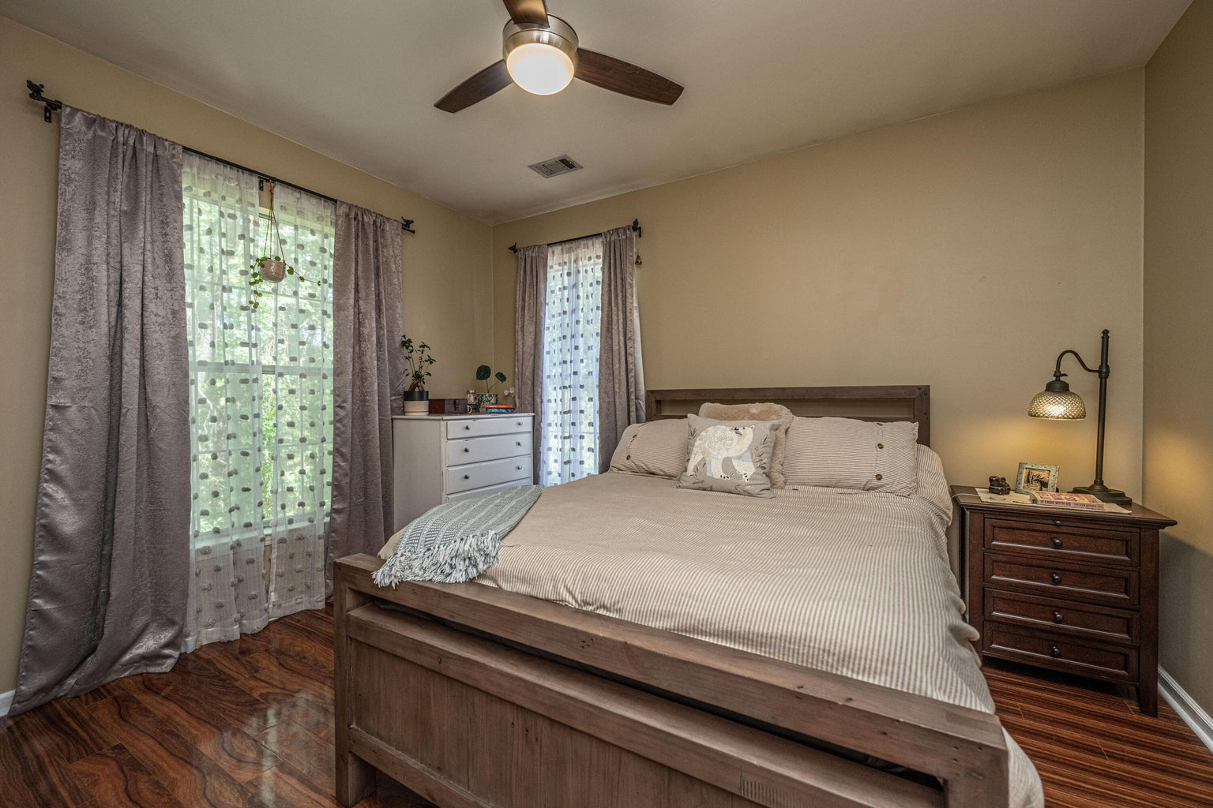




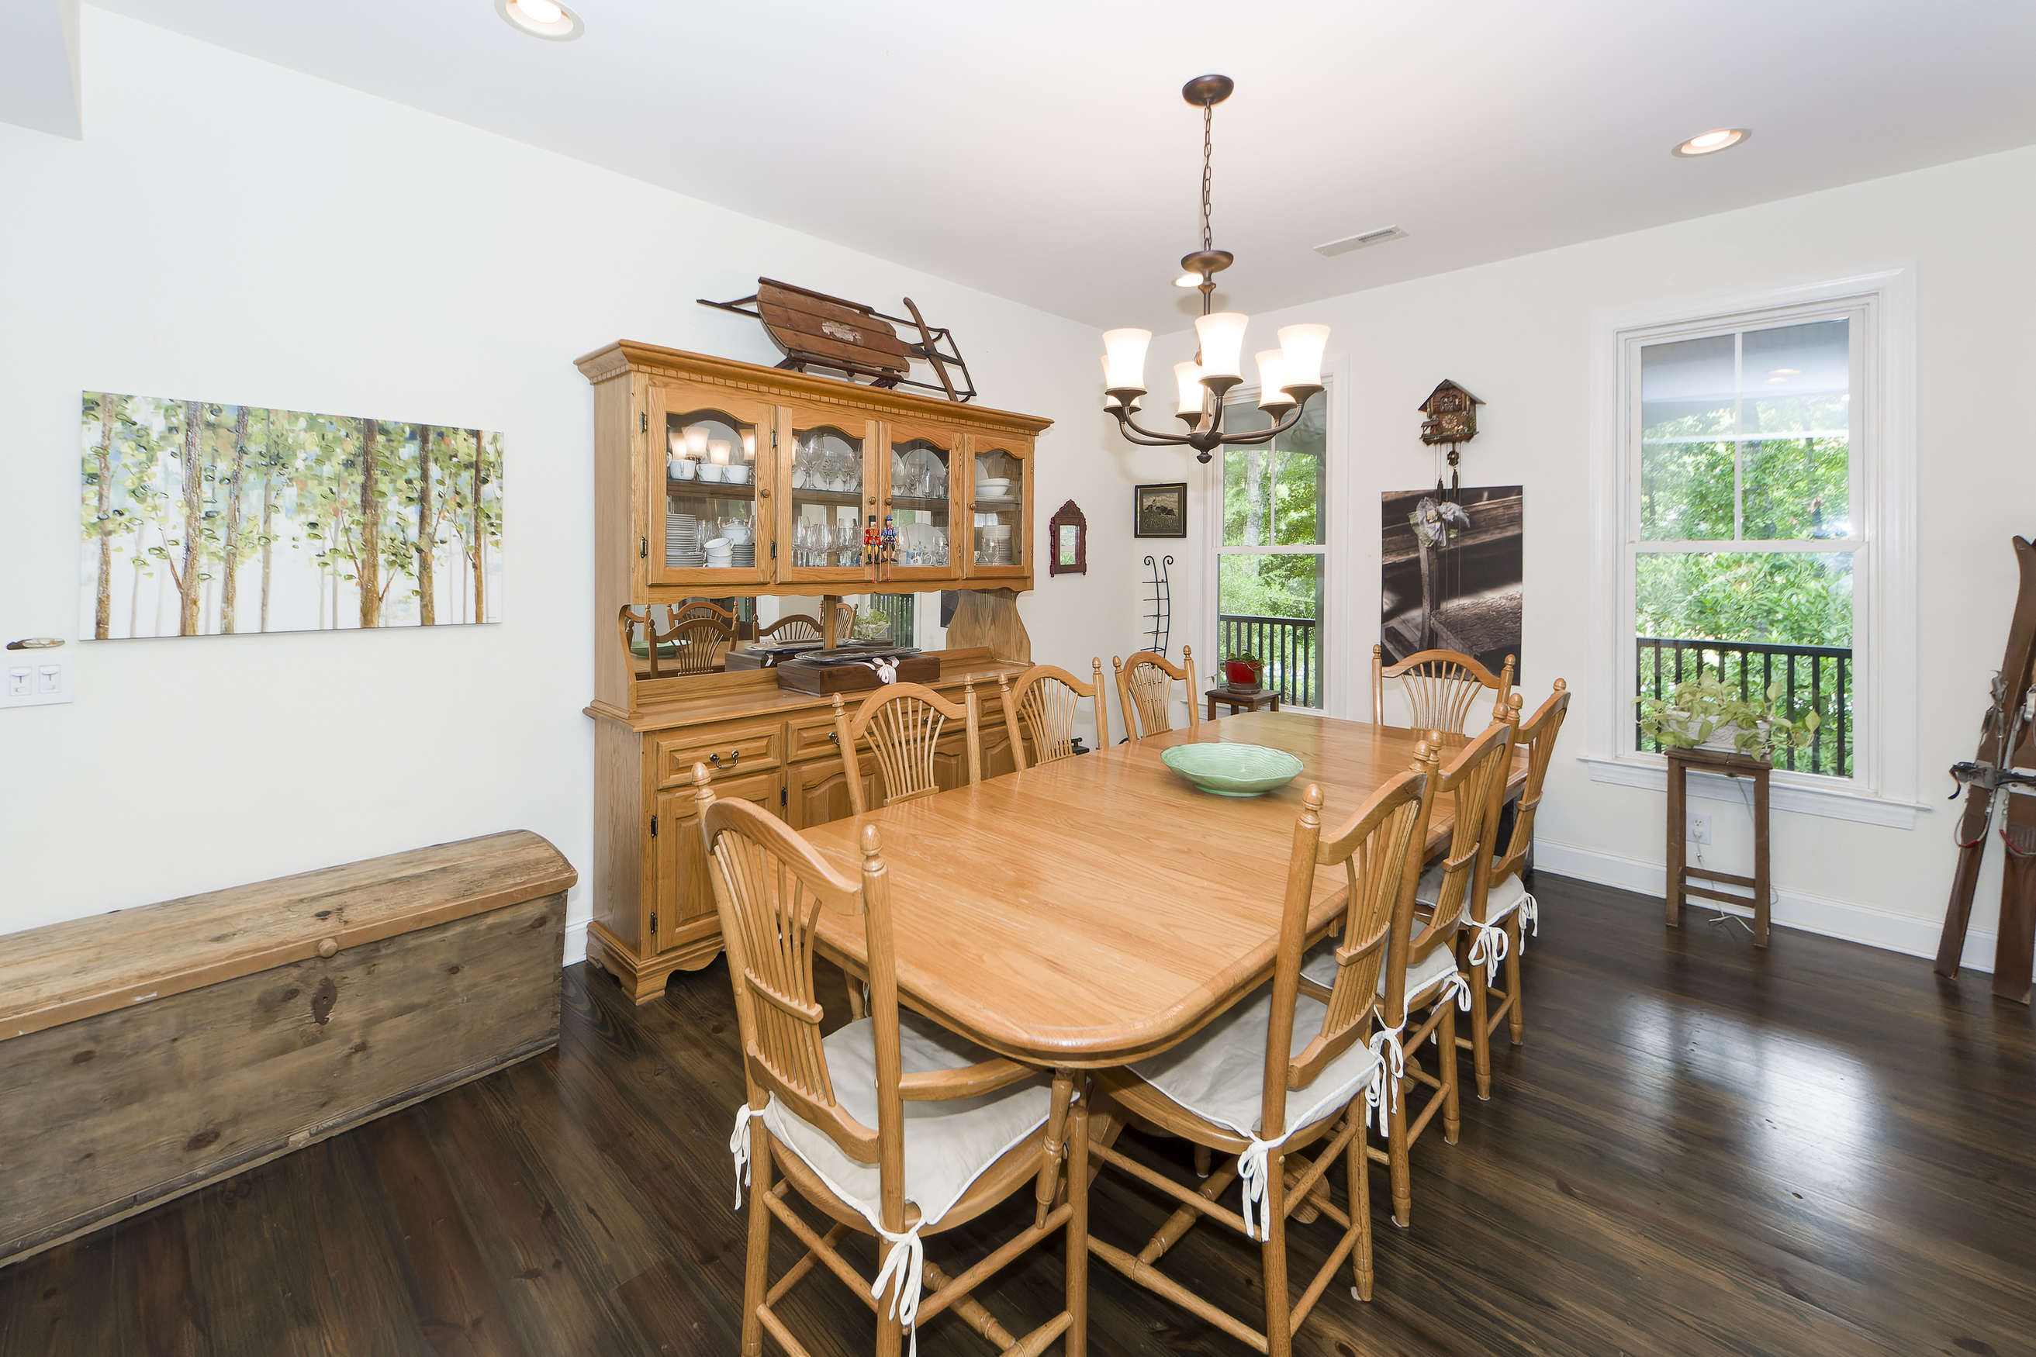
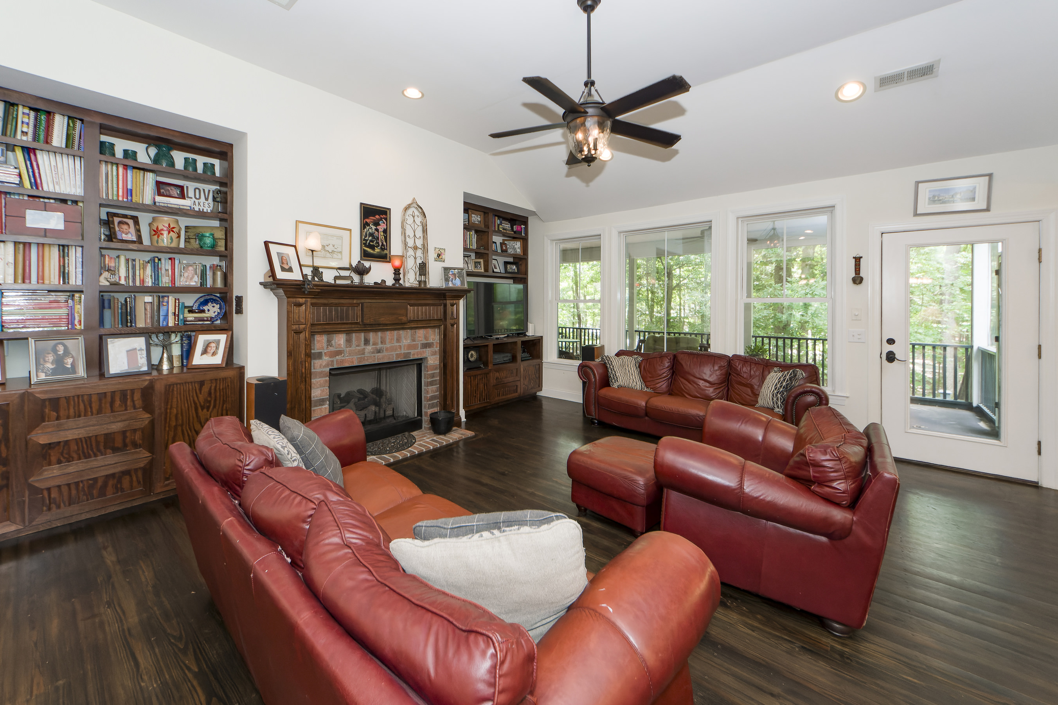
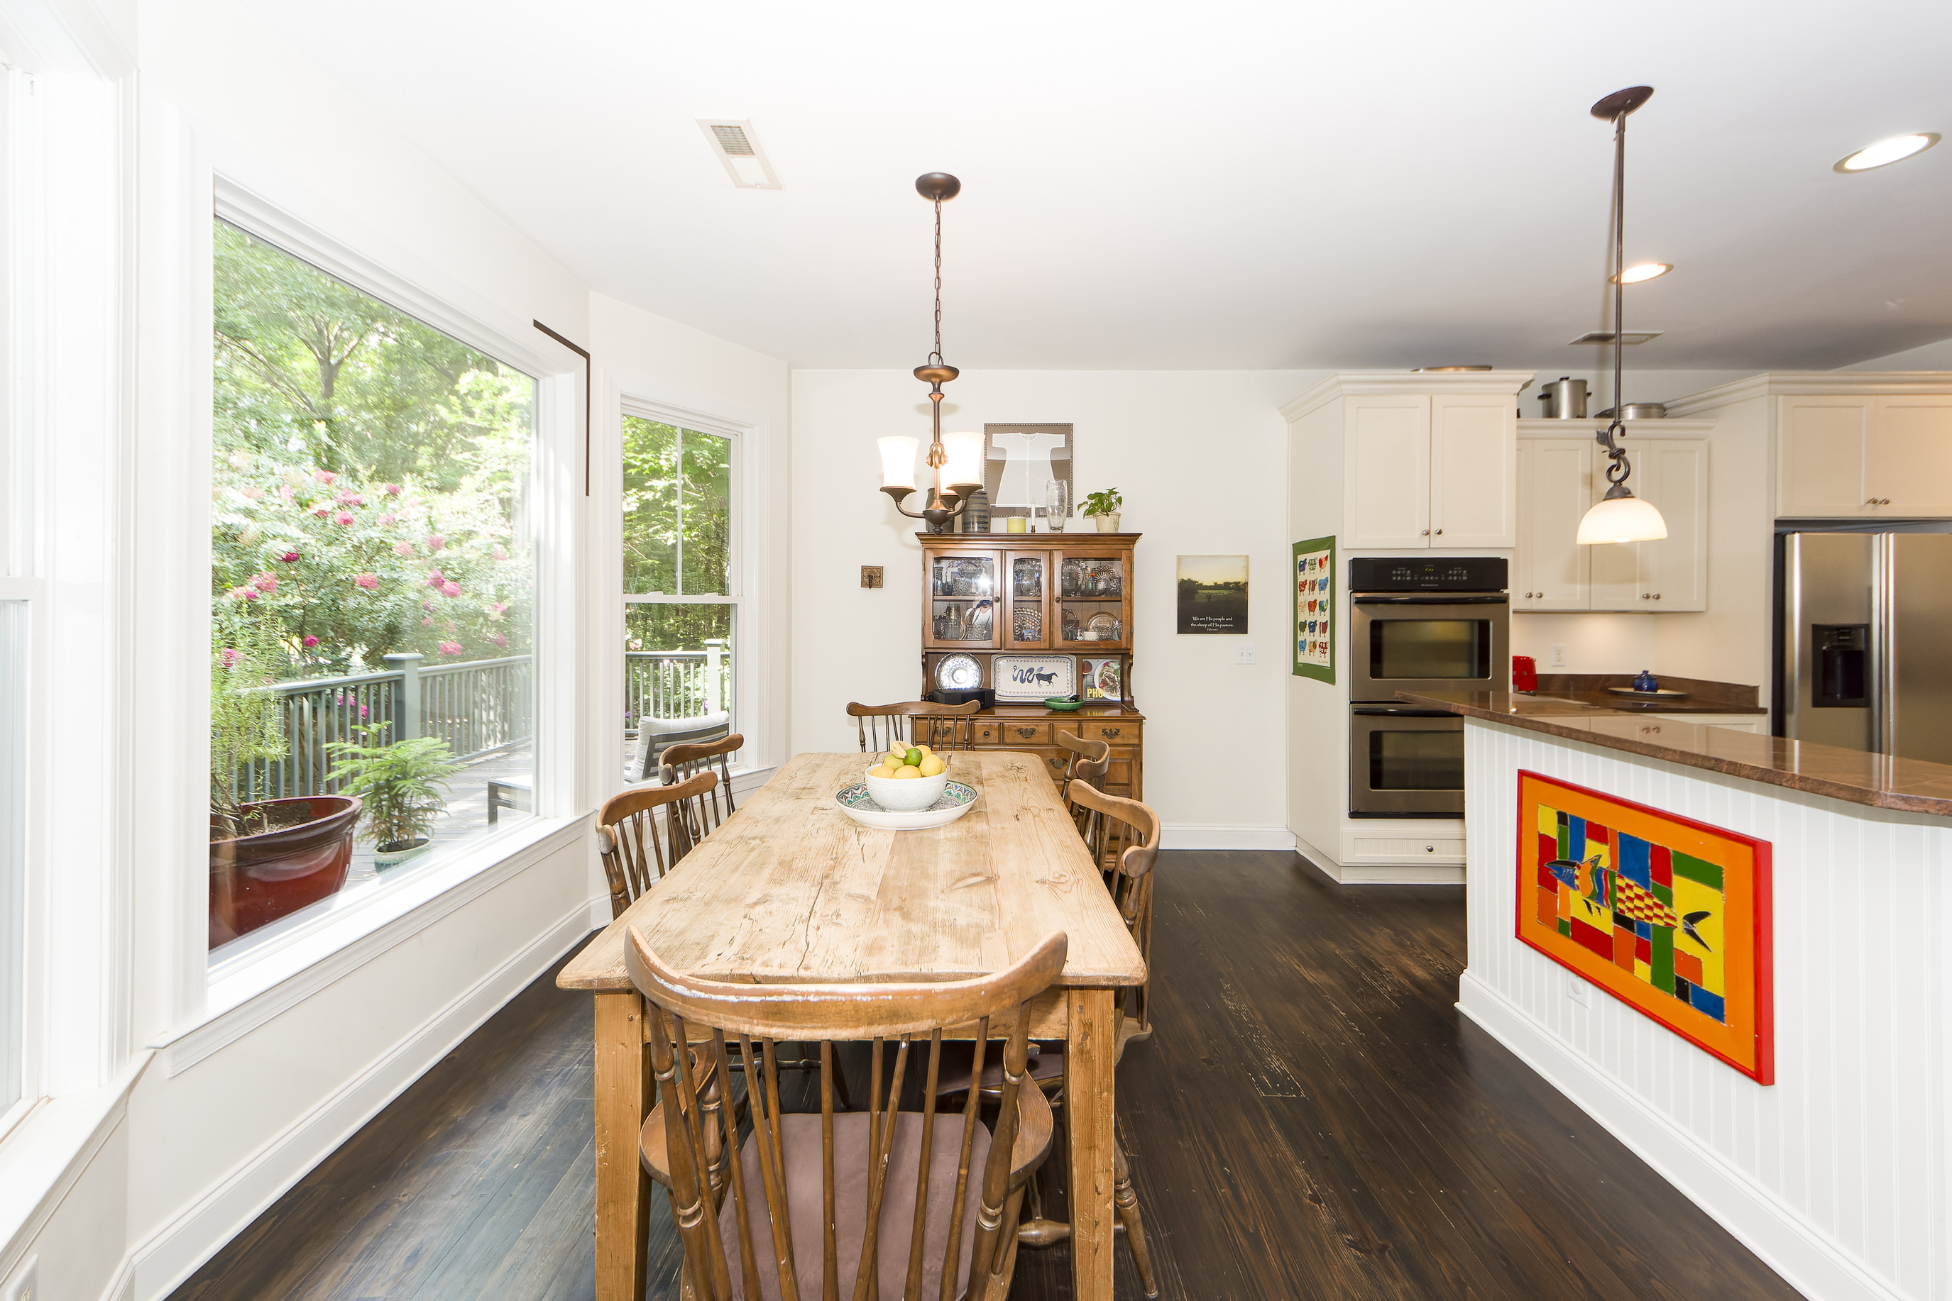
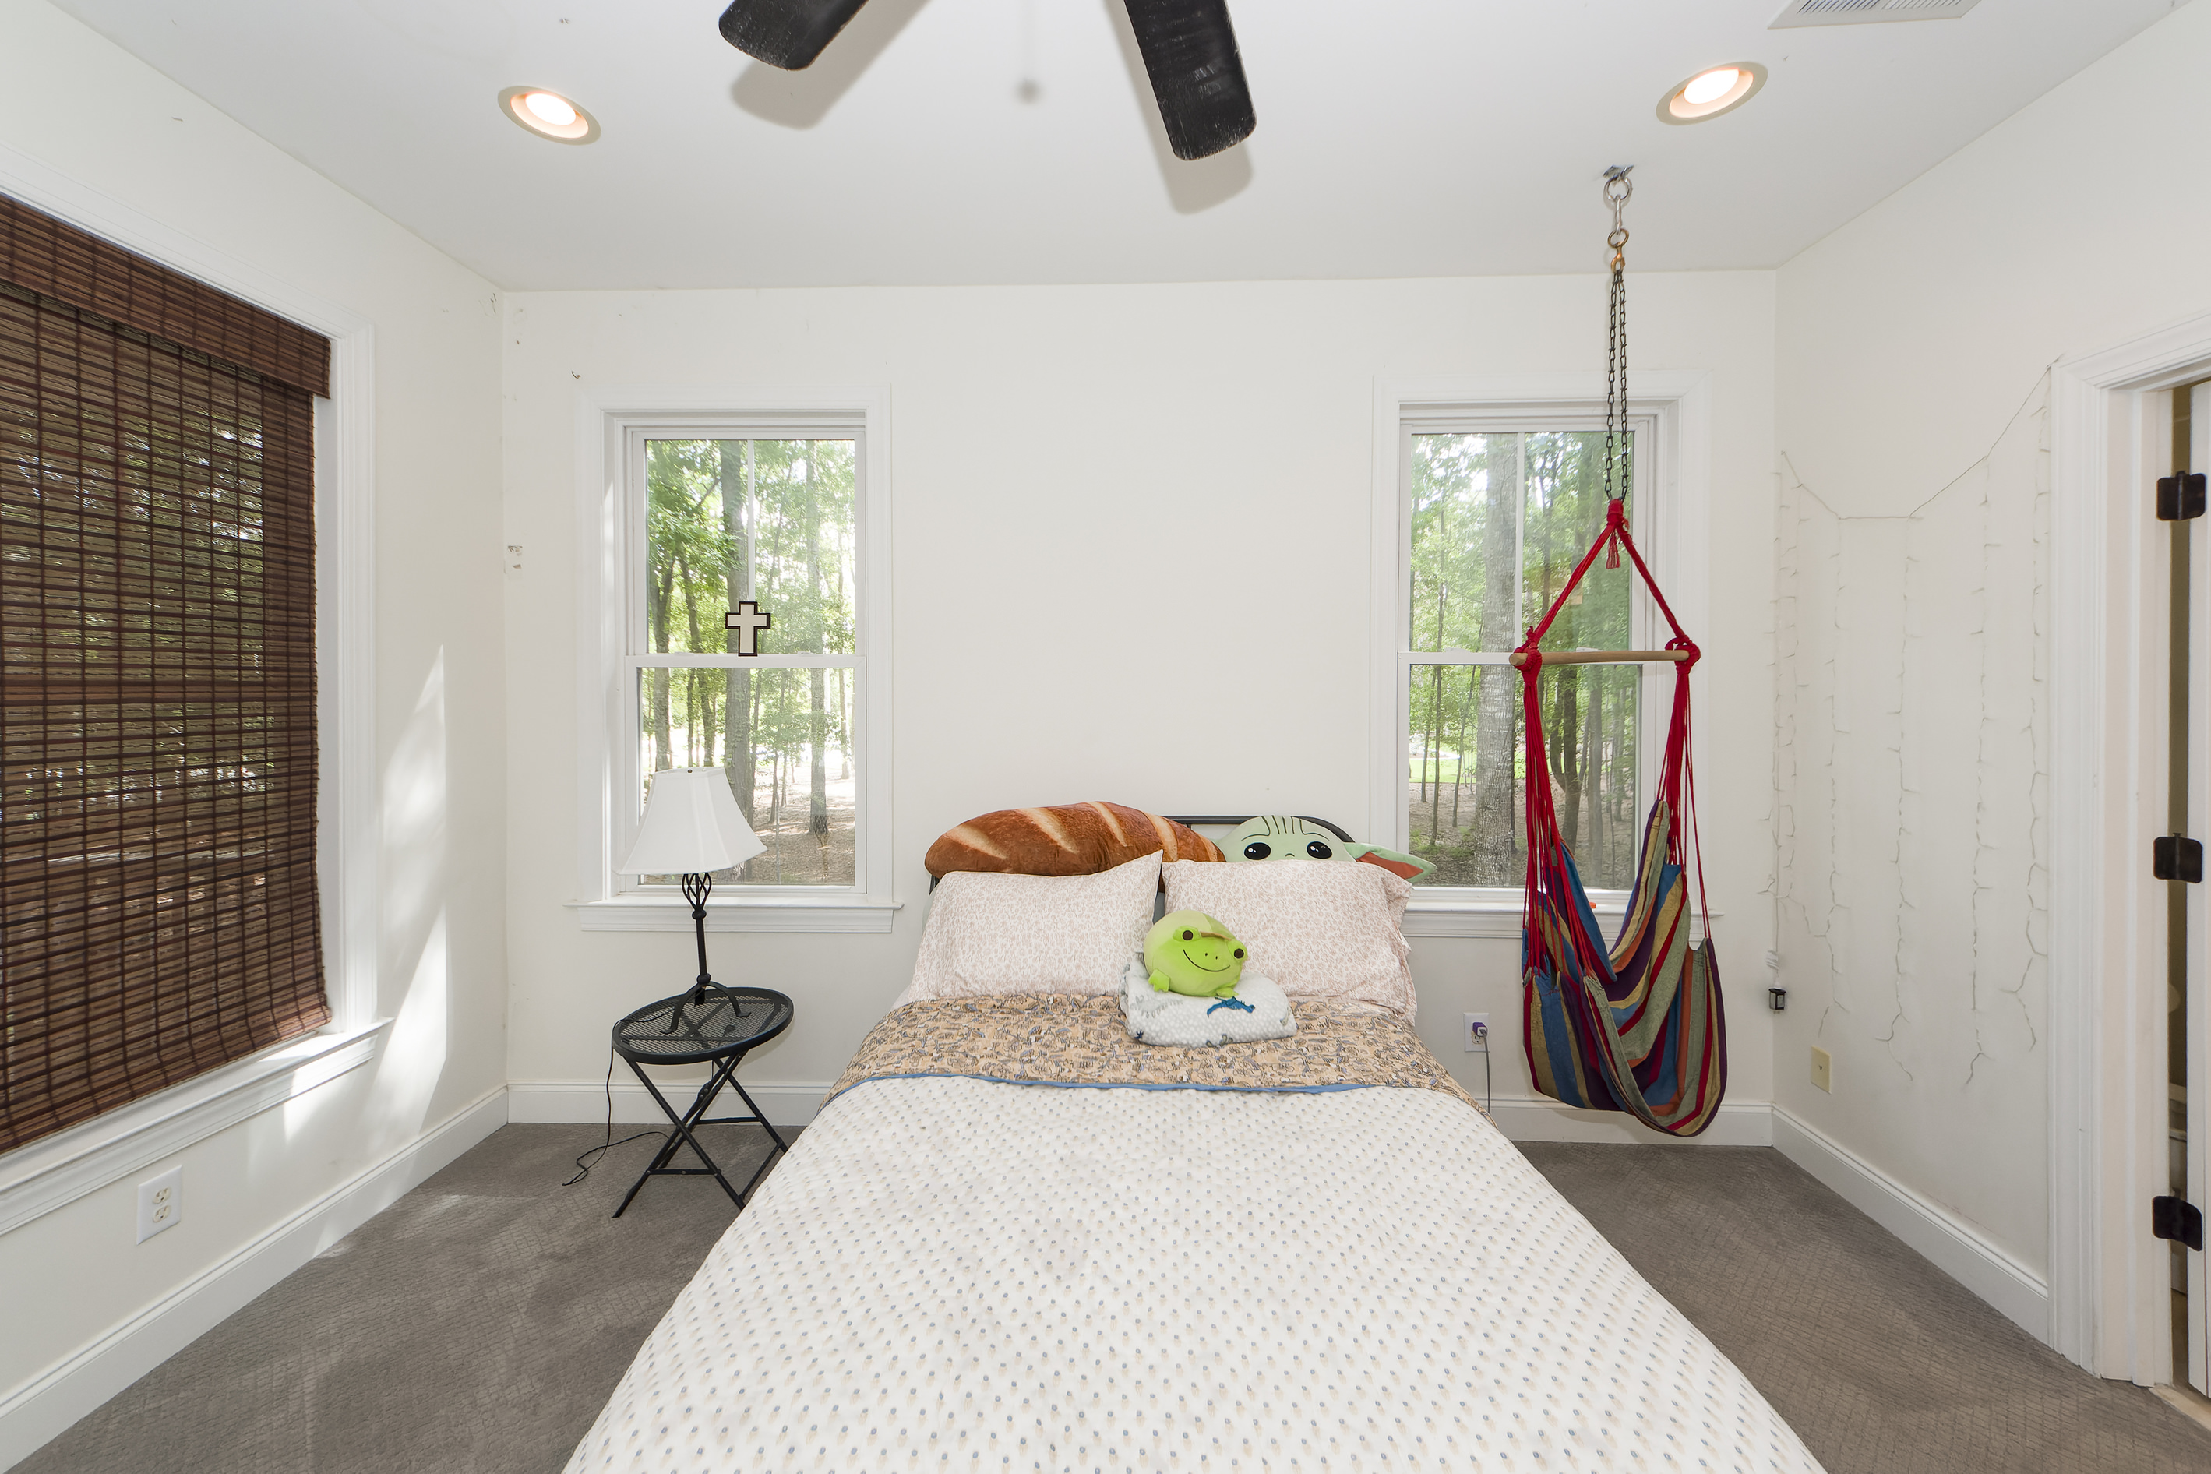
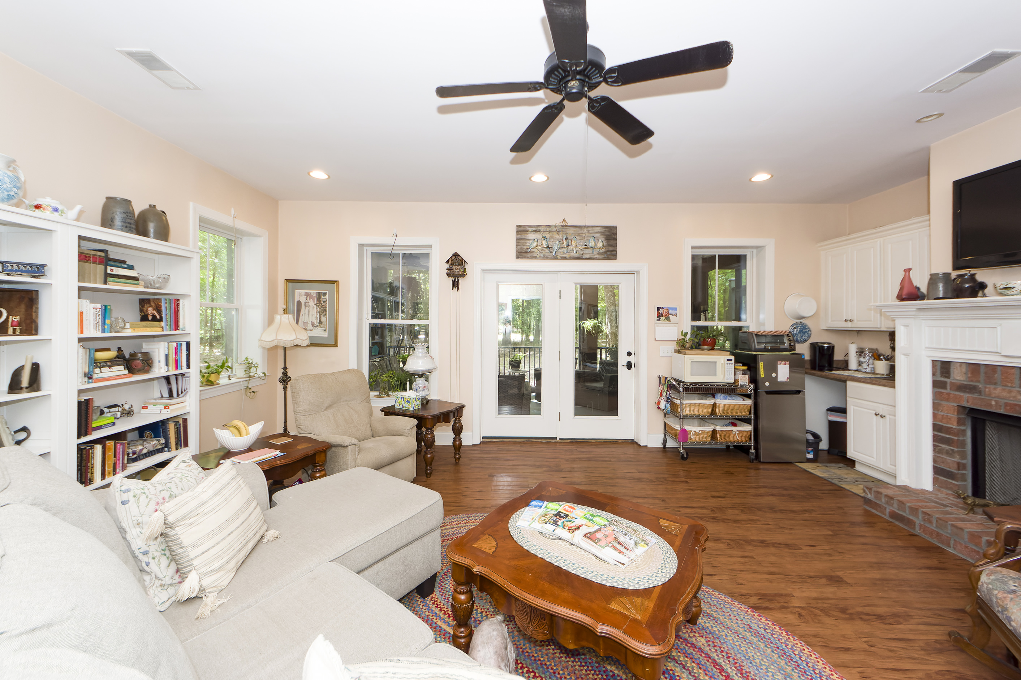
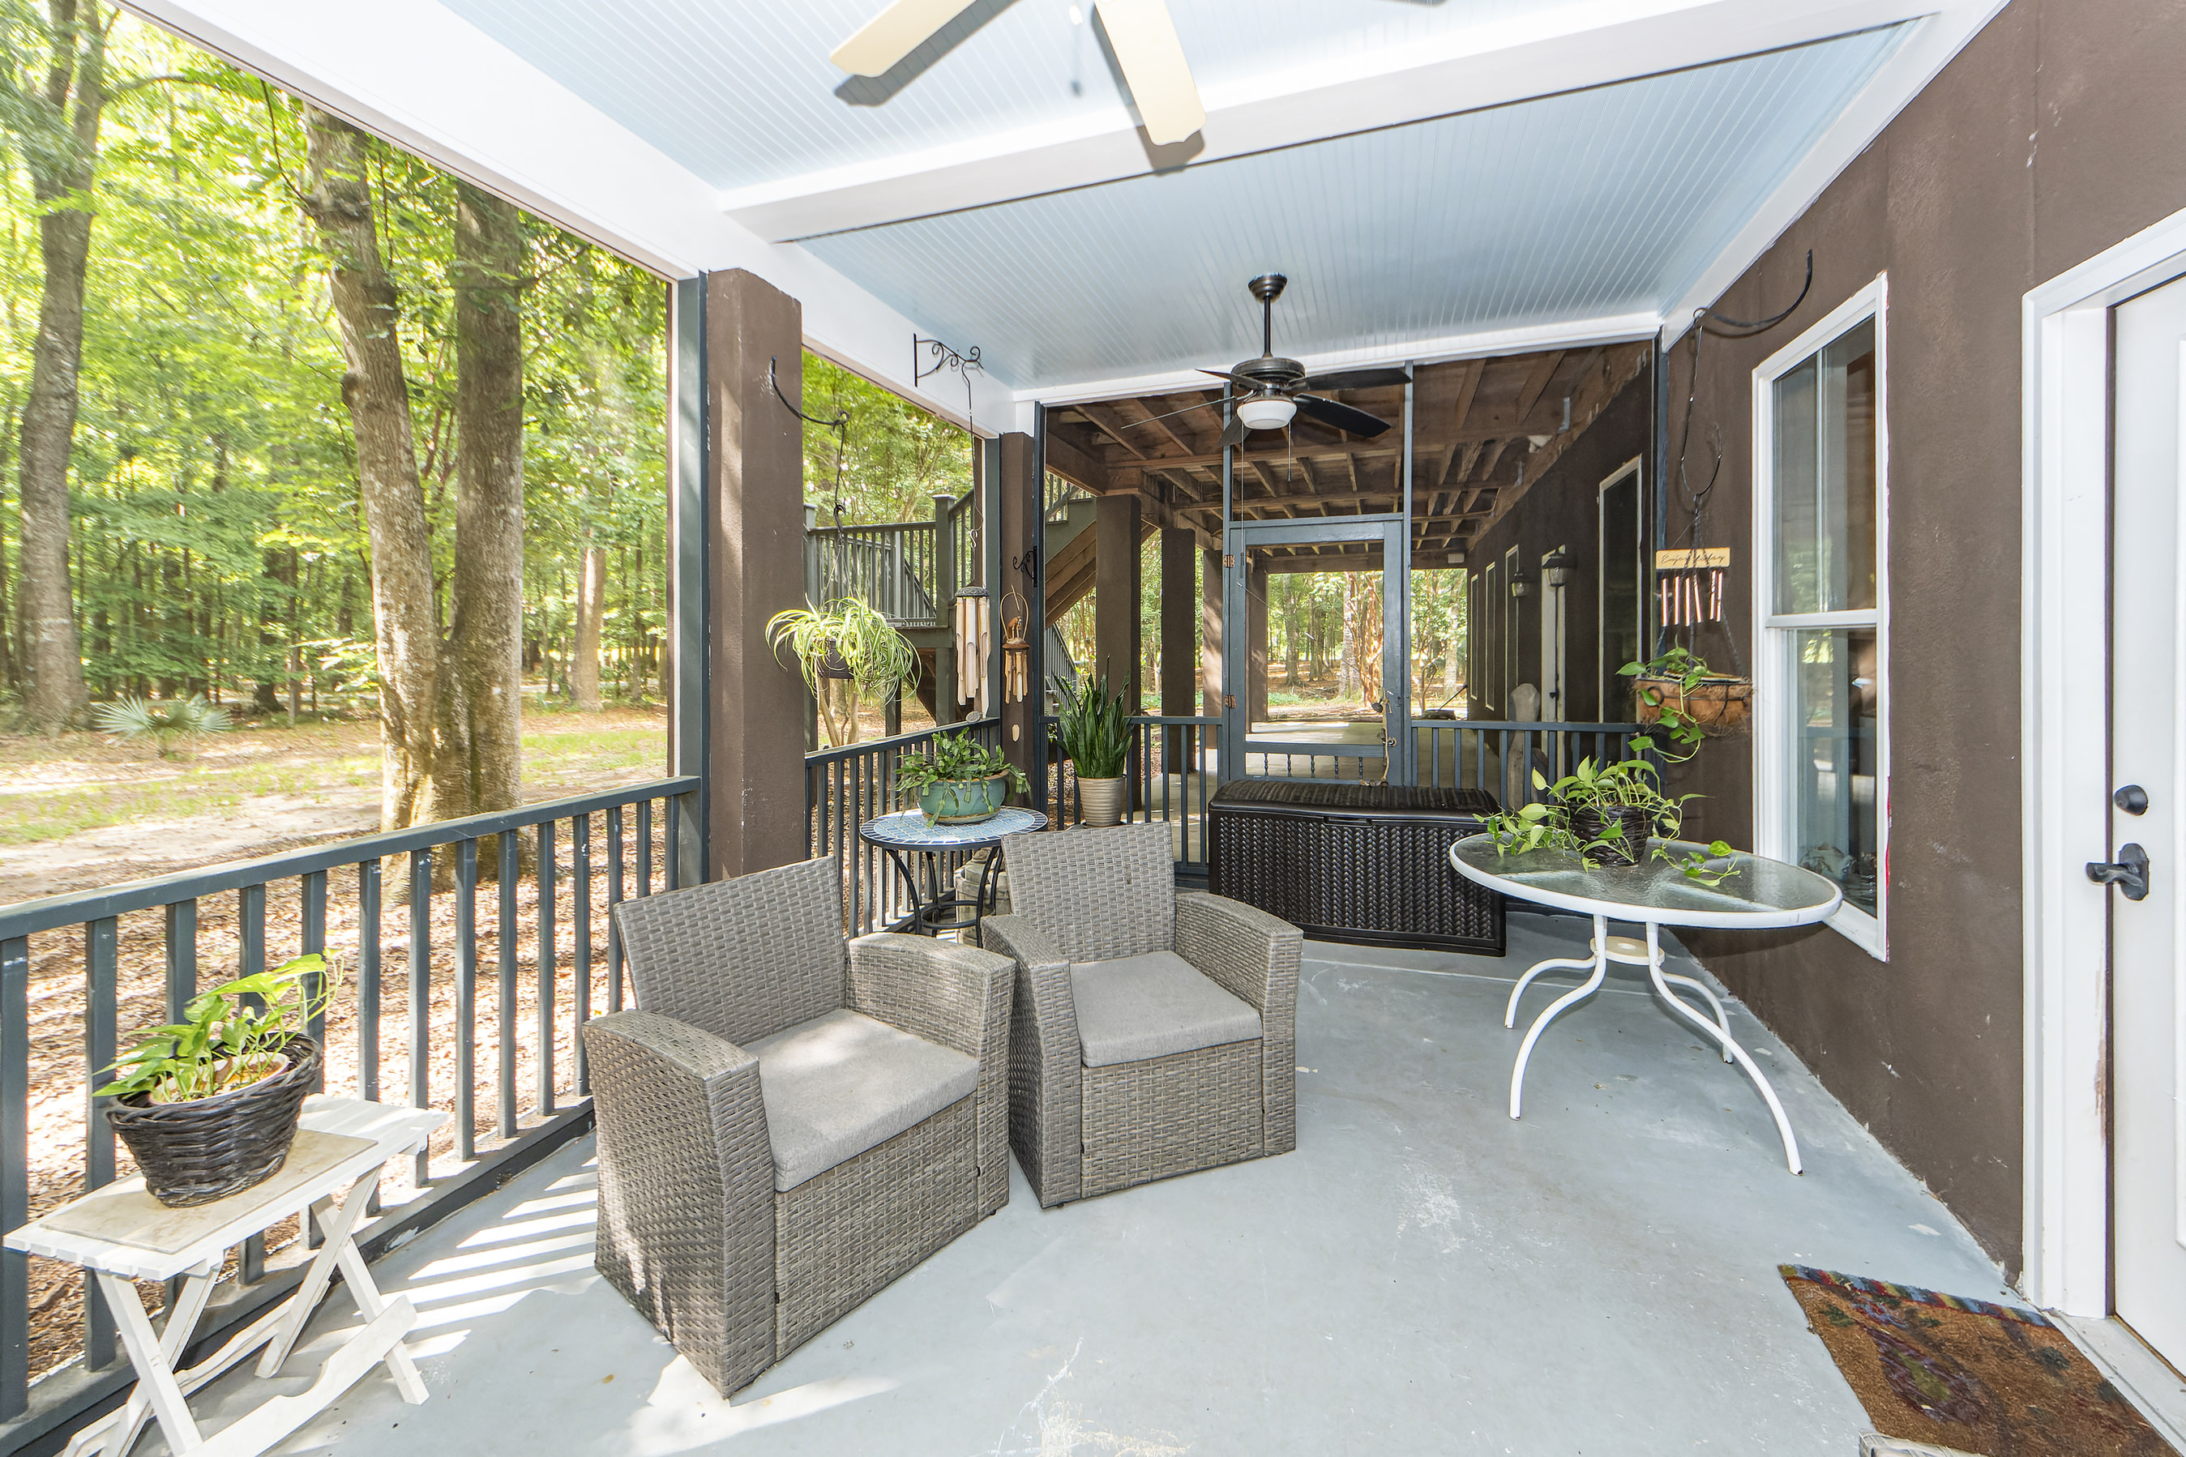
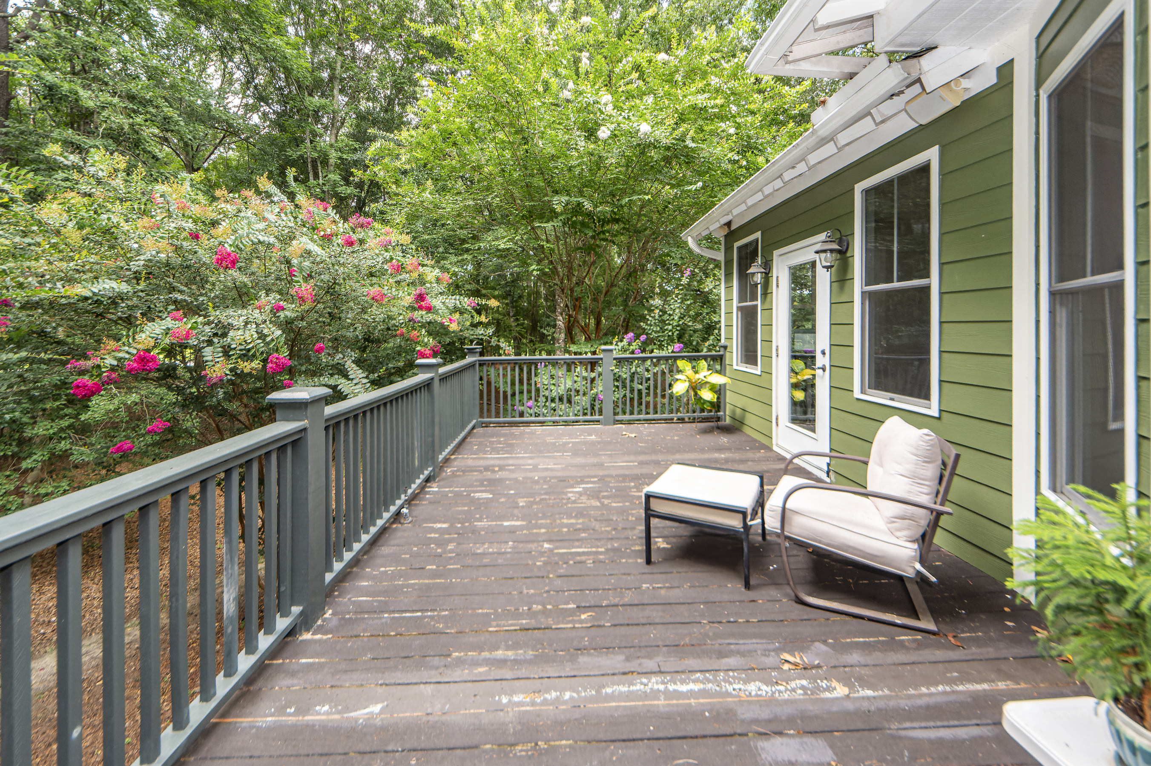
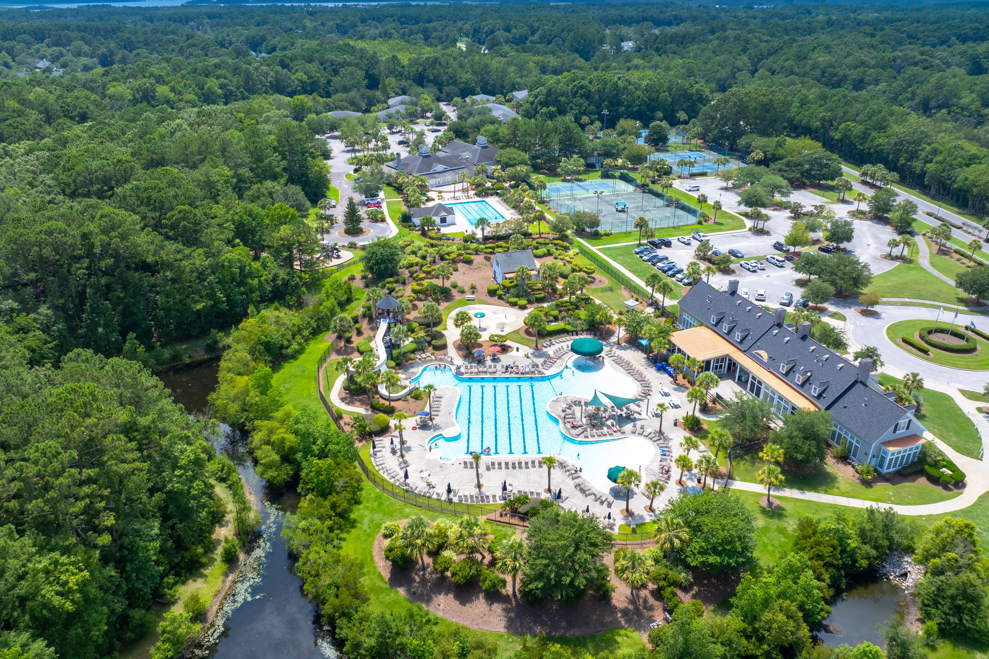
Lowcountry Home with Downstairs Apartment
This stunning 5br, 4.5ba low country custom built home by Simonini Home Builders has been meticulously cared for situated on a .60 acre heavily treed lot on large pond in private gated community of Popular Grove. This spacious , two story, 4721 square foot home features master bedroom suite on the first level, full front porch, beautiful heart pine wood flooring, large entry foyer which separates the private study from formal dining room, open gourmet kitchen with Wolf 6 burner gas stove, built in SubZero refrigerator/freezer, dishwasher, microwave oven and large pantry. Half bath/Powder room under stairway and large utility room for washer and dryer and deep sink and built in cabinets off hallway. The smaller den with gas log fireplace opens to kitchen and breakfast room. The larger fireplace opens to kitchen and breakfast room and offers expansive views of the water year-round. The living room with its second gas log fireplace is great for entertaining away from dining areas. The large master bedroom suite is located on the first level and has travertine tile flooring in the master bath, his and hers walk in closets, separate vanities, soaking tub, and a large separate shower. There is a game room with separate stairs over the two-car garage large enough for a pool table. The second level boasts 4 spacious bedrooms and three bathrooms. On the rear of home is a large screened in porch and open deck overlooking firepit and pond. To reduce maintenance the exposed wood decking has been replaced with Trex decking and exposed rail caps with PVC. Yard has irrigation system and 120-gallon buried propane tank. Sellers just replaced roof with 50 year architectural shingles with transferable warranty. The two electric water heaters have been converted to a single LP gas fired tankless water heater. New epoxy coating on floors and newly finished walls now in two car garage. Neighborhood amenities include Privacy gate, Boat Ramp, Dock facilities, Exercise area, Pool, RV/boat storage and walking/jogging trails. Don't forget the fantastic equestrian center for your horses!
3147 Cottonfield Drive
Dunes West | Mount Pleasant, SC 29466 | MLS# 24017823 | $1,250,000
Elevated one story custom home with porches on the front and rear. There is a 3-car garage and a ground level mother-in-law suite on a large private wooded lot. MIL suite has family room w/fireplace, full bath & bedroom. MIL suite has access to screen porch & laundry room. Elevator shaft. Main living area...dining room., great room w/ fireplace, breakfast room, and gourmet kitchen with access to second screen porch & deck. Large owner’s suite with double closets, soaking tub , separate shower & private access to the back deck. On the other side of the main living area are 2 bedrooms with a shared bath and access to porch. 2 laundry rooms. Amenities include golf, pool, & tennis memberships. Community pool and tennis/pickleball are a very short walk away. Award winning Mt Pleasant schools
4
3
1,844
Chip Aydlette
843-819-2467
chip@carolinaone.com
Tommy Lovett
843-442-1276
tlovett@carolinaone.com
Charlotte Gerber
843-330-0014 cgerber@carolinaone.com
Carolina One Real Estate | 628 Long Point Rd | Mt Pleasant, SC 29464-3032

