Slide 1
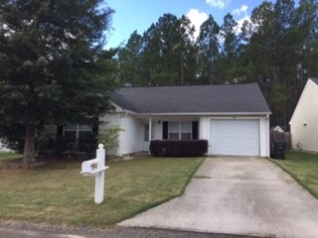
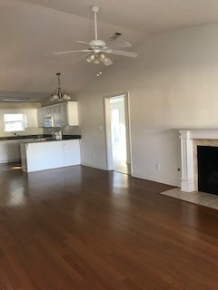
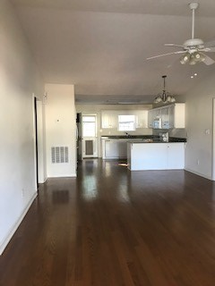
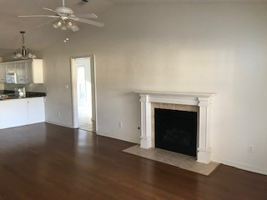
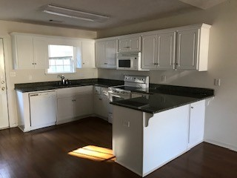
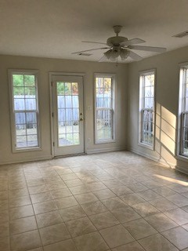
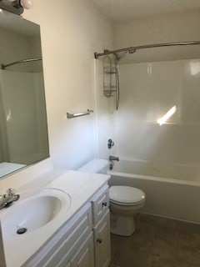
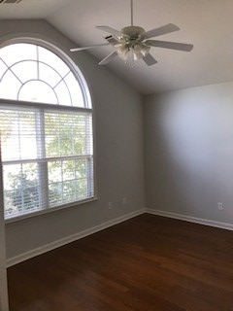
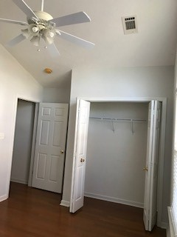
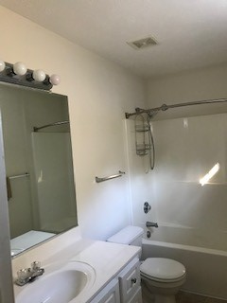

314 Beryl Drive South Meadows ~ Aiken ~ $147,500 ~ MLS #105135A
Just Reduced!
Open House
Sat 11am-1pm
Well maintained 3 bedroom 2 bath home on Aiken’s southside. This well designed floor plan features family room with fireplace and vaulted ceiling and open kitchen with granite countertops and white cabinetry. Hardwood flooring in family room, kitchen, hallway and bedrooms. Sunroom/den has ceramic tile flooring and lots of windows making it a bright and inviting place to relax.
Valli Catchpole
803-617-8540
valli1@me.com
Property Consultants of the South
1429 Lyon Dr SE
Aiken, SC 29801

