Slide 1
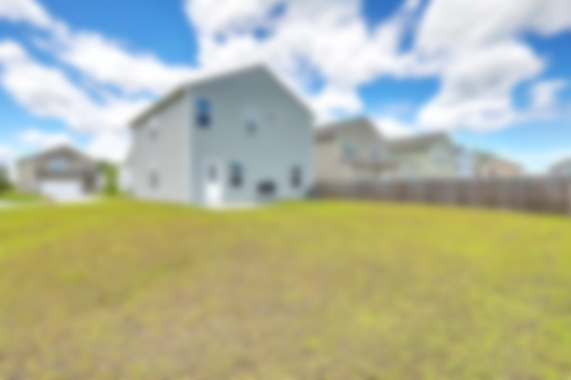
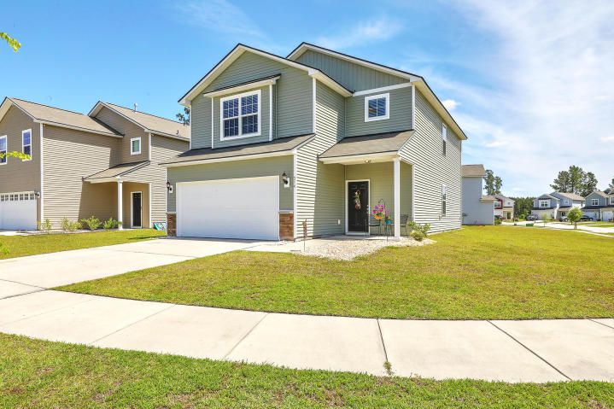

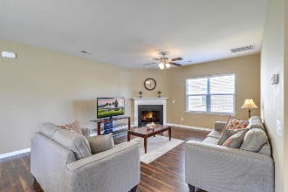
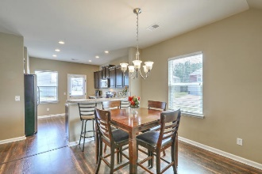
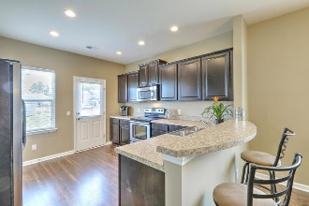
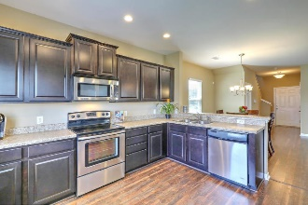
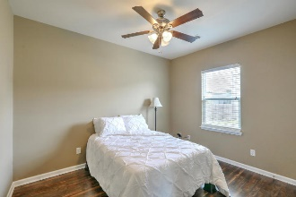
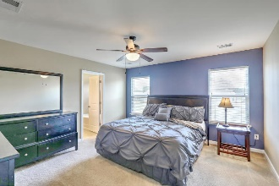
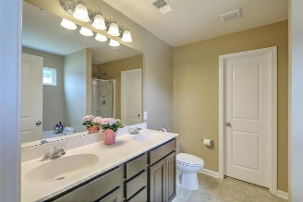
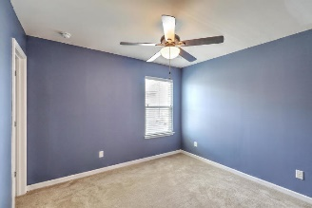
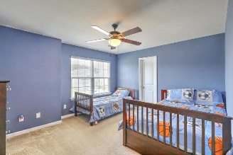


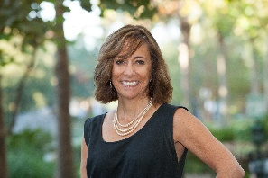
Just Listed - Spacious Cane Bay Home Open House Saturday from 11-1
314 Cantley Court
Cane Bay Plantation | Summerville, SC 29486 | MLS# 19013523 | $239,975
This beautiful, well-maintained home on a corner lot, features a large open floorplan that welcomes you as you enter the front door! Features of this freshly painted home include**BRAND NEW laminate flooring throughout first floor**Large kitchen with breakfast bar, plentiful cabinet and counter space and pantry**Large family/living room with fireplace offers a relaxing spot for entertaining**First floor Flex Room with closet and half bath that easily be converted into 4th bedroom or play/craft room or office**Upstairs is the real treat with a huge loft perfect for lounging and is surrounded by 2 guest bedrooms, guest bathroom, large laundry room**Escape to your Master ensuite which has a walk-in closet, dual vanities and separate garden tub and shower. The community pool and Pavilion that can be rented year-round is close by. Enjoy easy access to miles of trails throughout the Cane Bay Community. Schools, shopping, and restaurants are a golf-cart ride away. You'll love living here!
Desiree Maurer Office - (843) 416-2000
Mobile - (843) 327-9010 desiree.maurer1@gmail.com
www.yourcharlestonhousesearch.com
Keller Williams Realty 496 Bramson Ct Ste 200 Mt. Pleasant, SC 29464

