Slide 1
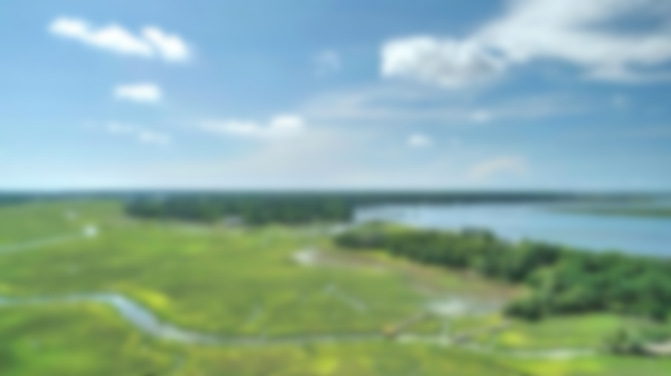
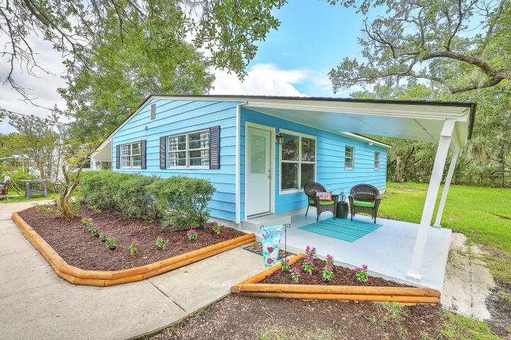
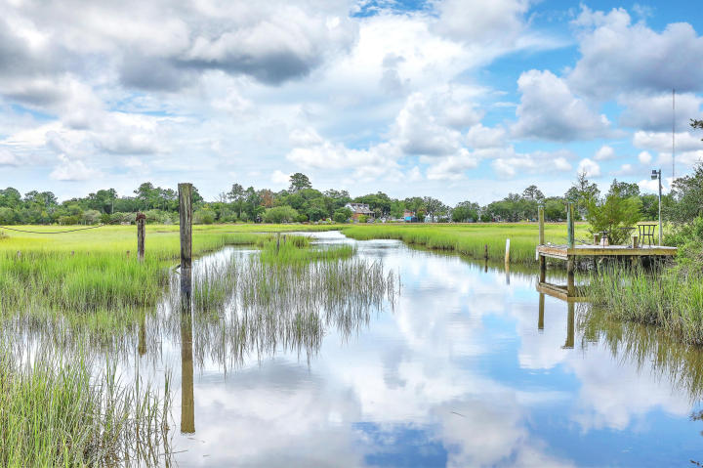
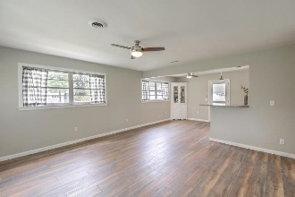
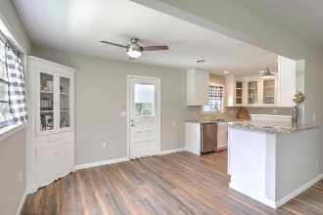
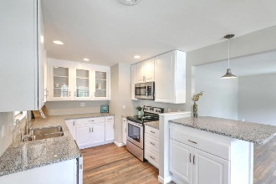
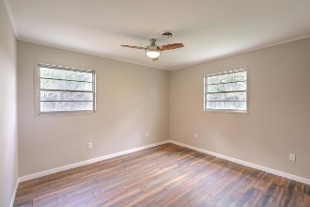
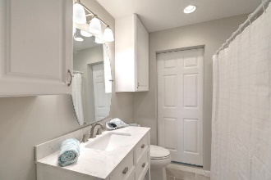
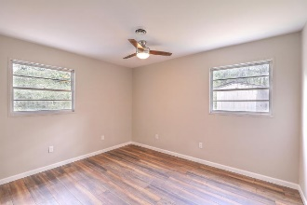
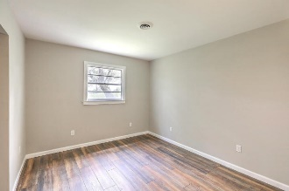
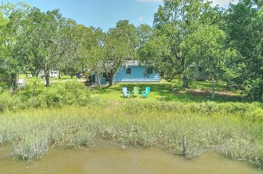
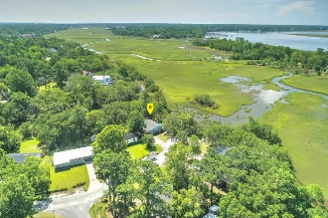
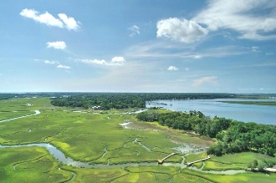


Join Us Saturday from 10a-2p
Just Listed – Waterfront Bungalow
314 Lantana Drive
Lantana | Charleston, SC 29407 | MLS# 18018808 | $424,777
A true hidden gem in this adorable renovated, waterfront bungalow w/its own tiny ''island''! Leave your stresses behind when sitting on your covered patio, listening to only the birds & rustling marsh grasses, enjoying Stono Creek views. Live oaks adorn this property & a boat landing is right at the edge so you can launch your jon boat, kayak or paddleboard into the tidal creek which leads out to the Intracoastal Waterway! Home Features: New Kitchen Cabinets, Granite Counters, S/S Appliances**Brand New Laminate Floors**Updated Bathroom**You are just a short ride to Avondale, the new Whole Foods, a new school close by, downtown Charleston & the West Ashley Greenway is an easy, close by, bike ride! NO HOA!! This is a truly unique opportunity to own your own waterfront slice of paradise!
Desiree Maurer
Office - (843) 416-2000
Mobile - (843) 327-9010
desiree.maurer1@gmail.com
www.yourcharlestonhousesearch.com
Keller Williams Realty
496 Bramson Ct Ste 200
Mt. Pleasant, SC 29464

