Slide 1
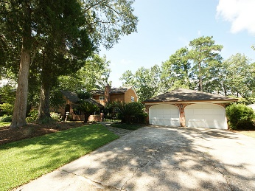
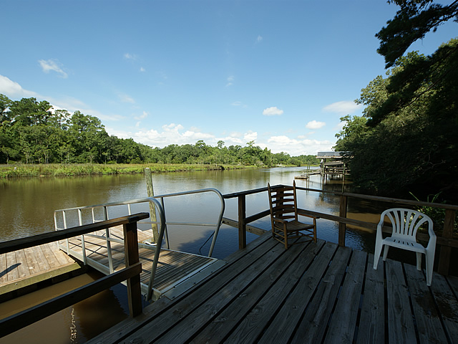
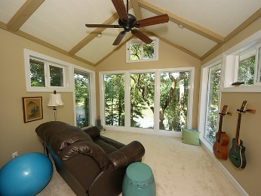
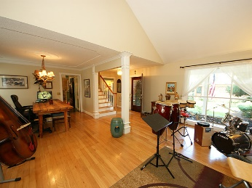
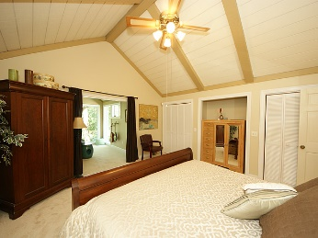
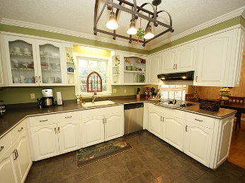
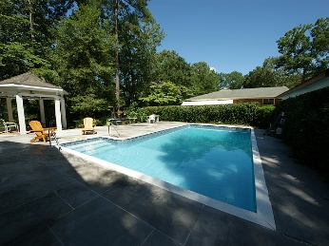
Deep Water On The Ashley River ~ Major Price Drop
314 Shaftesbury Lane
Summerville, SC 29485 ~ MLS# 16020652
Just Reduced to $656,000
Riverfront property with fantastic outdoor living space including a pool! This home has been meticulously renovated and is on the Ashley River with a dock and a floater. It sits on a bluff above the Ashley where beautiful views abound. Flood Insurance is not required. The exterior is old Charleston brick and cypress. The 1st floor master suite has a sitting area where you can look out over the Ashley while you have your morning coffee. The den has a pickled faux cypress finish and includes a wet bar with beautiful wood counters. The kitchen has corian counter tops and a nice pantry. The den looks out over the large swimming pool and the river below. You can also enjoy a fire under the gazebo in cooler months. Fish or throw the cast net from the dock which includes a jet dock, bring your boat! This truly is a unique property with many quality touches, you have to see it to fully appreciate the craftsmanship.
Mike Goldston, Realtor
mikesellscharleston@gmail.com | 843-343-7026 | www.cometocharlestonsc.com
Brand Name Real Estate | 4 Carriage Lane, Suite 106 | Charleston, SC 29407

