Slide 1
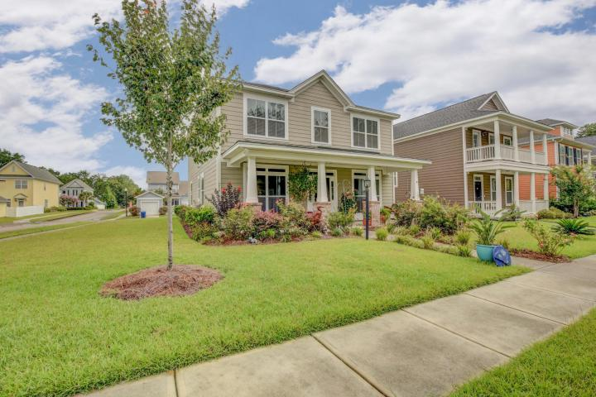
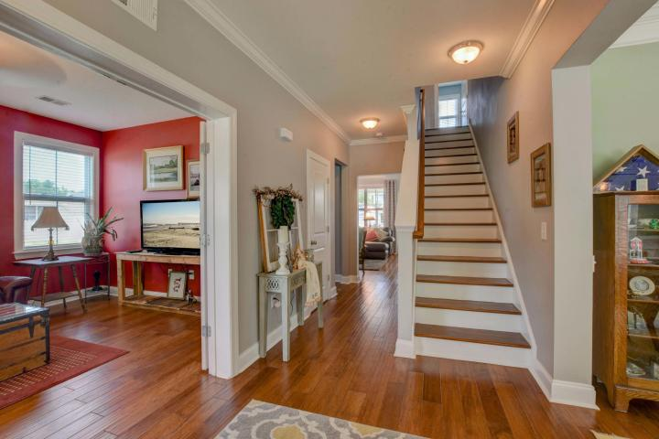
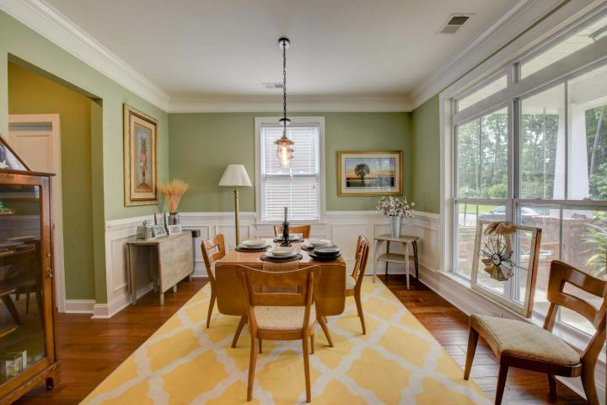
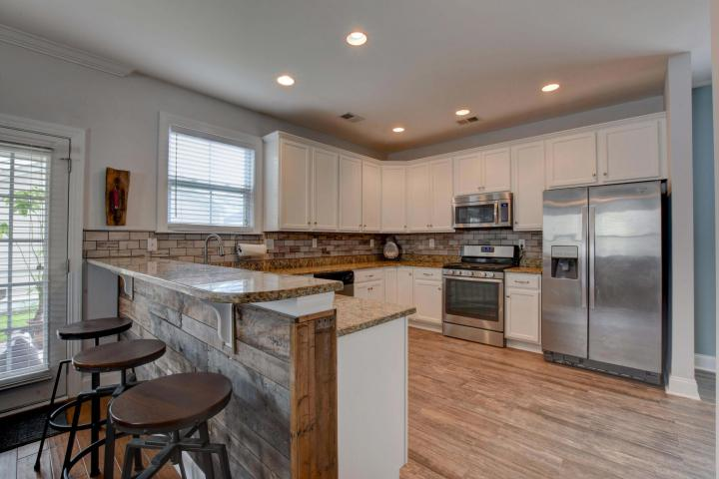
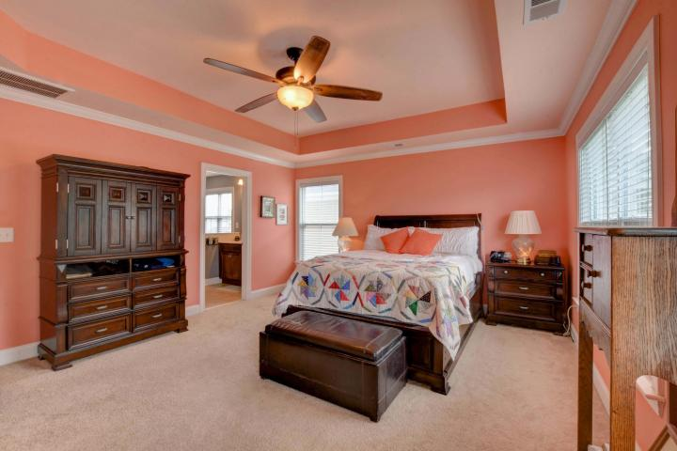
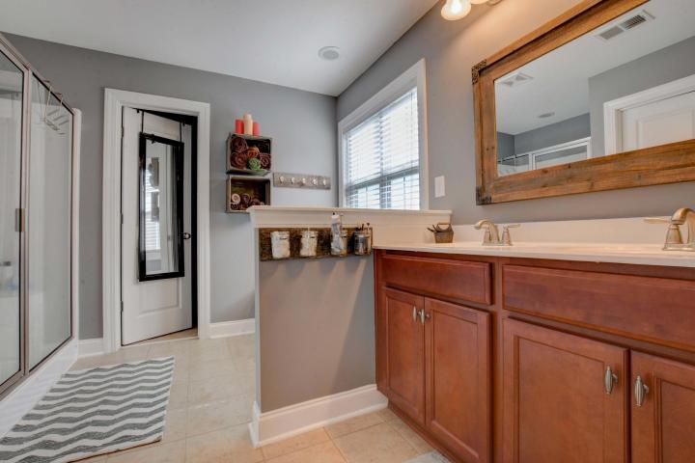
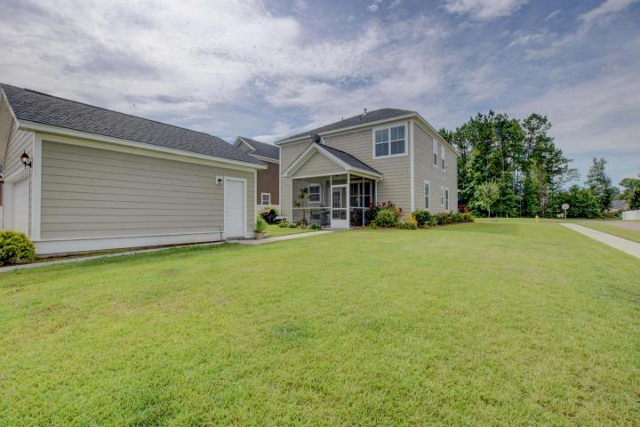

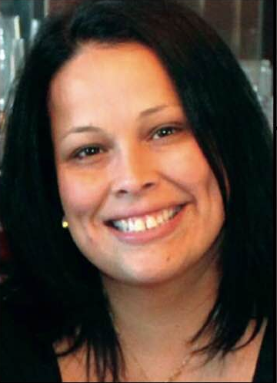
Come See This Home Today!
Corner Lot Better Than New Construction
314 Verbena Avenue
White Gables ~ Summerville
MLS# 17021883 ~ $278,000
MOTIVATED SELLERS! LOCATION LOCATION!
Premium corner lot with wooded view. Gorgeous curb appeal leads you to the quaint porch swing or rocking chairs. Take your shoes off to feel the grade 7 upgraded wood floors! Bonus/office adorned with French doors, crown molding across from formal dining room, picture molding and the perfect view through low windows with all upgraded trim throughout the entire home. Wide open kitchen comes dressed to the 9s! White upgraded 42" cabinets, tiled backsplash, granite countertops, upgraded gas oven, butler pantry, enormous pantry, ship lap accent walls, breakfast bar overlooks yard and just a few steps into the screened in patio out back to enjoy a quiet evening waiting on the ducks. Upstairs, find excellent sized secondary bedrooms all with ceiling fans, and upgrade 6" baseboards,& large closets. Master bedroom with ceiling fan, tray 9' ceilings are waiting for your king sized bed. master bath is garden sized tub, dual sinks and stand alone shower with caddy corner bench. walk in closet is huge! White Gables is located in Knightsville in the center of it all! DD2 schools and not even a mile from all everyday conveniences. Downtown Charleston is a 20 minute drive. Don't miss out on owning here with all the amenities your family looks for.
Lisa Horan
Full Service Realtor
843-501-8856
lisaghoran@gmail.com
AgentOwned Premiere Group • 100 Crowfield Blvd • Goose Creek, SC 29445

