Slide 1
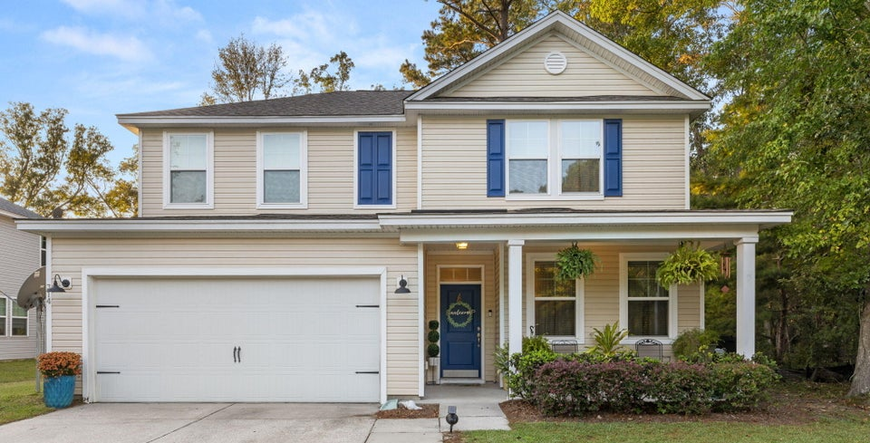




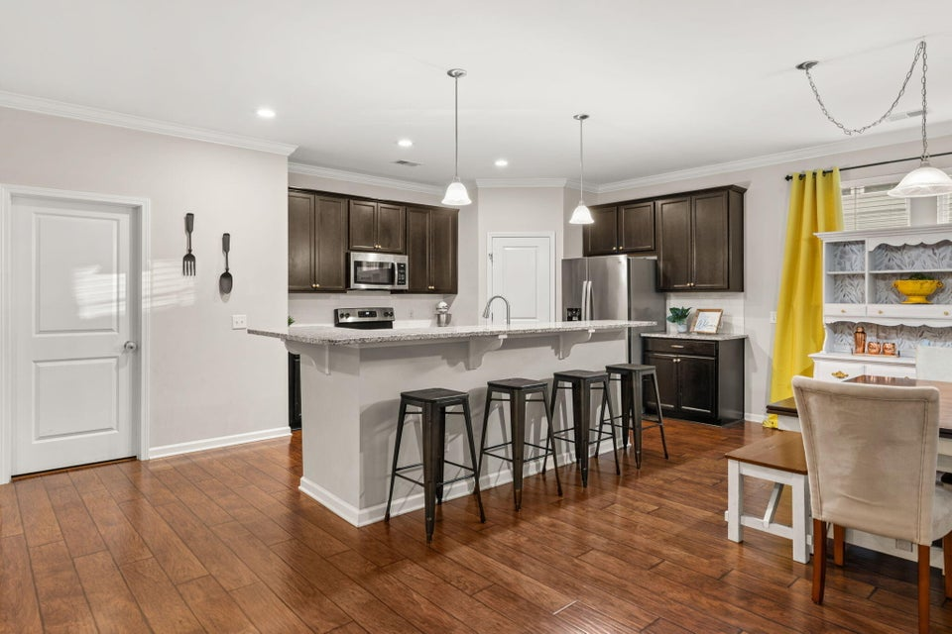
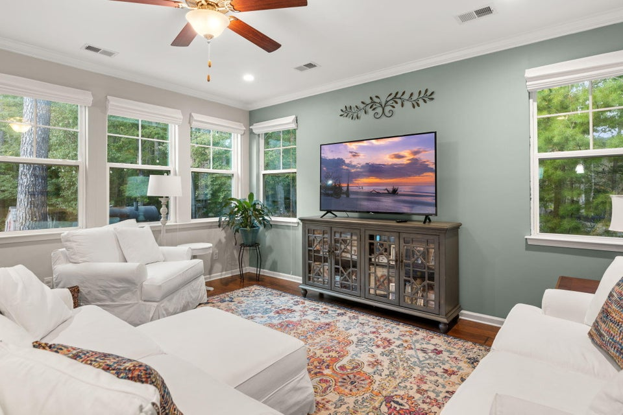
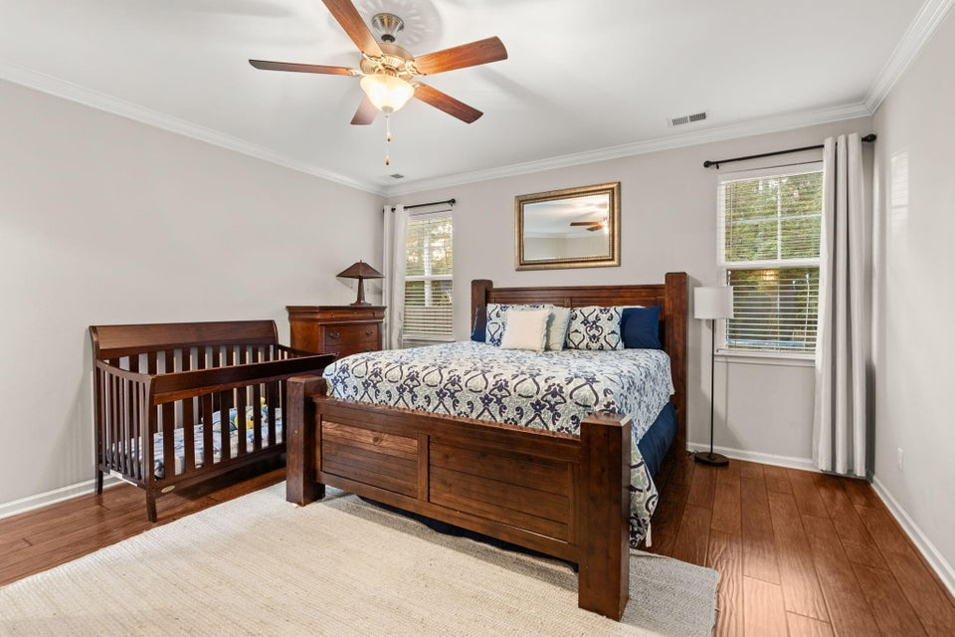
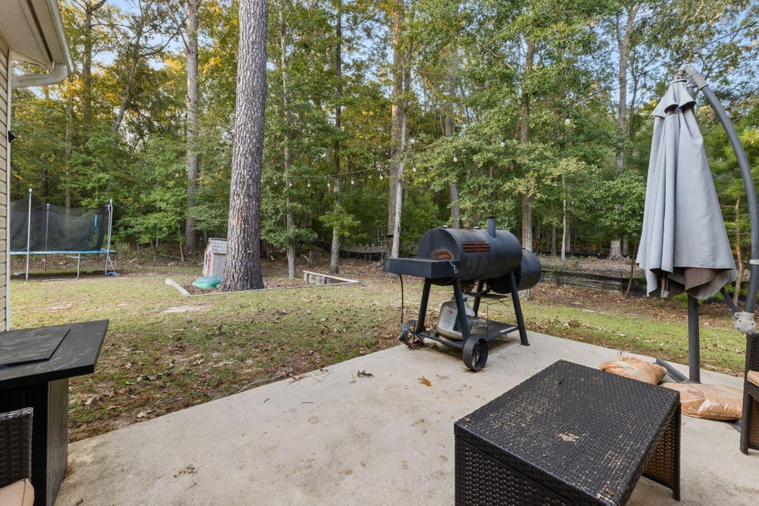

Like New, No HOA!
314 Beverly Drive
Ladson, SC 29456 | MLS# 24026163 | $460,000
Are you looking for the convenience of the Bridges of Summerville but not the confines of an HOA? Then this is the perfect house. Set 2 houses outside of the Bridges on Beverly Dr. and perfectly located in DD2 Schools. Just 10 minutes to Summerville's Historic downtown. Known for its beautifully landscaped parks, charming shops, delicious local restaurants, and lively atmosphere. This Hunter Quinn Saluda 2 was crafted with thoughtful design in mind, ensuring every inch of space is maximized for functionality and comfort. You will find plenty of closet space! This spacious 3,000 sqft home features a well-thought-out layout with 4 bedrooms, 2.5 bathrooms, a study, and a loft, offering plenty of room for both living and entertainment. The spacious primary suite is conveniently located on the first floor, offering privacy and ease of access. It includes an ensuite bathroom with double vanities, a walk-in shower, and a huge walk-in closet. This home sits on a larger wooded lot, offering both privacy and natural beauty, all while enjoying the freedom of no HOA. Out back you will have easy access to the almost finished Pine Trace Natural Area. The park will feature an extensive trail system throughout the mature mixed hardwood forest, bike/pedestrian connections, 6-acre fishing pond, fishing pier, kayak launch, shelters, playground, disc golf course, dog parks, and primitive group camping area
VIDEO TOUR
Kerry Roberts 843-304-5689
kerrysellscharleston@gmail.com
Realty ONE Group Coastal
1510 Trolley Rd
Summerville, SC 29485

