Slide 1
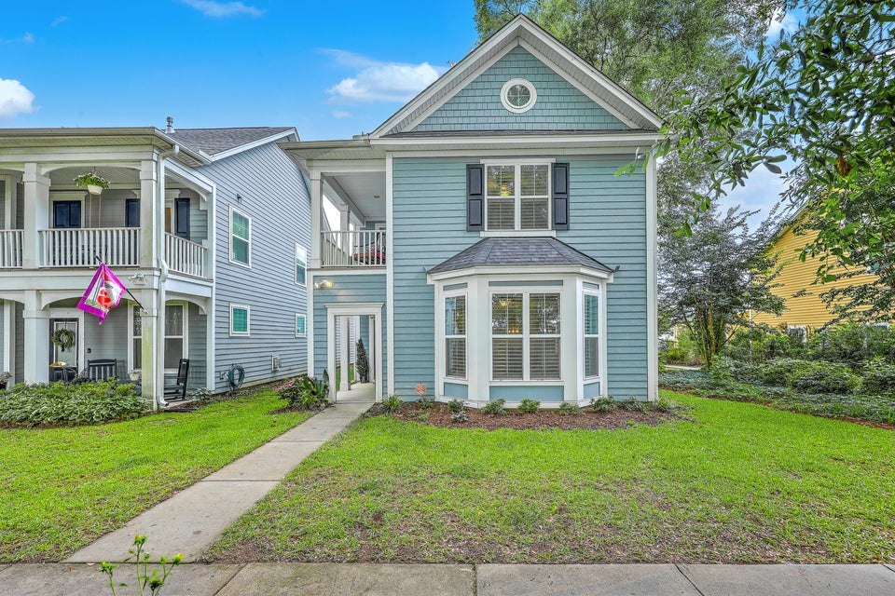
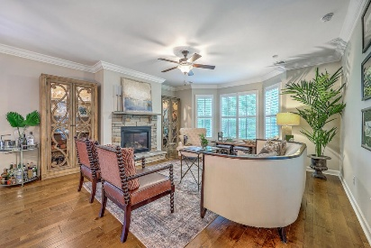
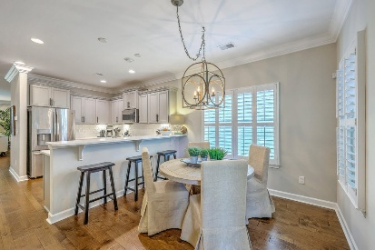
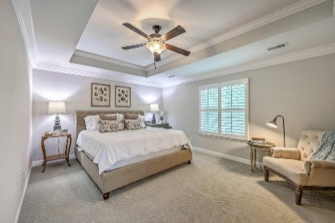
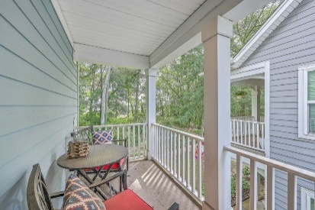
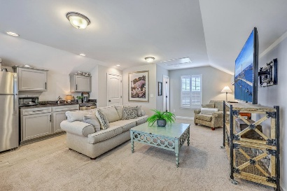
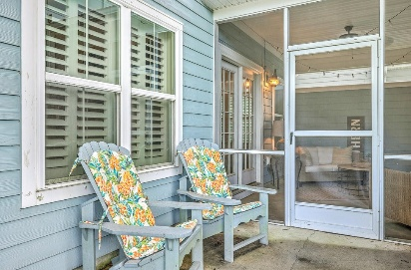
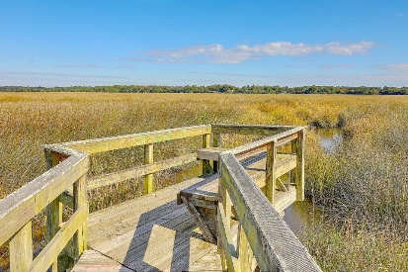


3152 Riverine View
Magnolia Bluff | Charleston, SC 29414 | MLS# 25015784 | $600,000
NEW PRICE! SELLER MOTIVATED!
UP TO 1% OF SALES PRICE 1-YEAR RATE BUY-DOWN
PRICED $10,000 BELOW RECENT APPRAISAL!!! Welcome to this beautifully maintained and thoughtfully appointed home, ideally situated on a premium Marsh view lot. Blending modern design with classic charm in this popular floor plan, you will love the tasteful upgrades and exceptional flexibility for today's lifestyle. The inviting foyer leads to an upgraded powder room featuring designer wallpaper, a stylish cabinet and sink and a fabulous light fixture-setting the tone for the rest of the home. The kitchen is a true standout, featuring quartz countertops, a tumbled tile backsplash, modern hardware on all cabinetry, and all major stainless appliances-which convey. Wood plantation shutters throughout, upgraded lighting fixtures in the dining room, kitchenette and foyer, and gutter guards are just a few of the thoughtful additions the seller has made. The spacious owner's en-suite is a private retreat, offering a large bedroom with a tray ceiling, two generous walk-in closets, and a luxurious bathroom, complete with a separate garden tub and walk-in shower, dual vanities and a linen closet. Step outside unto your covered porch and enjoy the marsh view and front yard oasis-ideal for morning coffee or evening relaxation. Two additional bedrooms, full bathroom and laundry room complete the second floor. One of the standout features of this home is the versatile fourth bedroom suite located above the garage. With its own secured private entry, full kitchen and bathroom and closet, this space is perfect for guests, multigenerational living, or as a potential income-producing rental. Conveniently located to dining, shopping, interstate, area beaches and downtown Charleston.
Enjoy a virtual tour!
Beth Mandell
M 803-463-7734 | O 843-871-2121
bmandell@century21properties.com
www.bestcarolinahomedeals.com
Century 21 Properties Plus of Summerville | 568-A Savannah Highway | Charleston, SC 29407

