Slide 1
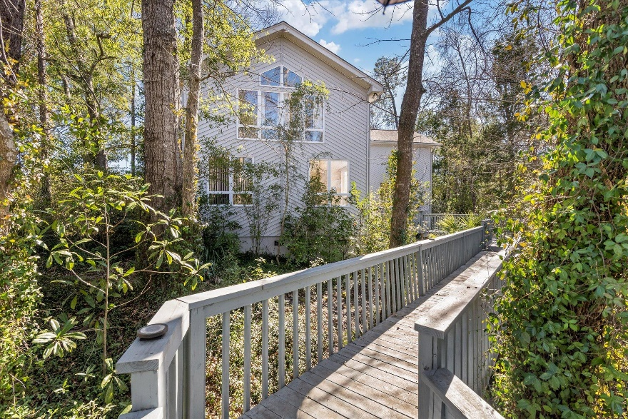
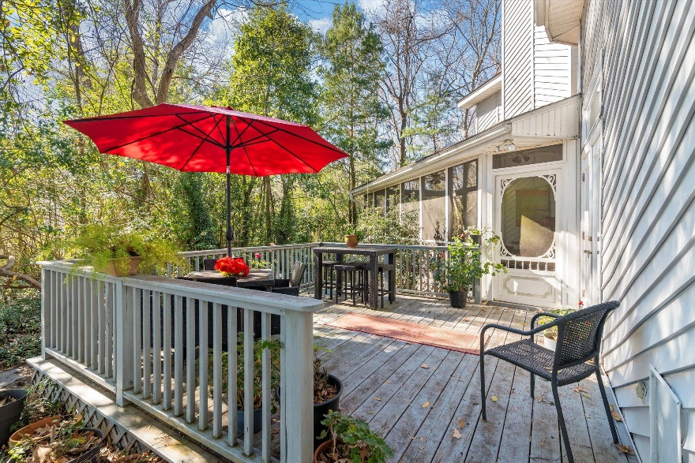
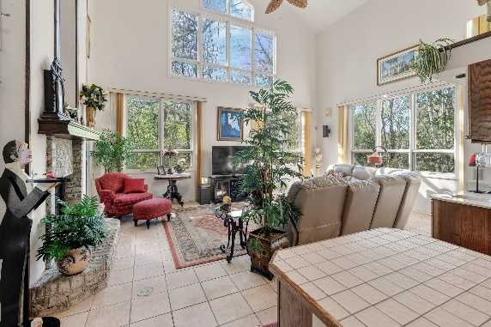
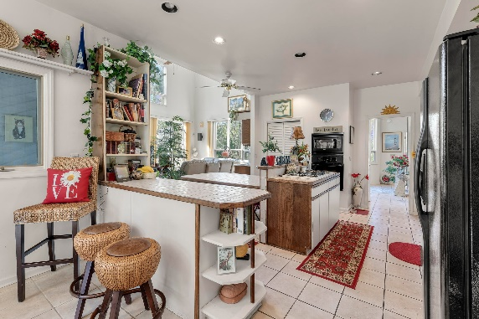
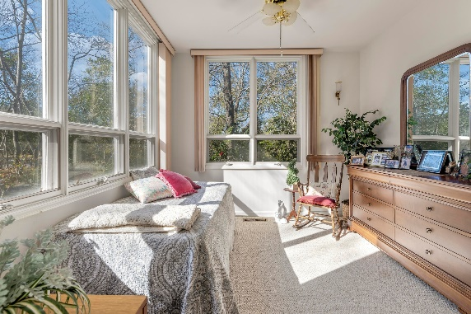
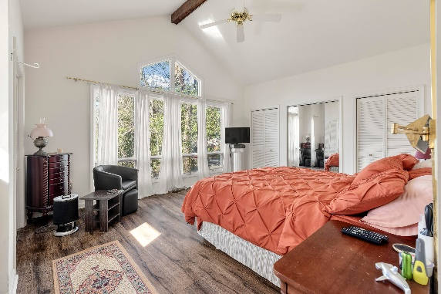
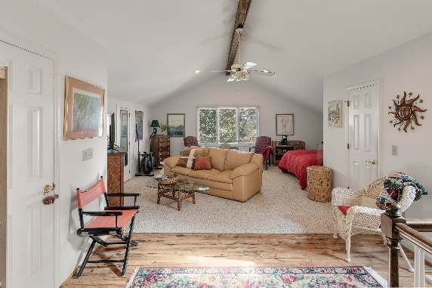
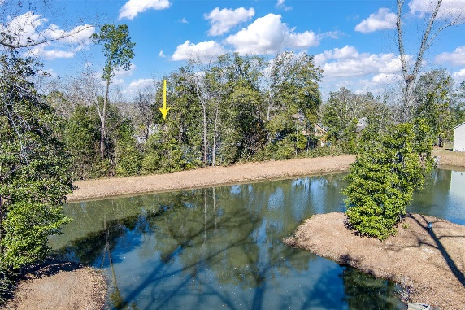

Pricing Improved Secluded Home in the Trees Minutes to Downtown
3153 Stanyarne Drive
Maclaura Hall
Charleston, SC 29414 MLS# 24002298 | $599,100
If you love a natural landscaped setting … Welcome Home!
The architecture of this home will give you the Mountain & Tree house feel to your daily living. Home features a vaulted ceiling , 2nd story loft, Custom windows and cabinets. Sit outside on the covered screened porch which opens to a deck overlooking the pond and wetlands. This well-established neighborhood is close to major roads which gives you easy access to Downtown Charleston and surrounding areas. Finished Frog with bathroom provides a private room for guest with private entrance.
Take a Virtual Tour
Nanette Piccirillo
843-345-8942
nanette@thomasmasi.com
Steven Olson
843-412-9848
solson1071@aol.com
AgentOwned Charleston Group | 902 Savannah Hwy | Charleston, SC 29407-7802

