Slide 1

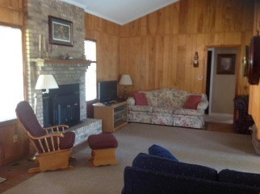
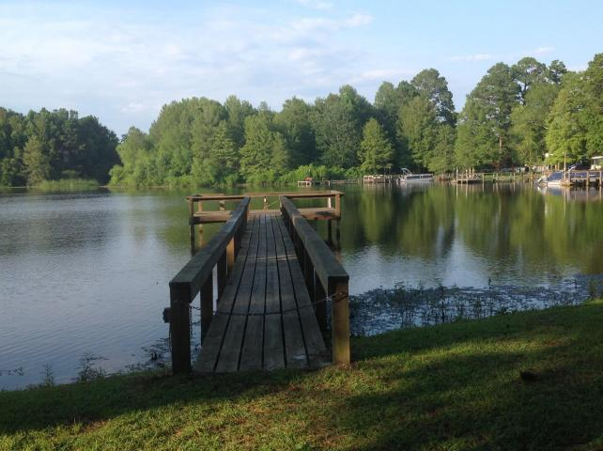
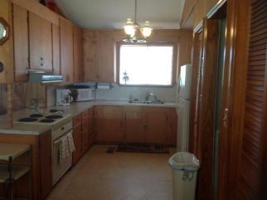
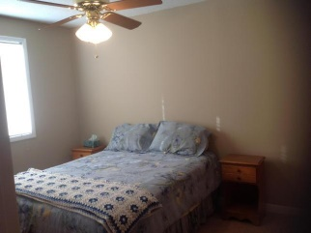
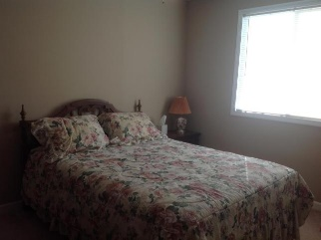
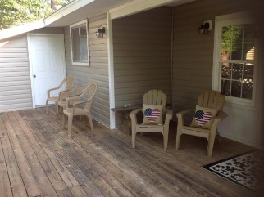
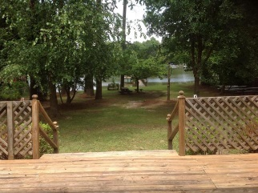
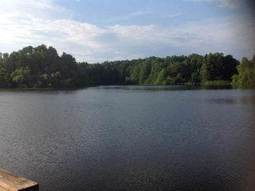

WATERFRONT LAKE MARION!
Great 4 bed/2 bath home with a beautiful view and its own dock!
315 Belvedere Drive
Belvedere II | Eutawville, SC 29048
MLS# 18019058 | $285,000
4 Beds | 2 Baths | 1,262 Square Feet
Well maintained waterfront 4/2 home on Lake Marion. Located on quiet cove with access to big water. Great place for family getaways or move to the lake full time. Back porch overlooking the scenic lake views. Close to public lake access (boat ramp). Book your appointment today!!! Golf cart does not convey.
Carla C Davis
Mobile - (843) 437-4873
gaweber@tds.net
AgentOwned Premiere Group
141 A N. Main Street
Summerville, SC 29483

