Slide 1
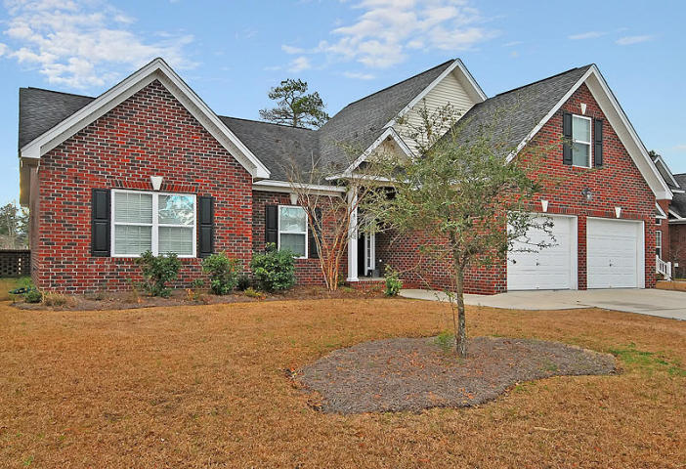
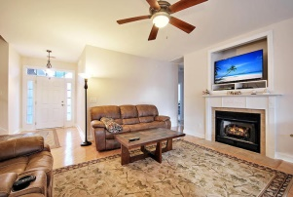
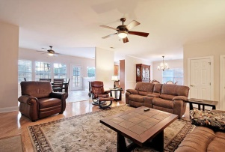
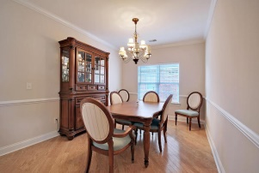
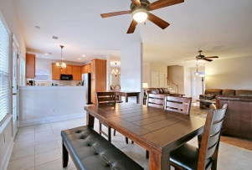
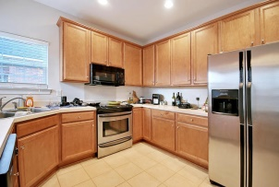
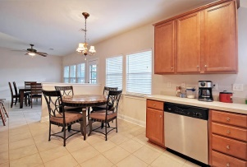
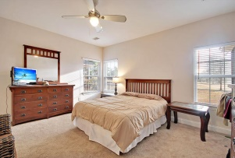
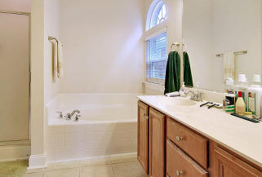
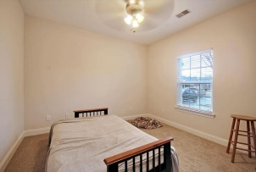
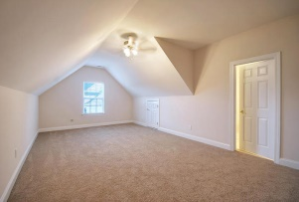
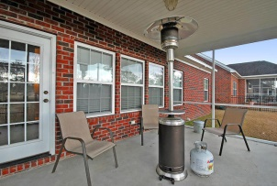
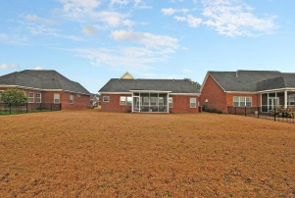


Lowest Price on the Golf Course
315 Renau Boulevard
Pine Forest Country Club
Summerville, SC 29483
MLS# 15001639
$279,900
4 Bedrooms | 2½ Baths | 2,400 sf
This beautiful one story, brick, golf course home is in excellent condition and offers 4BR, 2.5BA with 3 bedrooms on the ground floor. The large family room has hardwood floors and a gas fireplace. Buyers will also find a dining room, huge eat-in kitchen area and kitchen with stainless steel appliances and ample cabinetry. The screened porch overlooks a large backyard and the golf course with water beyond. The master bedroom also overlooks the golf course and has a walk in closet and master bathroom with dual vanity, garden tub and shower. Two additional bedrooms are downstairs and share a full bathroom. The FROG is the only room upstairs and can be used for almost anything but could be a 4th BR if needed. The FROG has a half bathroom attached to it. Laundry room is also downstairs. The home has a two car garage that is extra deep with plenty of room for storage, gas water heater, wired for alarm system. This one story, golf course home is a MUST see!
Larry & Kathy Mazalatis
Larry Cell 843-693-0529
Kathy Cell 843-693-0159
Office 843-871-9133
AGENTOWNED PREMIERE GROUP | 1800 TROLLEY RD | SUMMERVILLE, SC 29485

