Slide 1
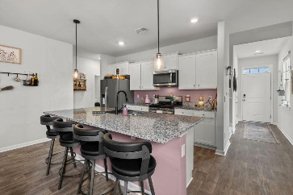
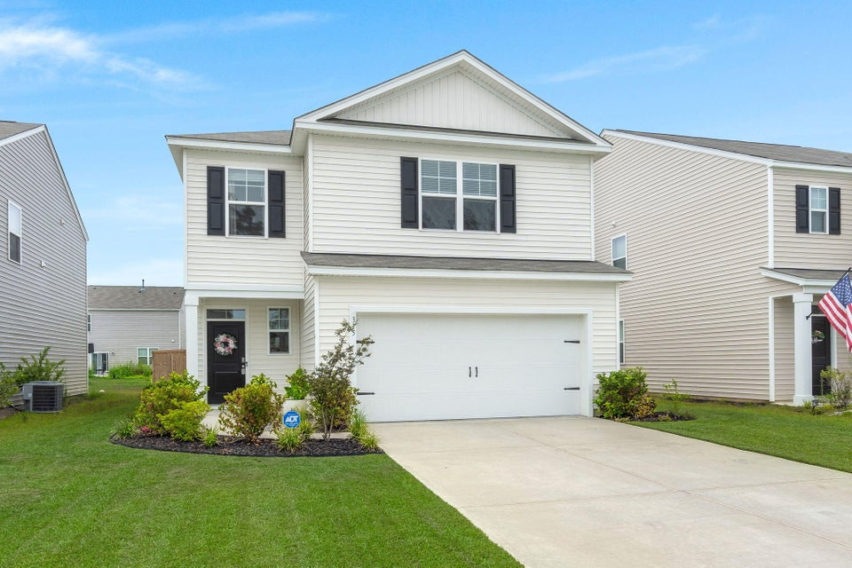
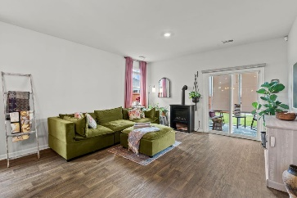
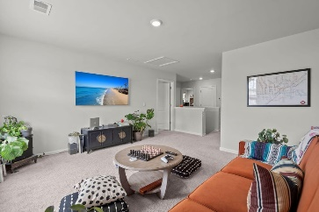
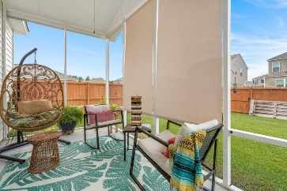


$10,000 PRICE REDUCTION
PLUS $2,500 AGENT BONUS
315 Black Birch Drive
Cane Bay Plantation | Summerville, SC 29486 | MLS# 24019547 | $399,900
WELCOME HOME to the long-awaited Pine Hills at Cane Bay. With the resort-style amenities, vacation is merely steps away! DON'T wait for construction and eliminate the potential of dreaded delays with this better than new home. Rest easy knowing you are located in the front of Pine Hills, on a short quiet street with little to no through traffic! Upon your arrival, you are greeted with an inviting front porch accompanied by luscious landscaped surroundings, offering a warm welcome to residents and guests alike. Walking through the front door, prepare to immerse yourself into your very own paradise with this light and airy and ever so popular Manning floor plan that boasts 4 bedrooms, 2.5 baths and 2257sq ft. This exceptional home standouts with countless tasteful upgrades and improvements.
From the foyer, attractive wide plank flooring guides you down the hall to a seamless open floor plan effortlessly connecting the kitchen, dining, and living room, establishing an inviting environment for both everyday living and entertaining. The well-appointed kitchen stands as the heart of the home, boasting a generously sized island, granite countertops, custom lighting, stainless steel appliances, pantry and plenty of cabinet space. A cozy living room space adorned with sliding glass doors that are equipped with motorized blinds, opens up to the expanded custom screened patio, extending the living area outdoors. This would truly make the perfect spot for al fresco dining or enjoying a morning cup of joe, while overlooking the perfectly landscaped yard. For utmost convenience retreat to the main floor primary suite, complete with a generously sized walk-in shower, double vanity bathroom and large walk-in closet that provides plenty of storage. Completing the main floor is a lovely powder room, storage closet and dedicated laundry room that provides comfort and convenience.
Upstairs a versatile landing flex space awaits, ready to be transformed into a home gym, playroom, or a casual living area to suit your lifestyle. Three more thoughtfully designed bedrooms, a full bath and another storage space on the second floor provides additional convenience and functionality. The fenced yard offers security and space for recreational activities, completing the picturesque setting of this remarkable home. Living in a community with amenities like a resort-style pool, water slide, walking and bike paths, playground, and a splash pad can enhance the overall experience of residents, offering opportunities for relaxation, recreation, and socializing! *$1,400 Lender Credit is available and will be applied towards the buyer's closing costs and pre-paids if the buyer chooses to use the seller's preferred lender. This credit is in addition to any negotiated seller concessions*
Robert Jacoby 843-455-7075
Jericha Jordan 843-568-1767
jericha@charlestonpropertyexperts.com
Charleston Property Experts
513 Ruby Dr
Mt Pleasant, SC 29464

