Slide 1
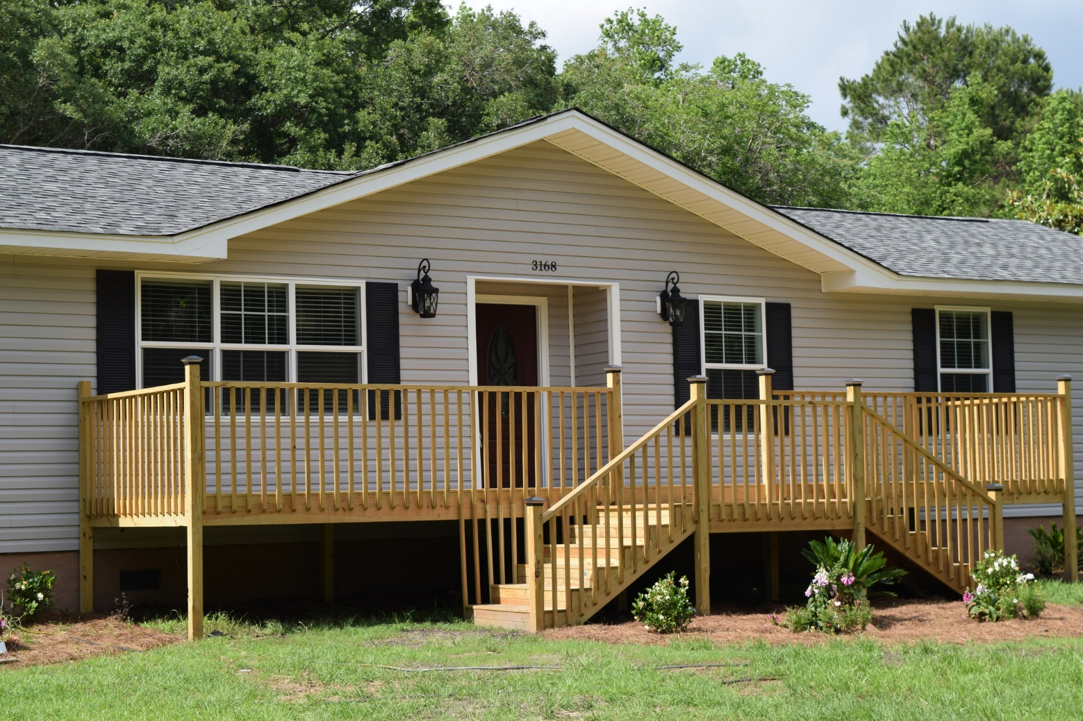
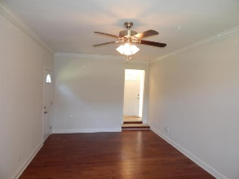
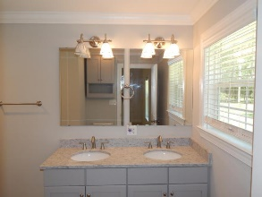
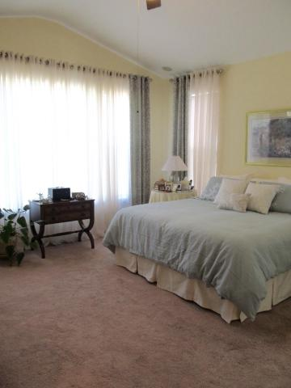
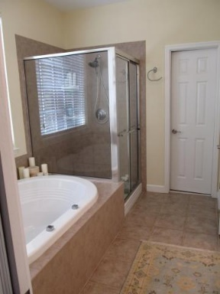
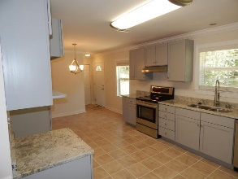
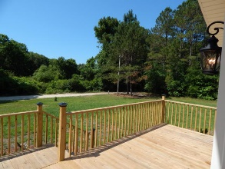
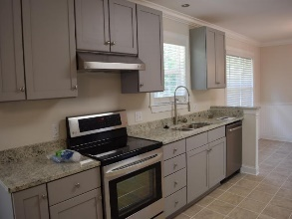
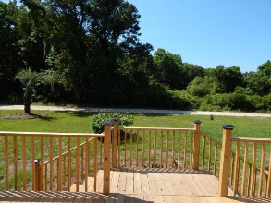
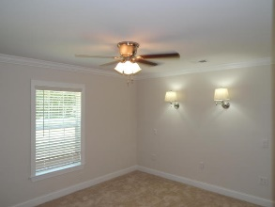
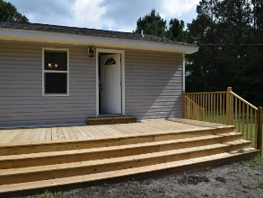
Open House Thurs 10-12
3168 Thomas Jones Road
Johns Island, SC 29455 ~ MLS# 16012299 ~ $278,800
Gate Passes Available
$5,000 toward buyer's closing cost.
$5000 agent bonus w/ BIC approval.
NOT A MOBILE HOME!
A fully updated conventionally built home with new stainless steel appliances, new cabinets, granite counter tops, architectural tiles, quality hardwood floors, carpet crown molding and wainscotting are among the special touches in this private oasis. The upgraded master bathroom has new tile and a spa tub with jets.
New roof and upgrades in every aspect makes it a better than new home! Large decks on the front and back and over 1.3 acres give you many options for relaxing or entertaining. PRIVACY! NATURE! Convenience! Perfectly positioned on John’s Island close to downtown and Folly Beach. Flood Zone X - No Flood Insurance Required!
Owner is SC licensed Real Estate Agent
Christopher Watson
(843) 471-0956
chris@chriswatson.com
Harbourtowne Real Estate | 672 Marina Drive, Ste 110 | Daniel Island, SC 29492

