Slide 1
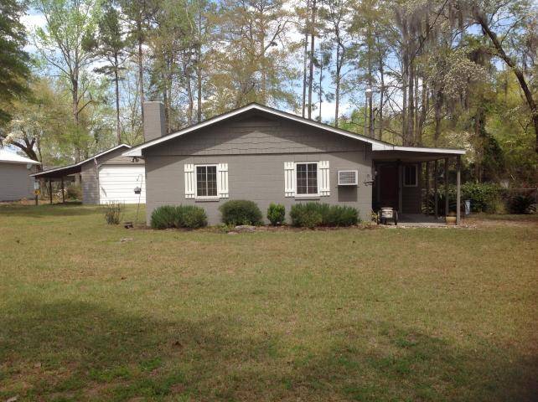
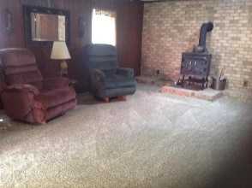
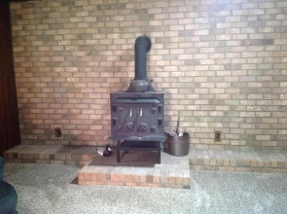
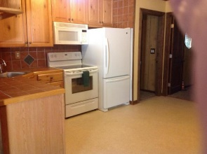
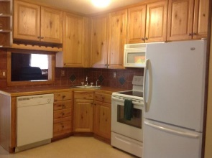
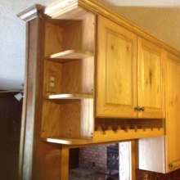
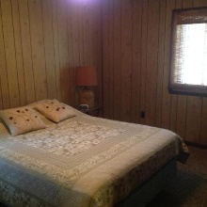
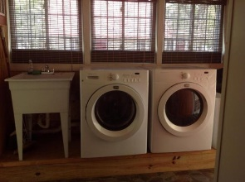
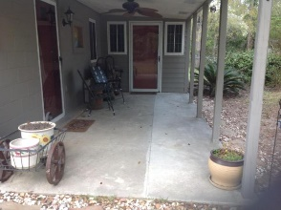
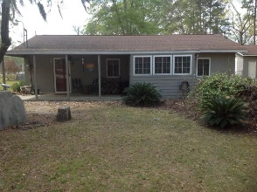
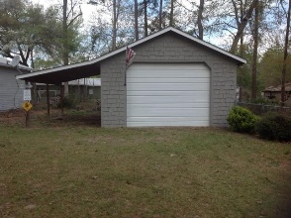
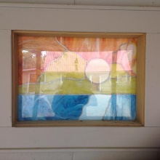

Large Workshop Within Minutes Of Little Cathead, Lake Marion!
316 Sinkler Avenue
Eutawville, SC 29048 | MLS# 17008956 | $119,900
2 Beds | 2 Baths | 960 Square Feet
Well maintained lake property that is ready for your family! This property has 2 bedrooms, 2 bathrooms and a HUGE workshop, and it is less than a mile to Little Cathead boat landing.
Adjacent property (310 Sinkler) is also for sale if you are looking for the perfect lake property for both you and your family or friends!
Carla C Davis
Mobile - (843) 437-4873
gaweber@tds.net
AgentOwned Premiere Group
141 A N. Main Street
Summerville, SC 29483

