Slide 1
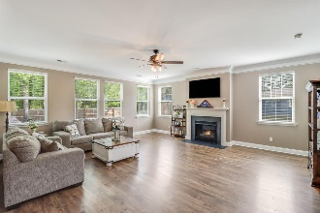
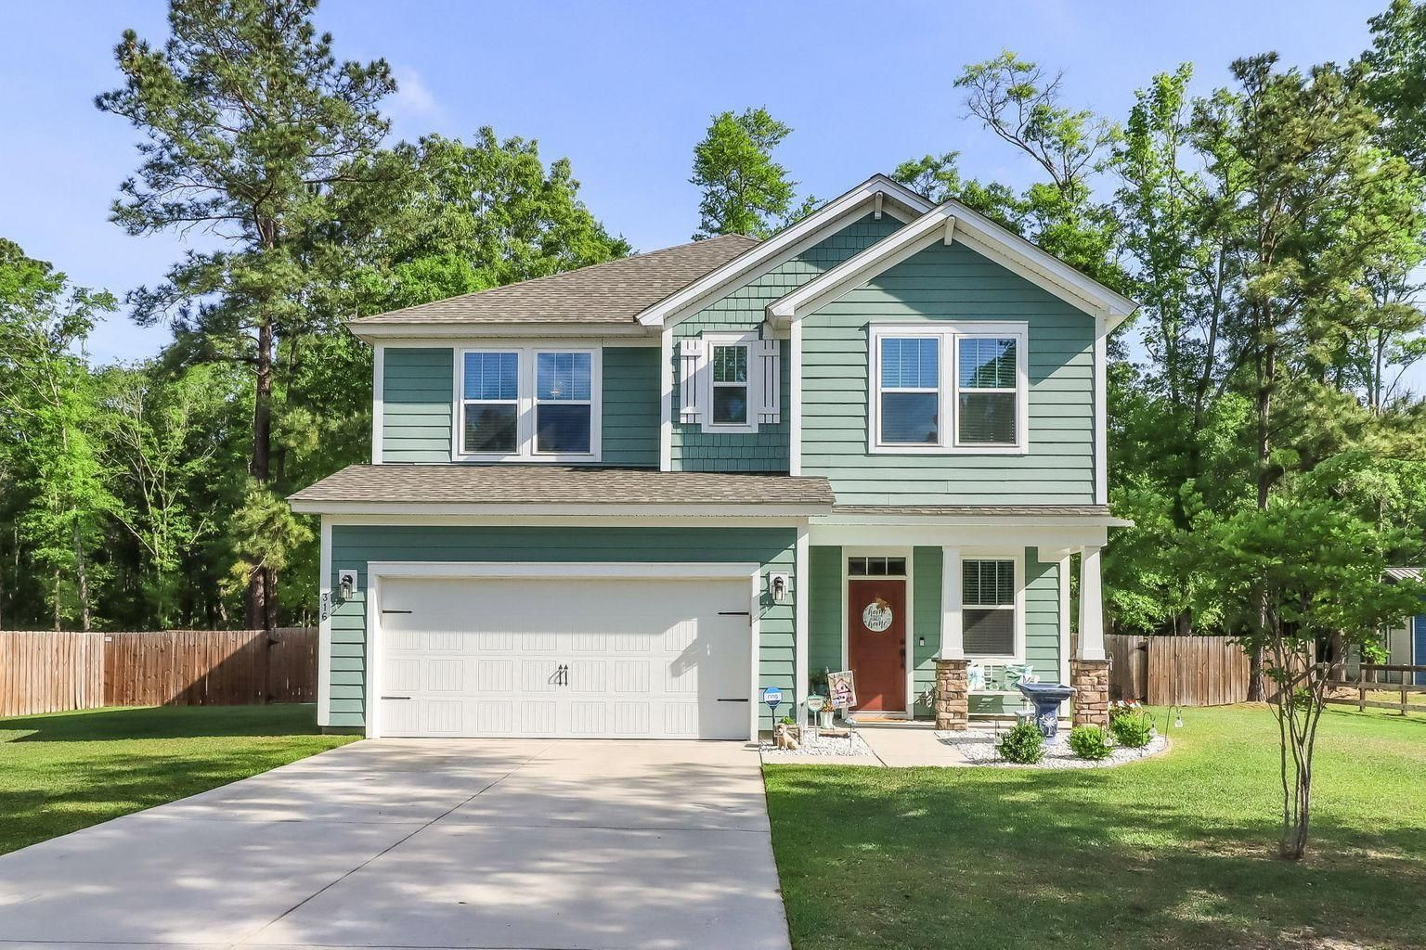
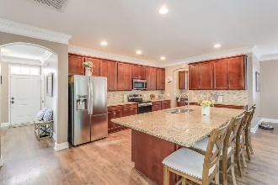
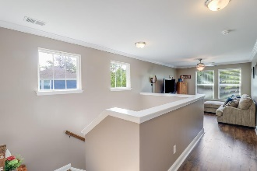
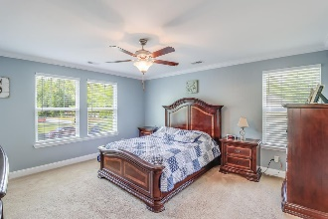
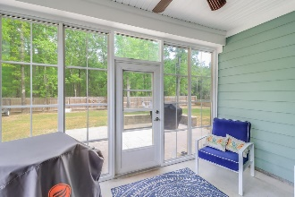
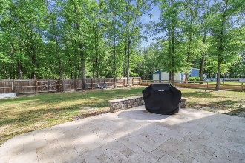
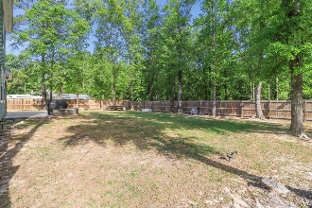
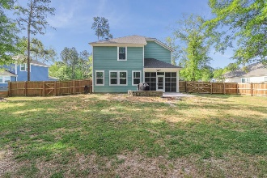

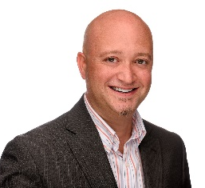
316 Bay Village Lane Bay Village | Moncks Corner | MLS# 21010162 | $479,900
3/4 Acre Lot! No HOA!
SCHEDULE YOUR SHOWING TODAY!
The perfect home to get away from the hustle and bustle of the city life and still be close to several amenities! Only 25 mins from Summerville and 5 minutes to Moncks Corner! Located in the beautiful community of Bay Village in Moncks Corner; this 3 bedroom 2.5 bathroom with 2,682 sq ft of living space on .78 acres is a must see! NO HOA! Approaching the home you will notice a long driveway leading to the 2 car attached garage. Enter the home through the spacious foyer. Have your guests kick off their shoes and welcome them into the large open concept living area. Notice the beautiful crown molding through-out and the abundance of natural light filtering in from all the windows. The open concept living area offers space to entertain, relax and dine. The kitchen has a huge island perfect to gather around, prepare meals or to grab a quick bite to eat. Plenty of cabinet space to store all your kitchen accessories and ample amounts of counter space. The separate dining area is a great space for a dinner party or a nice family meal. Set the ambiance through out the living area with the slate surround fireplace. The large patio door leads out to the three seasons room and a stoned outdoor patio. These spaces are perfect for grilling, entertaining or just relaxing and enjoying the private backyard space. The spacious master bedroom has plenty of room for furniture arrangement and an en-suite bathroom with dual vanities and an oversized walk in shower. Two more generously sized bedrooms and another full bathroom are also included upstairs. The separate loft space is great for that man cave you always dreamed about or a kids play area. Don't miss out on what this gorgeous home in a wonderful location has to offer!
Schedule your appointment fast before it goes under contract!
Brandon Ray
(843) 499-1928
brandon.ray@carolinaone.com
www.therightrayhome.com
Carolina One Real Estate
900 N Main St
Summerville, SC 29483

