Slide 1
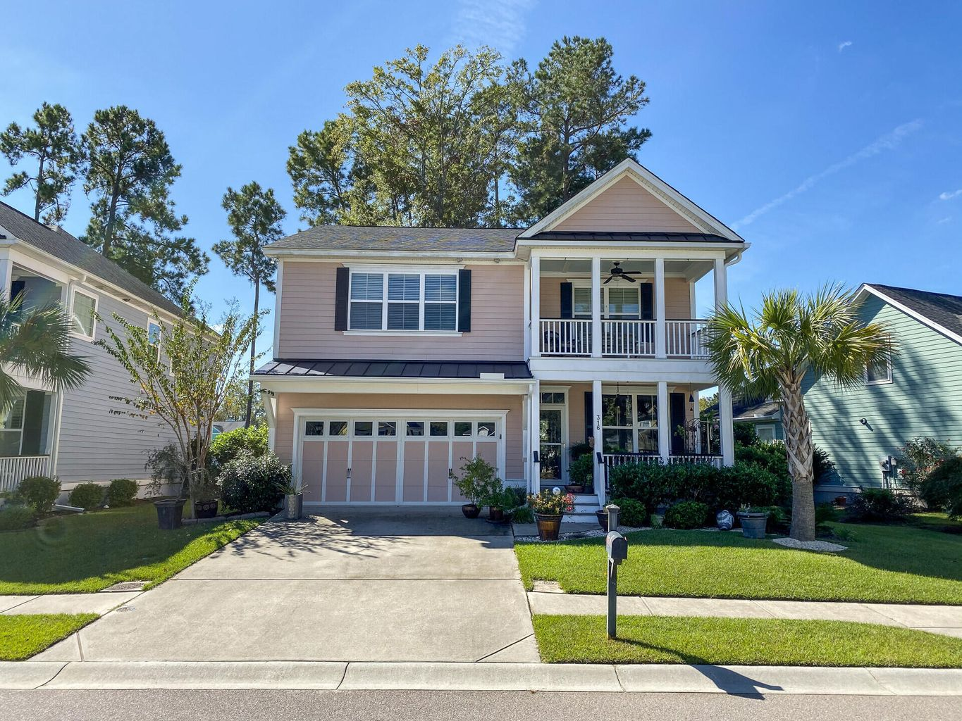
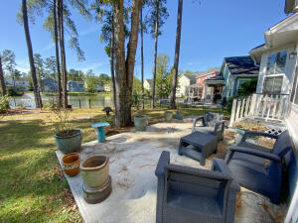

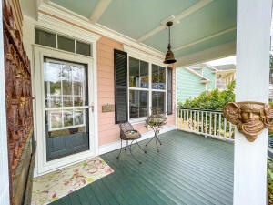
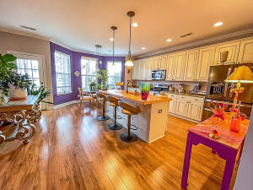
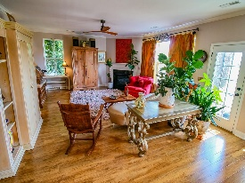
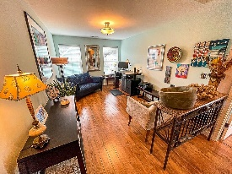
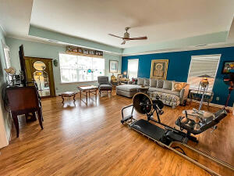

LOVELY HOME WITH POND VIEW
316 Brick Kiln Drive
Branch Creek | Summerville, SC 29483 | MLS# 22013380 | $429,000
This two-story home is located in the quaint and quiet community of Branch Creek. The double front porches add to the exterior ambience and the fenced in backyard with patio, has a view of the pond with a fountain. This three bedroom and 2 1/2 bath home has been updated with engineered floors throughout, as well as new tile flooring in the guest bathroom. The kitchen offers granite countertops and a custom concrete island counter with a large copper sink. The many windows in the open kitchen and family room offer a lovely view of the backyard and serene pond. A gas fireplace in the family room adds additional ambience to the downstairs interior. Upstairs, a large loft perfect for a home office or playroom is central to two bedrooms, one bath, and laundry room on one side. On the opposite side is the primary bedroom suite with a private porch. Additionally, there are two walk-in closets, an ensuite bath with jetted oversized tub, a walk in shower, and vanity with double sinks. Please note: while touring home in person or looking at pictures online, the primary bedroom is now being used as a second living area upstairs. This lovely home is zoned within the areas award winning Dorchester II school district and is just minutes away from an abundance of shopping and dining. Branch Creek is less than 2 miles from charming downtown Summerville.
Contact Owner For Showings/Info
Jan Beaudreau
(843) 991-1144 | janmichelles123@gmail.com
Limited listing offered by Randal Longo | iSave Realty | 843-737-6347

