Slide 1
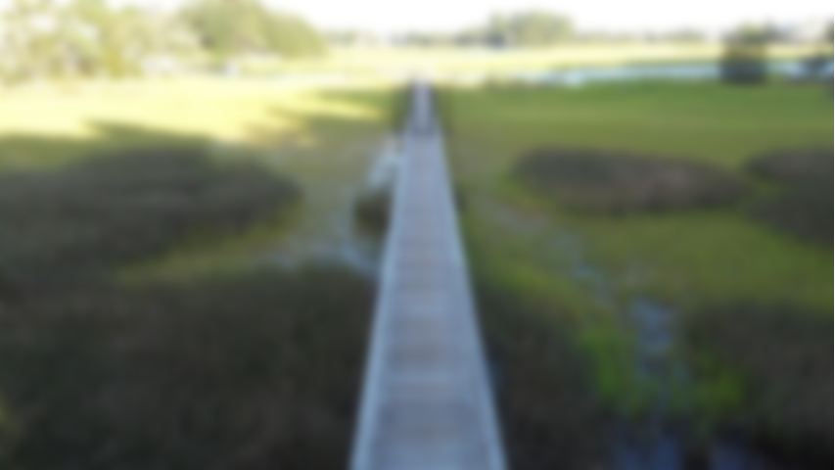
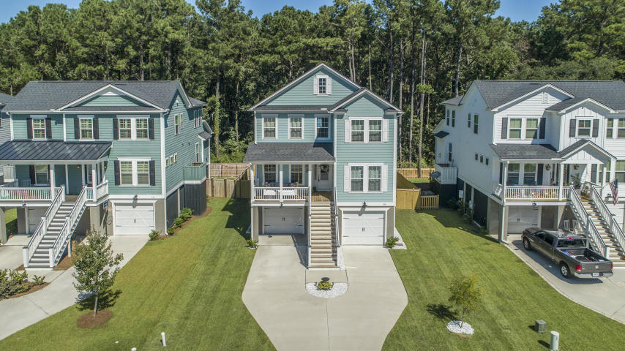
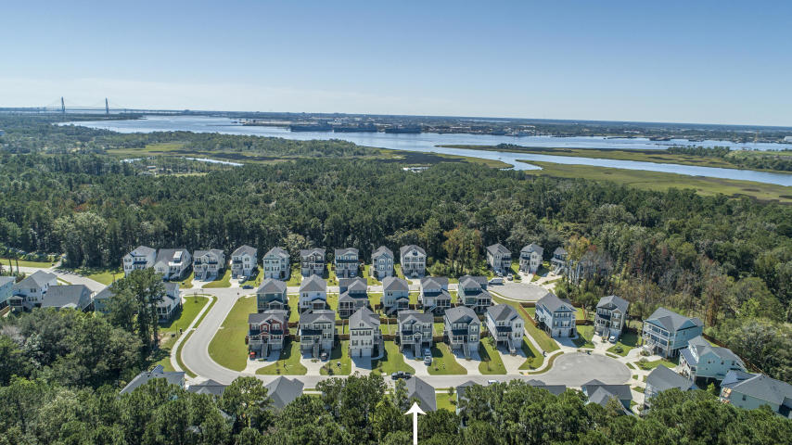
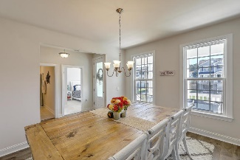
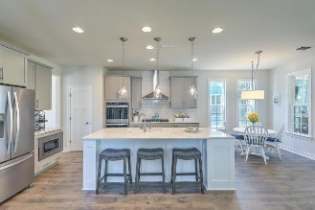
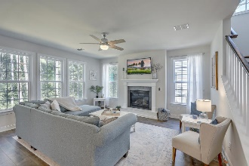
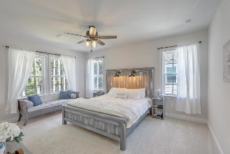
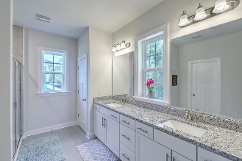
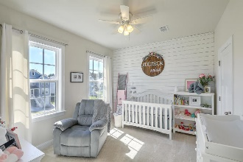
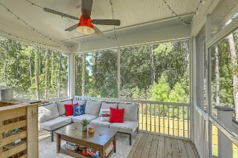
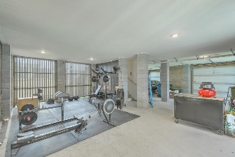
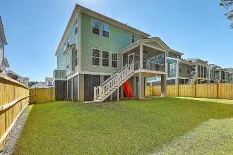
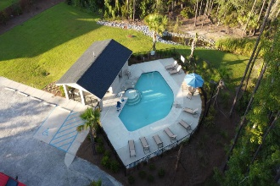

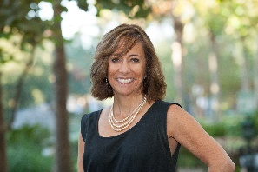
JUST LISTED! Open House Saturday, October 10th from 1- 4PM
316 Coki Amalie Court
St Thomas Preserve | Charleston, SC 29492 | MLS# 20027480 | $599,975
Welcome to this amazing Lowcountry home, just a bike/golf cart's ride away from downtown Daniel Island where you can enjoy all that DI has to offer, including its schools! Nestled against a wooded preserve, on a cul-de-sac, you will be instantly wowed the moment you walk up the stairs where you are greeted by gas lanterns and a bed swing overlooking the beautiful neighborhood. Upon entering your home, a formal dining room is off to the left and a privately situated bedroom and full guest bath is to the right. The open concept kitchen features a butler's pantry for easy access into the dining as well as wall oven, gas cooktop, plenty of cabinet storage, large island, granite counters, breakfast area & opens into the spacious Great Room which is ideal for entertaining. Lots of natural light fills this room which is complete with a gas fireplace, perfect for getting cozy on those chilly winter nights. From here, you can step outside, enjoy the tranquil wooded views while sipping a glass of wine on your back porch as the sun sets. Upstairs, the Owners Suite, complete with tray ceiling, dual vanities, HUGE walk-in closet with access to the laundry room, is privately located on the entire back portion of the home. The additional 2 bedrooms and guest bathroom are a great size and have wonderful architectural features, making each bedroom truly special. The sellers have put a lot of upgrades into this wonderful Energy Star Certified home, too numerous to list here! Oh, and the abundance of storage on all 3 levels - wow!! Water sport enthusiasts will love this waterfront, natural gas community which features neighborhood pool, walking trails and a private deep water community dock overlooking Beresford Creek. An easy drive into downtown Charleston, the airport, Joint Base Charleston and all that Daniel Island has to offer, this home has everything to make your Charleston dream a reality.
Video Tour: http://vimeo.com/464830022
Desiree Maurer Office - (843) 416-2000
Mobile - (843) 327-9010 desiree.maurer1@gmail.com
www.yourcharlestonhousesearch.com
Keller Williams Realty 496 Bramson Ct Ste 200 Mt. Pleasant, SC 29464

