Slide 1
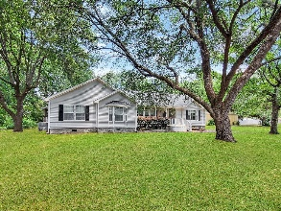
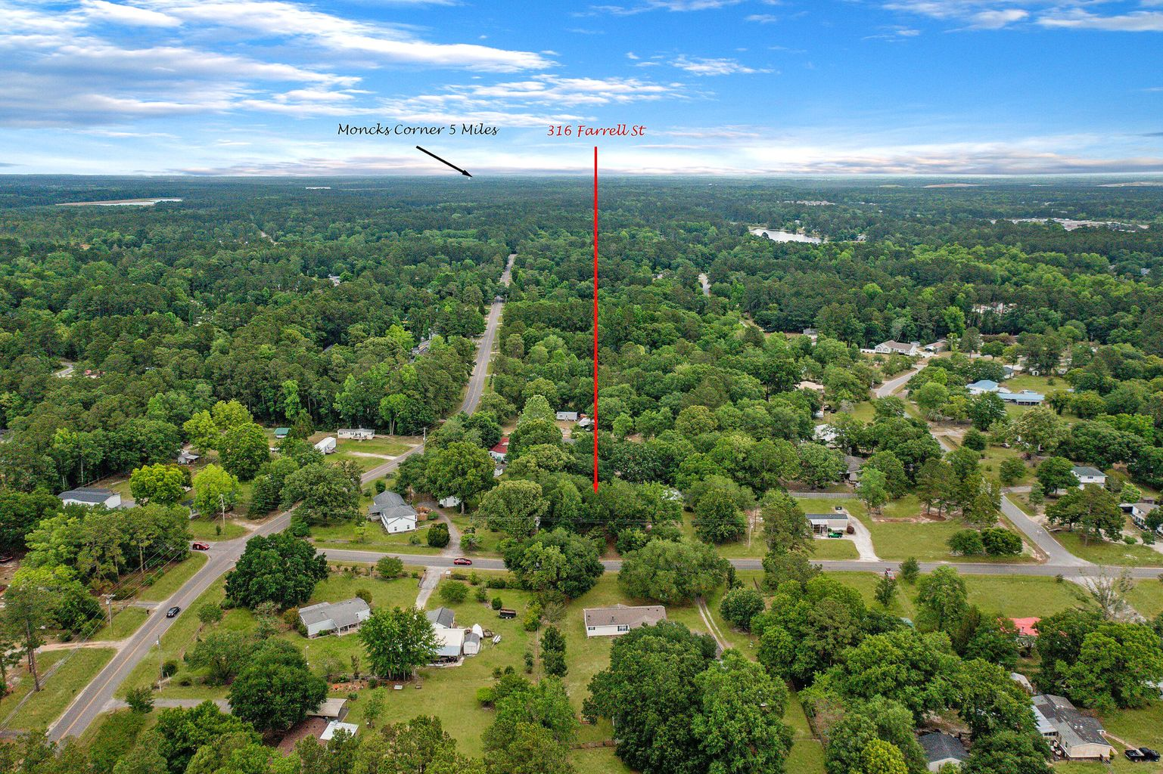
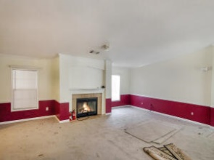
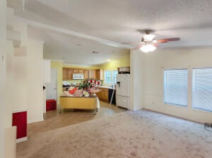
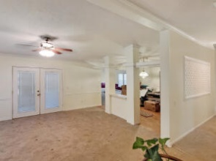
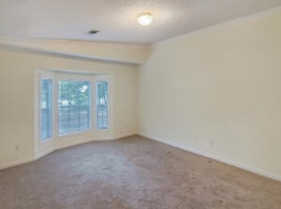
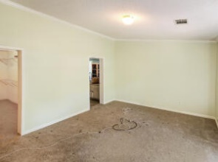
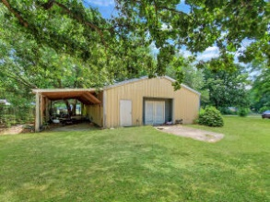
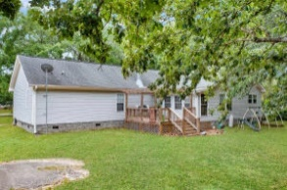


316 Farrell Street Lakewood | Moncks Corner, SC 29461 MLS# 22012727 | $380,000
Welcome home!
SCHEDULE YOUR SHOWING TODAY!
This wonderful, well maintained, 3-bedroom, 2 full bathroom home has 2276 sq ft of living space on .8 acres! The huge, power equipped detached garage is 1800 sq ft of space for all your toys. Located in beautiful Moncks Corner, this home is central to schools, shopping, and several other amenities. Approaching the home, you are greeted with a large front porch, perfect for relaxing or conversing with neighbors. Enter the home through the large family room. The fireplace focal point sets the ambiance while entertaining and adds warmth on those cold nights. Off the family room to the left is the master bedroom with its own private en-suite. To the right of the family room is a separate dining area perfect for those dinner parties or a nice sit-down family meal. Another sitting area is located near the kitchen. The kitchen offers plenty of cabinet space for all your accessories and a great island to grab a bite to eat at. Down the hall are two more generously sized bedrooms which share a full-sized bathroom. The home has new carpet and has been well cared for. This one won't last long so schedule your appointment as soon as possible!
Brandon Ray
(843) 499-1928
brandon.ray@carolinaone.com
www.therightrayhome.com
Carolina One Real Estate
900 N Main St
Summerville, SC 29483

