Slide 1
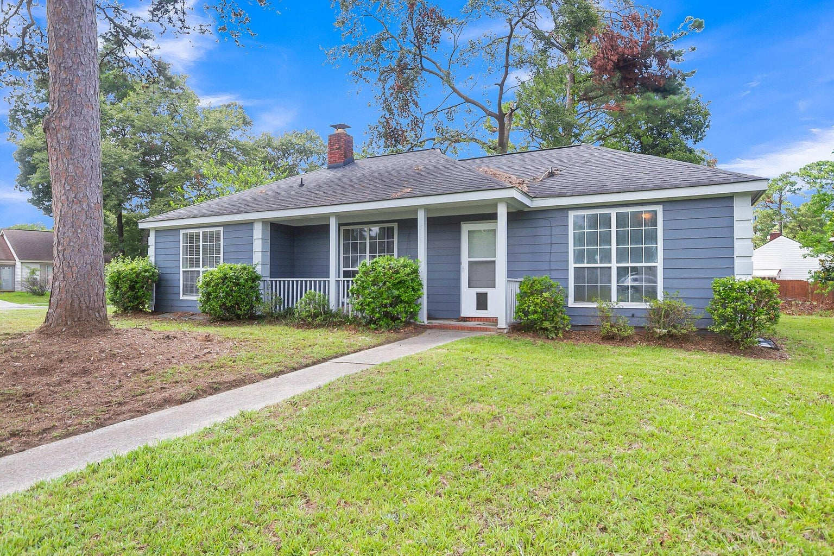
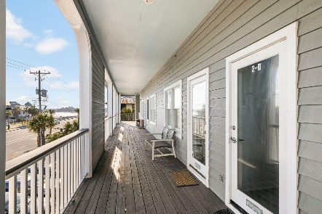
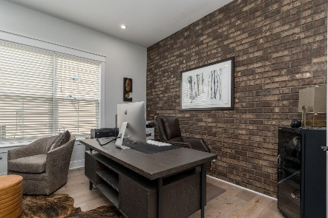
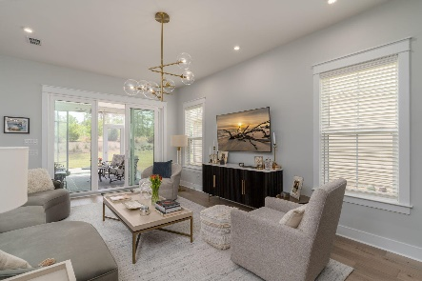

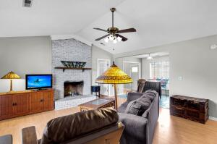
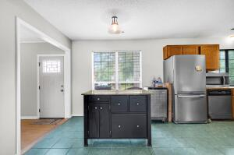
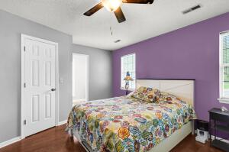
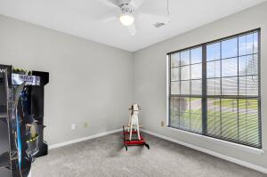
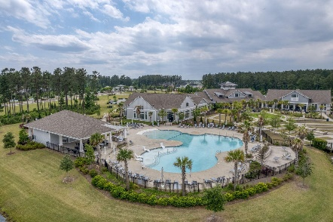
316 Indigo Road Indigo Place | Goose Creek, SC 29445 | MLS# 24017747 | $288,999
Darrell Creek Elevated Home With Elevator & Salt Pool
Blue Beauty in Goose Creek
Co-sponsored by
Offering $3000
Lender Credit
Check out this great house in Indigo Place of Goose Creek. Centrally located and close to so much, this house boasts 3 bedrooms, 2 bathrooms and NO HOA. The large corner lot has so much potential- outdoor entertaining, add a garage, put in a pool? You name it. Entering the home you find yourself in the living room where the focal point is a lovely fireplace . The split floor plan allows for extra privacy since the Primary bedroom is on one side of the house and the other two bedrooms are on the other. The living room and kitchen make up the living space in between and allow for an open space for entertaining . New paint, new carpet and priced to move! Seller offering $2500 toward buyers closing costs. Check this one out today!
Rochelle Rennert
843-847-9694 | rochellesellscharleston@gmail.com | www.RochelleSellsCharleston.com
AgentOwned Premiere Group, Inc. | 219 N Highway 52 Ste A | Moncks Corner, SC 29461-3926

