Slide 1
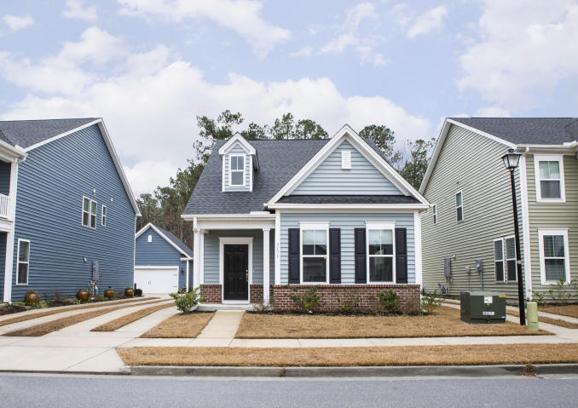
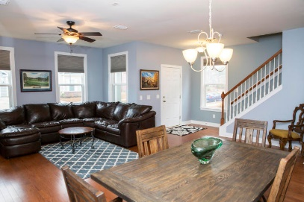
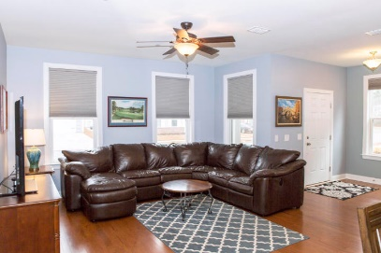
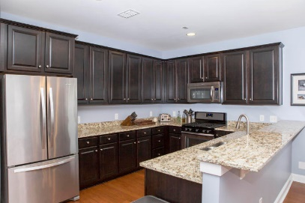
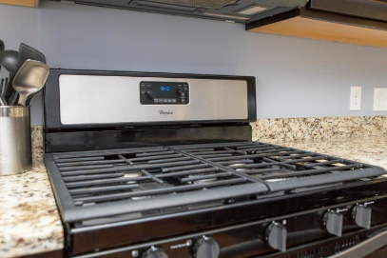
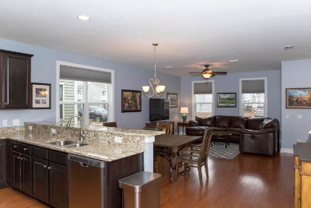
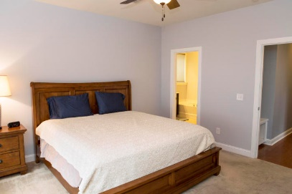
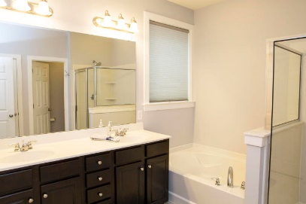
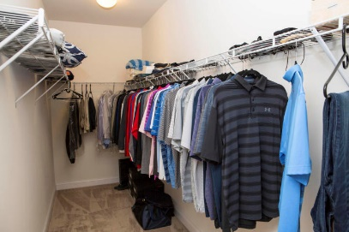



3171 Moonlight Drive
Boltons Landing ~ Charleston, SC 29414
MLS# 18002457 ~ $295,000
Just Reduced
$785,000!
West Ashley Less Than 2 Yrs Old Master Down
JUST LIKE NEW - Less than two years old and meticulously maintained in popular Boltons Landing in West Ashley! This master down floor plan is open and has huge rooms. There is a lot of privacy, as the master suite is tucked off in the back of the first floor while the secondary bedrooms upstairs have direct access to the loft, giving everyone space!
No detail was spared when this home was built: *Architectural Roof *Extensive Hardwood Flooring *Tankless Water Heater *14 Seer HVAC *Gourmet Kitchen ~ Upgraded Staggered Cabinets with Crown Molding *Granite Counters *Stainless Appliances with Gas Range *Recessed Lighting *Pre-Wired for Surround Sound *Detached 2 Car Garage *Covered Porches *Custom Hunter Douglas Blackout Blinds *Near City Park with Extensive Sports Complex and Community Events
Beth Moore
M (843) 532-4892
bmoore@carolinaone.com
Meg Kandik
M (843) 814-5137 | O (843) 603-4659
Meg@HolyCityRE.com | www.holycityre.com
Bennett Construction & Realty | 804 Tennent Dr | Charleston, SC 29412

