Slide 1

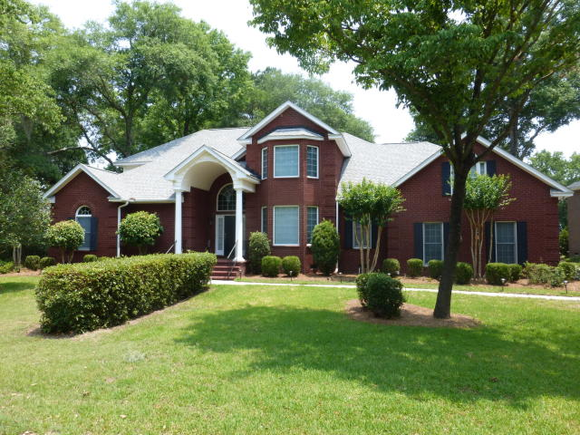
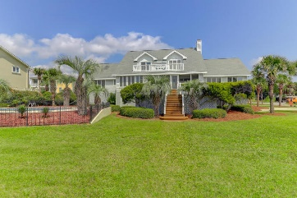
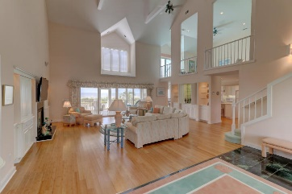
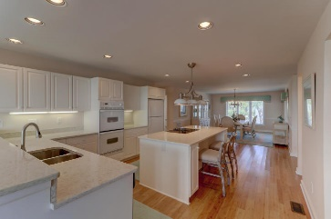
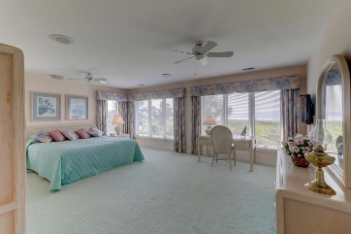
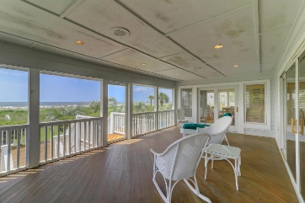
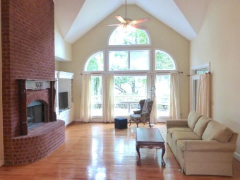
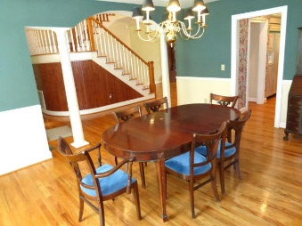
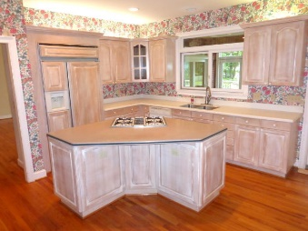
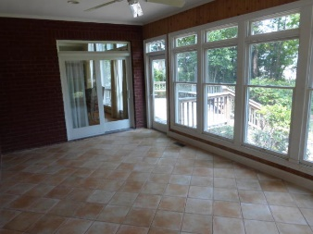
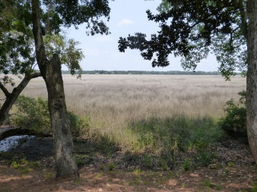


3174 Prevatt Court
Maclaura Hall | Charleston, SC 29414 | MLS# 19016249 | $650,000
Agent Open House Saturday June 22
New Price
Welcome to the beautiful neighborhood of Maclaura Hall. This almost 1/2 acre property sits on a high bluff overlooking the expansive marsh of the Ashley River. As you enter this home, you are greeted by the lovely view from the two story foyer looking through the large windows in great room. The formal dining room is to the right, which leads into the eat-in kitchen with island. The master bedroom is off the great room and conveniently opens onto the back deck. The large master bath has 2 walk-in closets, dual vanities, garden tub, and shower. From the great room, you pass the wet bar leading into the kitchen. Off the kitchen is a large heated and cooled sunroom that leads to the back deck and the large, open backyard with those breathtaking views.
The elegant winding staircase from the great room takes you past the large beautiful light fixture hanging in the foyer to the second floor. To the left is a bedroom with ensuite bath and walk-in closet. To the right, there are 2 bedrooms and a full bath. Then there is the large family/media with separate office and lots of storage space.
Garage access and laundry are off the kitchen, along with the back staircase leading to the family room. Another downstairs bedroom and hall bath with shower is on the front of the house, left of the front door. The roof was replaced in 2018.
Gregory Ricker
(843) 209-8229
greg.h.ricker@gmail.com
Brand Name Real Estate | 4 Carriage Lane Suite 106 | Charleston, SC 29407

