Slide 1
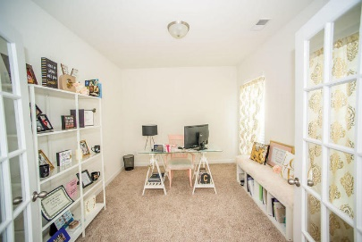
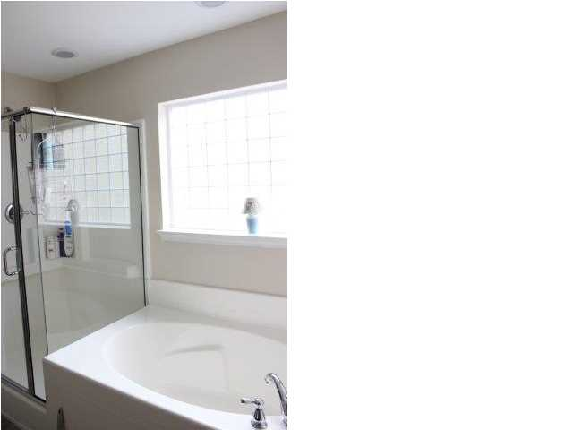
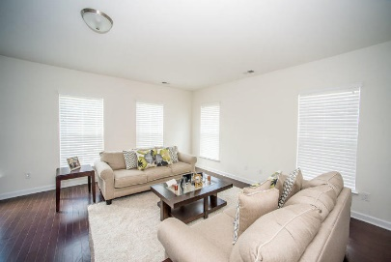
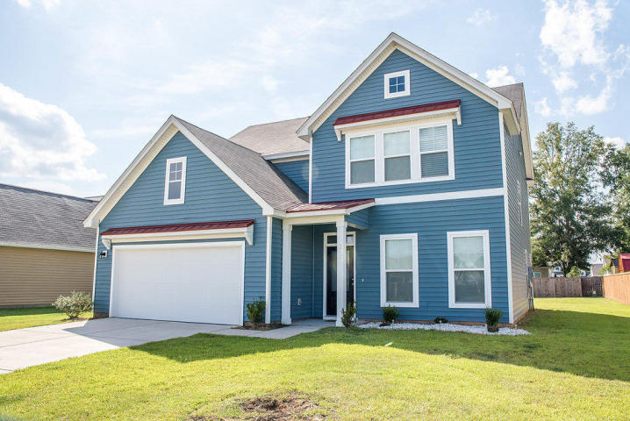
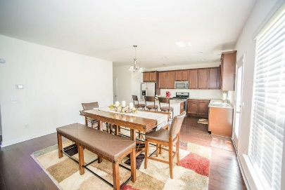
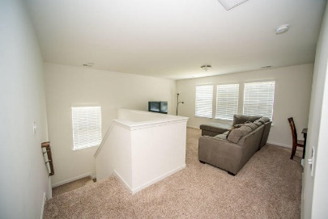
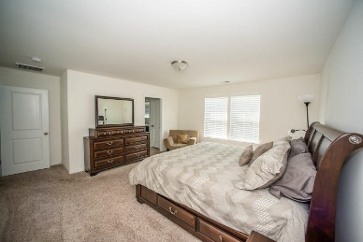
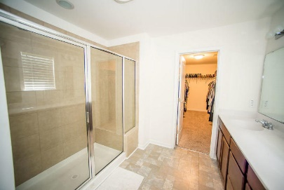
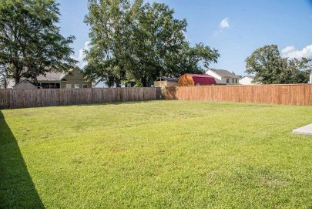

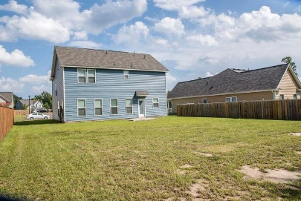
Strawberry Station Open House Saturday 11a-1p $1500 Agent Bonus!!
Free Charleston Print to First 10 Visitors
Register for a Housewarming Gift Basket!
317 Bountiful Drive
Moncks Corner ~ MLS# 18018059 ~ $277,900
Looking for a neighborhood that allows you to park your boat or RV in your driveway? Welcome Home! The large open foyer greets you as you enter the home. The entire first floor is open with all wood floors. The kitchen includes a large island, granite counter tops, all stainless steel appliances, and a large pantry. The upstairs provides extra living space with a large open loft. The master suite offers a walk in closet, bathroom with double vanities, and a large walk in shower. The laundry room is conveniently located on the upper level. This home has more than enough storage space, with several large closets throughout the home. You don't want to miss out on this home!
Joanie Rhoten
Office: 843-261-7166 | Mobile: 513-518-7475
joanie.rhoten@agentownedrealty.com
www.agentownedmainst.com
AgentOwned Realty Co. Premier Group | 141 A N. Main Street | Summerville, SC 29483

